Slide 1
West Virginia AIM Update
Patient Safety Bundle Implementation

Slide 2
AIM in West Virginia
Review of Progress:
Accepted as an AIM State in the fall of 2017
Launched the first patient safety bundle on obstetric hemorrhage in March of 2018
Collaborative effort with WVPP, WV ACOG, WV Hospital Association, WV Office of MCFH, and healthcare providers from across the state
100% participation by WV delivering facilities

Slide 3
A Patient Safety Bundle is “a small, straightforward set of evidence-based practices — generally three to five — that, when performed collectively and reliably, have been proven to improve patient outcomes.”
Institute for Healthcare Improvement

Slide 4
Safety Bundle Elements
Readiness in every unit
Recognition for every patient
Response that is timely and evidence based
Report data and event reviews

Slide 5
The 5th R: Respectful Care
Equitable access to care
Reduce bias and pre-conceived judgement
Listen to patients and families
Collegial teams that communicate and value each other

Slide 6
Patient Safety Bundles Currently Being Implemented in WV
Obstetric Hemorrhage
Assess and prepare unit to recognize and respond to OBH
Collect data to measure outcomes
Sustain improvement with continued monitoring
Severe HTN in Pregnancy
Educate and prepare staff to recognize and respond to severe HTN
Support case and data review to facilitate improvement

Slide 7
Data Plan
Structure
Process
Outcome

Slide 8
SMM Outcome Measures
Two outcome measures on severe maternal morbidity – with and without transfusions are used for both bundles (HEM and HTN)
Two HEM-specific; two HTN-specific
Outcome measures use administrative billing data (hospital discharge data)
WV has data back to 2012 for most outcome measures (2016 for the HTN measures)

Slide 9
Severe Maternal Morbidity (SMM)

Slide 10
SMM Excluding Blood Transfusions

Slide 11
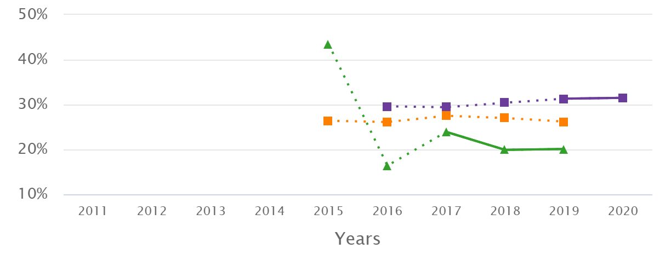
SMM among OB Hemorrhage Cases

Slide 12
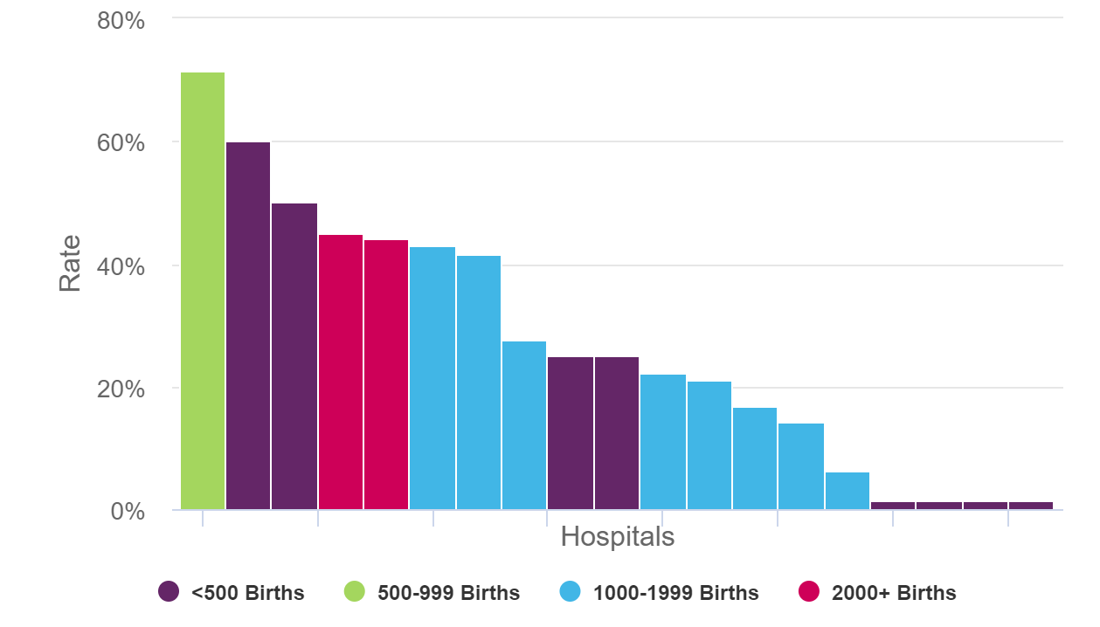
SMM among OB Hemorrhage Cases 4Q 2020

Slide 13
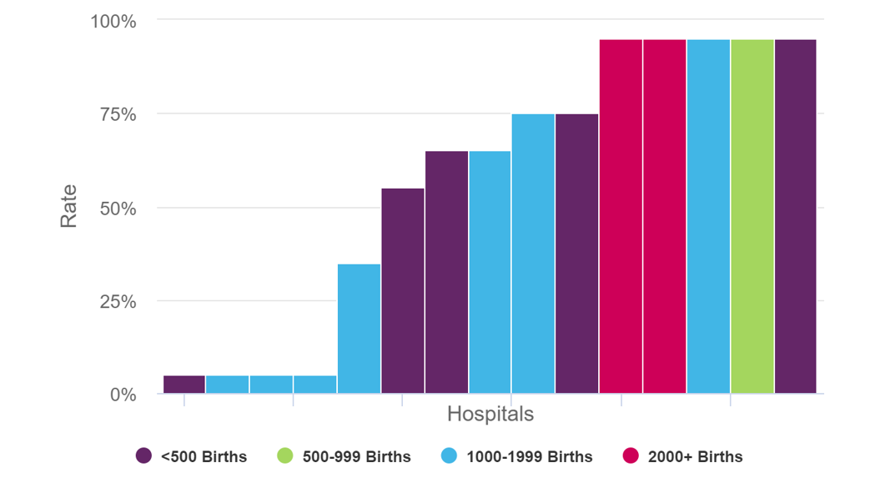
HEM Process Measure Blood Loss Measurement – 2Q 2019
Notes:
These are reported in 10% increments – so the highest 5 hospitals reported 90-100% - I think the bars are going to 95% - so I tried to put the line at 90%
The ones at 75% are 70-79%
Then two at 65% are 60-69%
One at 30-19%
And 4 at 0-9%

Slide 14
Severe Hypertension in Pregnancy
Launched bundle implementation with webinar May 2021
Pilot set of hospitals collected and inputted data on HTN safety bundle
Webinars on diagnosing pre-eclampsia and assessing risk for HTN complications

Slide 15
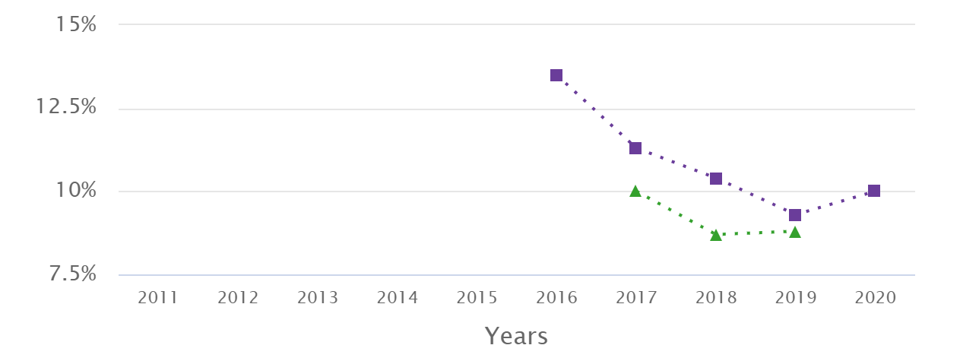
SMM among HTN Cases

Slide 16
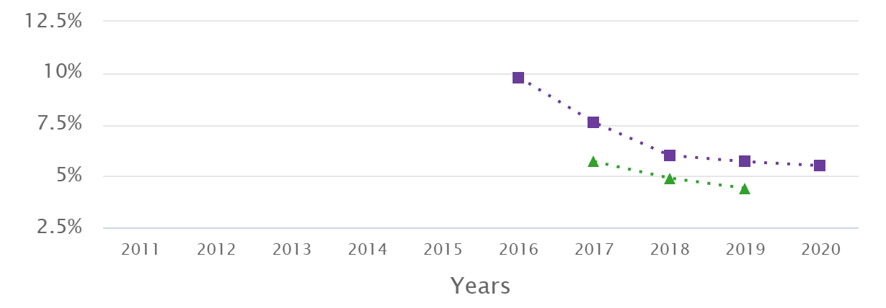
SMM among HTN Cases excluding blood transfusions

Slide 17
Quarterly Data Submission
New measure for HTN patient safety bundle
Time to Treatment – how many patients with severe HTN received treatment within 60 minutes?

Slide 18
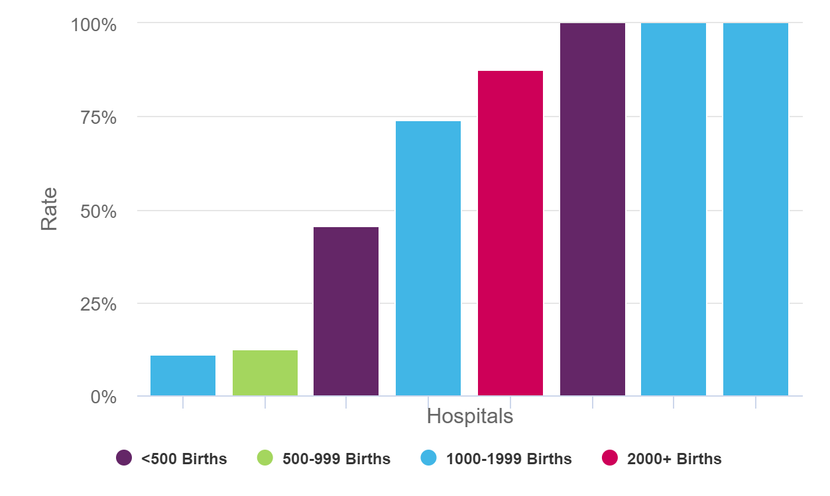
HTN Process Measure Timely Treatment of HTN – 2Q 2021
Notes:
The pink bar is 87.5. The target line is attempting to be 90%. Purple and other two blues are at 100.

Slide 19
WVU Medicine – Ruby Memorial
Hypertension Protocols
Use of the Pre-Eclampsia Early Recognition Tool

Slide 21
NORMAL
ACT
Proceed with normal care

Slide 22
YELLOW
MOBILIZE | ACT | THINK
⬜ Notify Provider: Junior PHONE # 78744 Senior PHONE# 76152 Attending PHONE# 78617 Midwife PHONE# 74044 ⬜ Notify Charge RN # 76161 | Primary Nurse or designee  ⬜ Confirm with manual blood pressure cuff or serial BP measurements every 15 minutes with automated BP Cuff until a care plan for admission or discharge is made. ⬜ Obtain IV access ⬜ Sending the following labs: ⬜ Urine protein/creatinine ratio   ⬜ Creatinine ⬜ CBC ⬜ AST/ALT ⬜ Uric acid and LDH (per provider request) Provider ⬜ Provider to perform in-person evaluation | ⬜ Consider Magnesium Sulfate ⬜ Consider Anesthesia consult PAGE #1343

Slide 23
RED
MOBILIZE |  | ACT |  | THINK
⬜ Notify Provider: Junior PHONE # 78744 Senior PHONE# 76152 Attending PHONE# 78617 Midwife PHONE# 74044 ⬜ Notify Charge RN # 76161 ⬜ Anesthesia PAGE #1343 for Consult ⬜ Notify STAT RN PAGER # 1241 -Consider for IV placement ⬜ Notify Chaplin/Support Care or assign family support person |  | Primary Nurse or designee ⬜ Notify provider of severe symptoms ⬜ Place patient on following monitors   ⬜ Maternal cardiac monitoring   ⬜ Continuous fetal monitoring if fetus is considered viable   ⬜ Monitor BP every 10 minutes until systolic BP (SBP) < 160 diastolic BP (DBP) < 100mmHG   ⬜ Once below Threshold Monitor as follows:     ⬜ Every 10 minutes X 1 Hour     ⬜ Every 15 minutes X 1 Hour     ⬜ Every 30 minutes X 1 Hour     ⬜ Every 60 minutes X 1 Hour     ⬜ Then every 4 hours ⬜  Pad patient bed side rails for seizure prophylaxis Provider ⬜ Consider Labetalol Protocol   ⬜ Administer 20mg labetalol IVP STAT   ⬜ If NOT effective within 10 minutes follow with 40mg Labetalol IVP   ⬜ Continue with 80mg labetalol IVP every 10 minutes, up to maximum cumulative dose of 300mg or SBP of < 160 or DBP < 105 is achieved. ⬜ Consider Hydralazine Protocol   ⬜ Administer 10mg hydralazine IVP every 10 minutes up to maximum cumulative dose of 30mg or SBP of < 160 or DBP < 105 is achieved. ⬜ Consider NIFEdipine (Procardia) if no IV access available  ⬜ Administer 10mg NIFEdipine IR (immediate release) STAT  ⬜ If NOT effective within 20 minutes follow with 20mg NIFEdipine IR. ⬜ Continue with additional 20mg NIFEdipine IR after 20 minutes if repeat BP if SBP not < 160, DBP not <110.  ⬜ ONCE IV obtained continue with 40mg labetalol IVP after 20 minutes once, if SBP of < 160 or DBP < 105 is not achieved. ⬜ Consider Magnesium sulfate |  | ⬜ Consider Emergent Delivery ⬜ Consider Neurology consult ⬜ Consider CT angiogram for Chest Pain ⬜ Rule out pulmonary edema ⬜ Consider X-ray

Slide 24
Debriefing of event required if patient requires high level of care or emergent delivery of fetus HYPERTENSIVE MEDICATIONS
DRUG | DOSE |  | Comments |  | Onset of Action
Magnesium 20 grams/500 mL bag | Initial (loading Dose): 4-6 g (100-150 ml) over 20 minutes Maintenance Dose: 1-2 g/hour 925 ml/her – 50 ml/hr) |  |  |  | Immediate
Labetalol 100mg/ 20mL vial | Initial: Draw 10-20mg IG, then 20-80 mg every 10 – 30 minutes to a maximum cumulative dosage of 300mg; or constant infusion 1 -2 mg/min IV 1-2 minutes |  | Tachycardia is less common and fewer adverse effects than other agents are. Avoid in |  | 1 – 2 minutes
Hydralazine 20mg/mL vial | 10mg IV, then 10mg every 10 minutes up to maximum cumulative dose of 30 mg |  | Higher or frequent dosage associated with maternal hypotension, headaches, and abnormal fetal heart rate tracings; may be more common than other agents |  | 10 – 20 minutes
Calcium gluconate 100 mg/10mL vial | 1-2 g over 5 minutes |  | Avoid extravasation; adverse events from extravasation can be devastating. Monitor IV site closely |  | 5 minutes
Nifedipine IR (Immediate Release) 10 mg, 20mg | 10 mg orally, repeat in 20 minutes if needed; then 10-20 mg every 2-6 hours; maximum daily dose is 180 mg |  | May observe reflex tachycardia and headaches |  | 5-10 minutes

Slide 25
AIM Physician Peer Group
We identified a Leader from each delivering hospital
Arranged a zoom session
Held in January
Goals of session
AIM presentation from ACOG
Engage with physician leaders
Encourage leaders to work with lead nurses on AIM Bundles
Identify areas where we can support

Slide 26
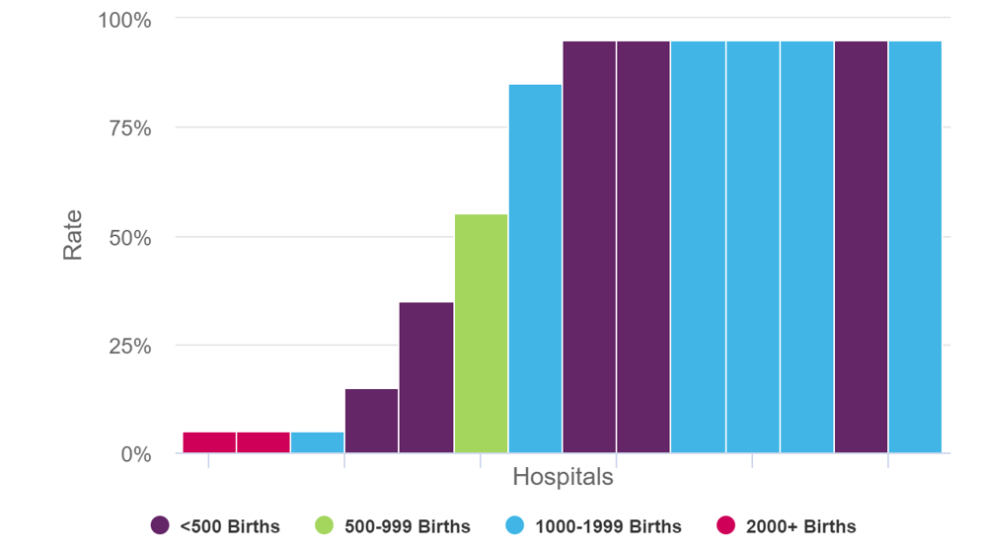
HEM Process Measure Provider Education – 2Q 2019

Slide 27
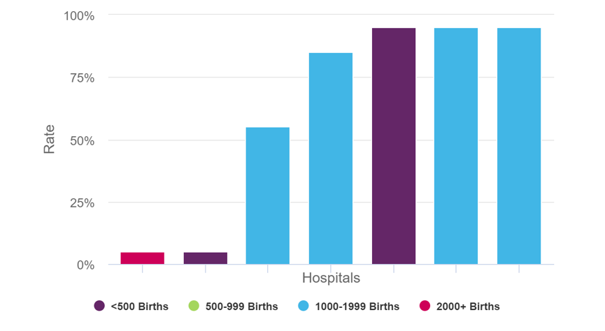
HTN Process Measure Provider Education – 2Q 2021

Slide 28
Physician Peer Group Future Plans
Setting up a second session
To assess current status
Re-engage with Leaders
Introduce the next bundle
If you are meeting physician resistance, please discuss with me so I can try to help.

Slide 29
Why we do what we do.

Slide 30
Shon Rowan, MD
Associate Professor, Dept. OB/GYN
West Virginia University School of Medicine
Morgantown, WV
WV Section Vice Chair for ACOG
srowan@hsc.wvu.edu

Slide 31
Melanie Riley, RN, MSN Nurse Coordinator, WV Perinatal Partnership
1018 Kanawha Boulevard East Charleston, WV 25301
(304) 582-2461
rileym@marshall.edu
www.wvperinatal.org
Coordinated by the West Virginia Higher Education Policy Commission, Division of Health Sciences

