Slide 1
Emerging Infections and Diseases and Their Impact to Mothers and Their Babies

Slide 2
Overview
Infectious diseases during pregnancy remain a public health concern
Many people living with an infectious disease are not aware that they have one
Infections with HIV, viral hepatitis, and Sexually Transmitted Diseases (STDs) can complicate pregnancy and may have serious consequences for a woman and her baby
Notes:
Good morning, I am Amy Atkins, Deputy Commissioner of Health Improvement for the WVBPH. Thank you for the invitation to speak and share information regarding the impact of infectious diseases for our moms and babies in West Virginia. But more importantly, to share information and resources that help us all work together to identify those with infectious diseases and link them to care so they and their babies can be live healthier lives.
Infectious diseases during pregnancy remain a public health concern and infectious diseases during pregnancy can complicate pregnancy, leading to serious consequences for a woman and her baby. We know that many people living with an infectious disease are not aware that they have one and timely screening is an important and necessary method for . And in our state, the substance use epidemic compounds this problem.
Our goal today is to share data regarding the impact of these infectious diseases on moms and babies, share current recommendations for screening so appropriate linkage to care and treatment can occur and share resources that are available for providers.

Slide 3
Screening Recommendations
CDC recommends that all pregnant persons get tested for HIV, hepatitis B virus (HBV), hepatitis C virus (HCV), and STDs during each pregnancy
Screening is necessary to access medical services and treatment to prevent transmission of HCV, HIV, HBV, and STDs to the infant
Early screening opportunities are often missed
Notes:
CDC recommends that all pregnant persons get tested for HIV, Hepatitis B virus, Hepatitis C virus and STDs during each pregnancy. The frequency may depend upon the risk factors associated with each individual. We know that early screening opportunities are often missed. However, timely screening is necessary so that individuals can access medical services and treatment to prevent transmission of HCV, HIV, HBV and STDs to the infant and to treat mom if necessary.
**Specific screening recommendation articles can be found at the NCHHSTP pregnancy website: https://www.cdc.gov/nchhstp/pregnancy/references.html
Syphilis
All pregnant women at the first prenatal visit8
Retest at 28 weeks gestation and at delivery if at high risk (lives in a community with high syphilis morbidity or is at risk for syphilis acquisition during pregnancy (using drugs, STIs during pregnancy, multiple partners, a new partner, partner with STIs))2
USPS 9/4/2018 The USPSTF found convincing evidence that early universal screening for syphilis infection in pregnant women reduces the incidence of congenital syphilis and the adverse outcomes of pregnancy associated with maternal infection.
All pregnant women should be tested for syphilis as early as possible when they first present to care. If a woman has not received prenatal care prior to delivery, she should be tested at the time she presents for delivery. In most cases of congenital syphilis, pregnant women received prenatal care but were not screened and treated for syphilis early enough during the pregnancy to prevent transmission to the fetus.
The USPSTF found no new studies that examined the effectiveness of repeated testing for syphilis during pregnancy. The Centers for Disease Control and Prevention (CDC)5 and joint guidelines from the American Academy of Pediatrics (AAP) and the American College of Obstetricians and Gynecologists (ACOG)6 endorse repeat screening. Specifically, these groups recommend that women at high risk for syphilis be rescreened early in the third trimester (at approximately 28 weeks of gestation) and again at delivery. Women at high risk for syphilis infection include those living in communities or geographic areas with higher prevalence of syphilis, those living with HIV, and those with a history of incarceration or commercial sex work.7 AAP and ACOG also recommend repeat screening after exposure to an infected partner.6 Clinicians should be aware of the prevalence of syphilis infection in the communities they serve.7 Most states mandate screening for syphilis in all pregnant women at the first prenatal visit, and some mandate screening at the time of delivery.8

Slide 4
Emerging Infectious Conditions, West Virginia, 2019
Disease | Reported Cases | Change from previous year
HIV | 146
Acute HBV | 76
Acute HCV | 79
Primary & Secondary Syphilis | 79
Chlamydia | 5,609
Gonorrhea | 1,771
Notes:
In West Virginia, screening is critically important given our substance use epidemic which is largely contributing to the transmission of infectious diseases. West Virginia’s rate of infectious diseases continues to increase annually for HIV, acute Hepatitis C, primary and secondary syphilis, chlamydia and gonorrhea. We are seeing declines in Hepatitis B, largely due to the introduction of the Hepatitis B vaccine in the 1990’s. Vaccination is an important tool to maintain this trend. For the other infectious diseases, strong surveillance, sufficient personnel to support disease investigation and routine screening that links individuals to care for treatment are needed to reduce the burden of these diseases. I am going to cover syphilis and Hepatitis C and then will turn it over to Shannon, our state epidemiologist to cover HIV and COVID-19.

Slide 5
Syphilis Transmission
Syphilis is a sexually transmitted disease that can have very serious complications when left untreated
Syphilis can be cured with the right treatment
When not adequately treated, syphilis can lead to visual impairment, hearing loss, stroke, and other neurological problems
Untreated syphilis can cause severe medical issues
Syphilis rates are increasing among women and their babies, and men throughout the United States
Notes:
Syphilis is an infection that is primarily sexually transmitted. Syphilis can be cured with the right treatment, however, when not adequately treated, syphilis can lead to visual impairment, hearing loss, stroke and other neurological problems. Syphilis rates are increasing among women and their babies as well as men throughout the U.S. and In W.V. For pregnant women, untreated syphilis infection can be transmitted to the fetus resulting in congenital syphilis and this transmission can occur at any time during pregnancy or at birth. Congenital syphilis is associated with stillbirth, neonatal death, and significant morbidity in infants potentially causing bone deformities and neurologic impairment).1

Slide 6
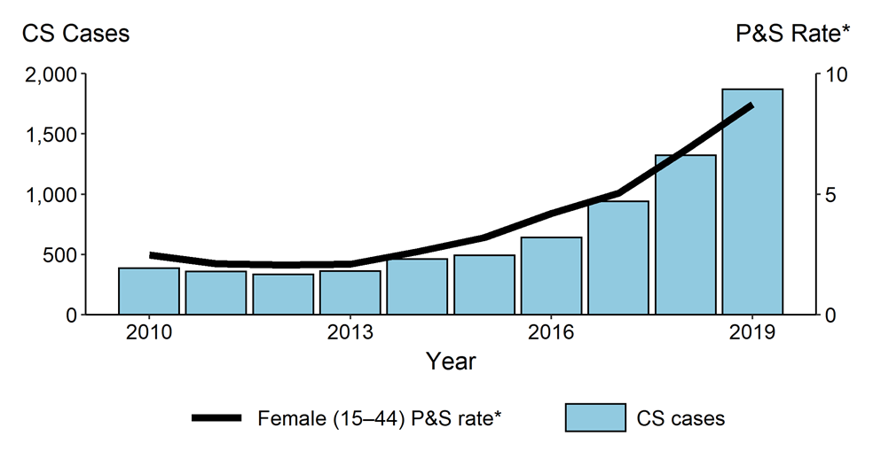
Syphilis in United States, 2010-2019
Congenital Syphilis — Reported Cases by Year of Birth and Rates of Reported Cases of Primary and Secondary Syphilis Among Females Aged 15–44 Years, United States, 2010–2019
* Per 100,000
ACRONYMS: CS = congenital syphilis; P&S = primary and secondary syphilis
Notes:
When we look at both congenital syphilis and syphilis rates, we saw a steady decline from 2008 to 2012. The nation began to see a marked increase in cases of syphilis and congenital syphilis from 2012 to 2016 with an upward trend continuing into 2020.
When we look at the rate of congenital syphilis during 2015–2019, we have seen an increase nationally of over 290% (12.4 to 48.5 per 100,000 live births) and the rate of primary and secondary syphilis among women aged 15-44 years increased over 170% (3.2 to 8.7 per 100,000 females).
In 2019, 1,870 cases of congenital syphilis were reported nationwide for a rate of 48.5 cases per 100,000 live births. This was a 41% increase from the previous year and this was concurrent with a 28% increase in the rate of primary and secondary syphilis among women aged 15-44 years.
Additionally, in 2019, 50% of U.S. counties reported at least one case of syphilis (all stages) among women of reproductive age (15–44 years) and in 2020, the nation is projecting that over 2,100 cases of congenital syphilis will be reported by year’s end.
These significant shifts in the epidemiology of this disease are occurring after a time period in which syphilis was almost eliminated. It is a stark reminder that syphilis and congenital syphilis can occur almost anywhere and screening for syphilis is critically important for identifying and treating moms and babies.

Slide 7
Congenital Syphilis by State, 2010 and 2019
Over the last decade, congenital syphilis has increased across the nation, including in West Virginia
By 2019, 43 states and D.C. reported at least one case
Notes:
In 2010, only 29 states and the District of Columbia reported one or more cases of congenital syphilis. In 2019, 43 states and the District of Columbia reported one or more cases.
In 2010, WV was one of many states with no reported cases of congenital syphilis. Over the past decade West Virginia has gone from reporting 0 cases of congenital syphilis to a high of 9 cases reported in 2020. The increase in reported cases in West Virginia began in 2016. By 2019, West Virginia now ranks 13th in the nation for reported cases of congenital syphilis.
In 2020, 13% of female syphilis cases in WV were pregnant. For these women, timely screening for syphilis is needed to treat the mom and prevent transmission to the infant.
Total syphilis cases in WV in 2020 = 245
Probable - Infant whose mother had untreated or inadequately treated at delivery
Confirmed – Laboratory confirmed from specimens from the baby

Slide 8
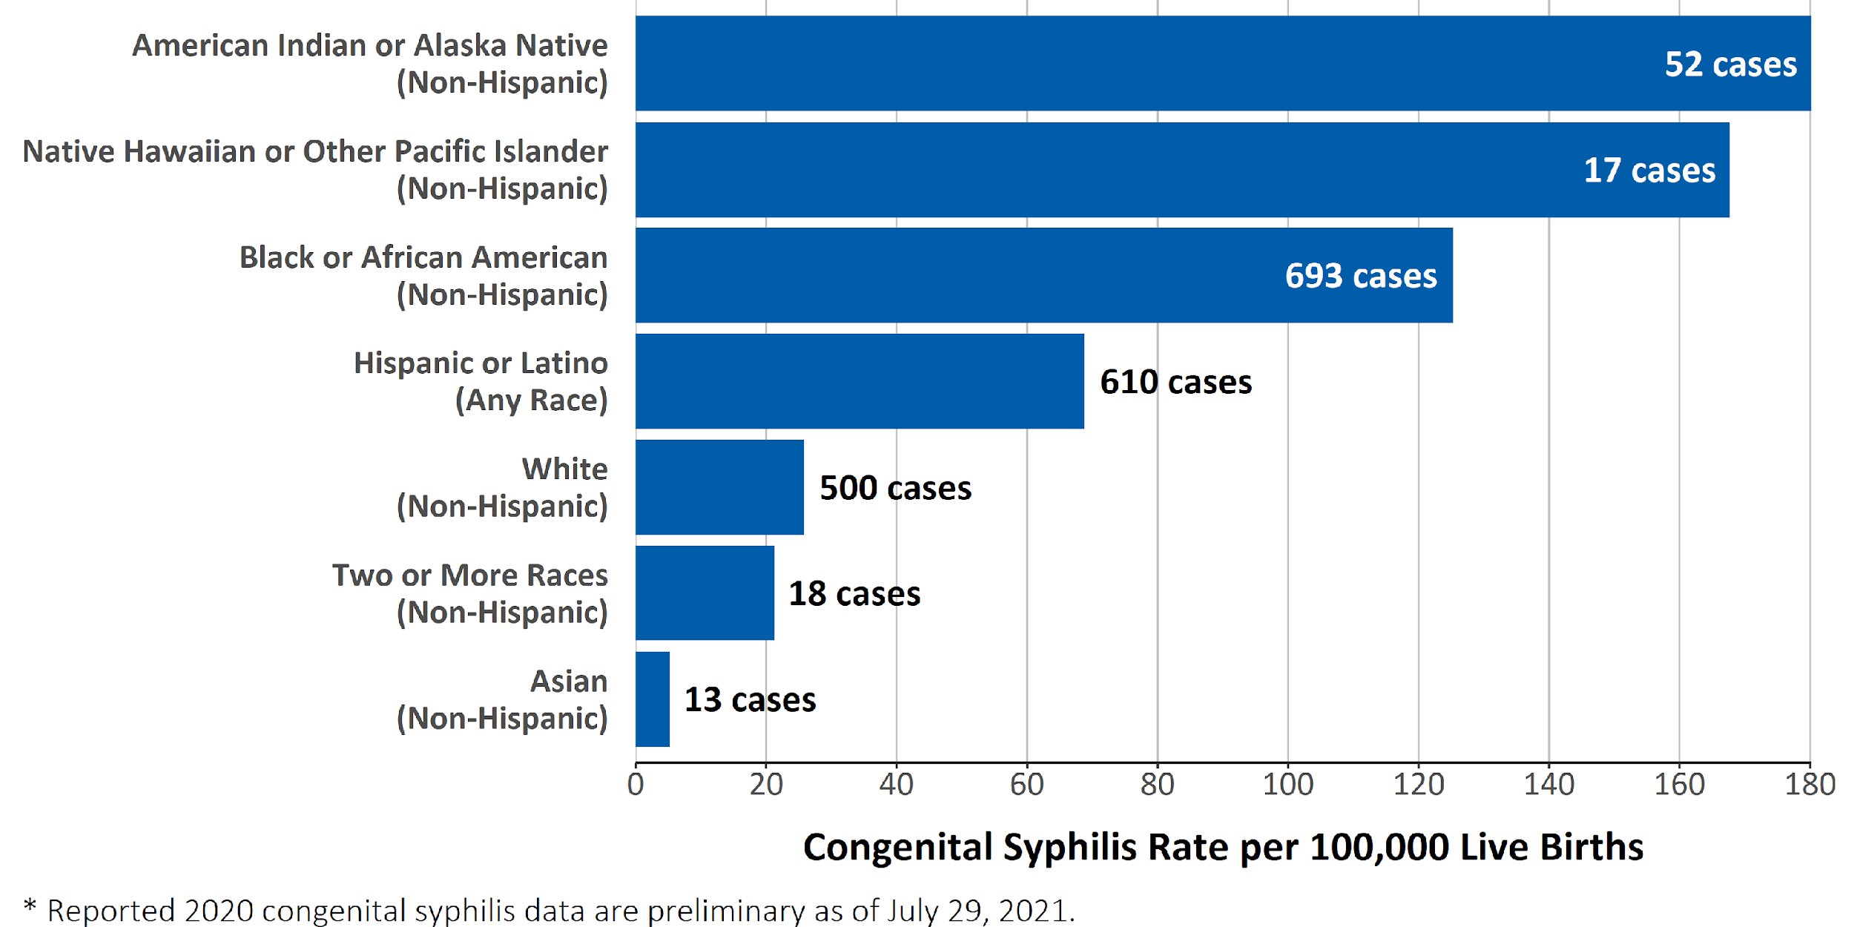
Syphilis in United States by Race, 2010-2019
Although 2020 data are preliminary,* racial and ethnic disparities are quite evident and similar to data seen in previous years.
Notes:
Like many infectious diseases, we continue to see disparities among our racial and ethnic populations. Based on preliminary 2020 congenital syphilis case data, rates of congenital syphilis are highest among mothers who were non-Hispanic American Indian or Alaska Native (180.2 per 100,000 live births), followed by mothers who were non-Hispanic Native Hawaiian or other Pacific Islander (167.7 per 100,000 live births) and mothers who were non-Hispanic Black or African American (125.3 per 100,000 live births).
The 2020 congenital syphilis data are preliminary and reflect cases received by CDC through the National Notifiable Diseases Surveillance System (NNDSS) as of July 29, 2021.
Currently, 119 congenital syphilis cases (6%) are not included in these calculations due to missing race and ethnicity. More information about cases, including mother’s race and ethnicity, will likely be reported by data closeout. As a result, reported rates of disease in these racial and ethnic groups will increase, but disparities may persist even with more complete data.
See the Congenital Syphilis Supplement Technical Notes (_link to CS tech notes_) for information on preliminary data and see the 2019 STD Surveillance Report Technical Notes (https://www.cdc.gov/std/statistics/2019/technical-notes.htm) for information on syphilis case reporting and collection of race and Hispanic ethnicity
Data points are available at https://www.cdc.gov/std/statistics/2020/preliminary-data/CS-data.zip.

Slide 9
HCV Screening Guidance During Pregnancy
Due to underreporting of risk behaviors and the increase in HCV among individuals of childbearing age new screening guidance is emerging
American Association for the Study of Liver Diseases (AASLD) and the Infectious Diseases Society of America (IDSA) jointly recommend universal screening for HCV during pregnancy
Centers for Disease Control and Prevention (CDC) recommends all pregnant persons be tested for HCV during each pregnancy
The American College of Obstetricians and Gynecologists is updating HCV screening guidance to recommend screening for all pregnant individuals during each pregnancy
Notes:
Due to the recognition of people not wanting to report risk behaviors, as well as the documented increase in HCV among individuals of childbearing age new screening guidance is emerging
In 2018, the American Association for the Study of Liver Diseases (AASLD), which issues HCV guidelines jointly with the Infectious Diseases Society of America (IDSA), made the recommendation to start universal screening for HCV during pregnancy
In addition, as of 2020, the Centers for Disease Control and Prevention (CDC) recommends all pregnant persons be tested during each pregnancy (except in settings where the prevalence of HCV infection is less than 0.1%).
Additionally the American College of Obstetricians and Gynecologists is updating its hepatitis C screening guidance to recommend screening for all pregnant individuals during each pregnancy.

Slide 10
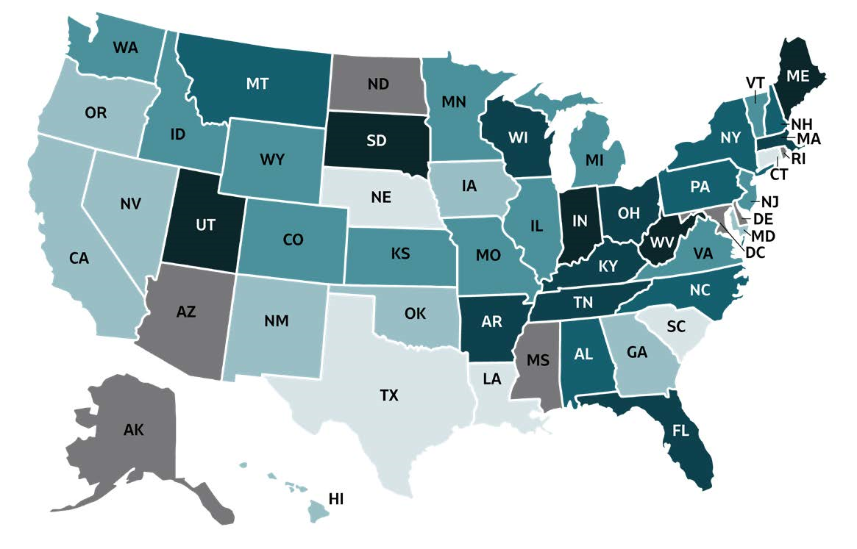
Reported Acute HCV by State, 2019
Source: CDC, National Notifiable Diseases Surveillance System
Notes:
West Virginia consistently has one of the highest rates of newly reported hepatitis C cases in the country, which is largely due to the ongoing drug crisis.

Slide 11
Acute HCV in the United States, 2004–2019
Rates of Reported Acute HCV Infection by Sex United States, 2004 –2019

Slide 12
Acute HCV, West Virginia, 2012–2019
Rates of Acute HCV, by Sex West Virginia, 2012–2019

Slide 13
Chronic HCV in West Virginia, 2019
Notes:
An infection that was mostly prevalent among adults born between 1945 and 1965, known as the baby boomers, is now more common among young adults who are of childbearing age.
This increased rise of hepatitis C virus (HCV) infection among individuals of child-bearing age places an increasing number of infants at risk for perinatally acquired HCV infection.
Note: includes probable and confirmed chronic HCV cases.

Slide 14
Perinatal HCV
HCV can be transmitted from a mother to child
No perinatal intervention is available to reduce HCV transmission
Birth to an HCV-positive pregnant individual carries 5-7% risk of transmission to the infant
HCV-associated liver disease usually progresses slowly in children, but infected children remain at risk for cirrhosis and liver cancer
Notes:
Unlike other bloodborne infectious diseases that have a risk for perinatal transmission, such as hepatitis B virus or HIV, there is no perinatal intervention available that has been shown to reduce vertical HCV transmission
Birth to an HCV-positive individual carries an approximate 5-7 percent risk of transmission to the infant, and this doubles for those coinfected with HIV
Unfortunately, because there are few systems in place to track and subsequently test these infants, most HCV exposed infants and children will never receive HCV testing of any kind.
Although HCV-associated liver disease usually progresses more slowly in children than adults, if left untreated, infected children remain at risk for eventual cirrhosis or liver cancer

Slide 15
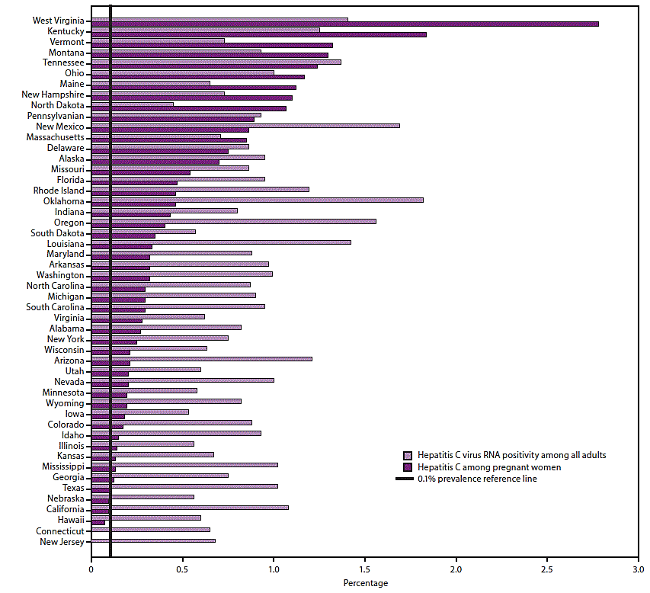
State HCV Estimates among Pregnant Women
Notes:
In fact, a 2020 CDC MMWR publication, reported WV to be the state with the highest percentage of live births delivered to mothers with hepatitis C.
Note: State estimates of HCV RNA positivity among all adults are based on a statistical model that allocated nationally representative hepatitis C prevalence from the 2013–2016 NHANES and additional previously published data for populations not sampled in NHANES to states according to the spatial demographics and distributions of 1999–2016 hepatitis C mortality and narcotic overdose deaths in the National Vital Statistics System. Live birth data are from an analysis of 2015, National Center for Health Statistics birth certificate data (live births) (Schillie SF, Canary L, Koneru A, et al. Hepatitis C virus in women of childbearing age, pregnant women, and children. Am J Prev Med 2018;55:633–41).
Image available: Schillie S, Wester C, Osborne M, Wesolowski L, Ryerson AB. CDC Recommendations for Hepatitis C Screening Among Adults — United States, 2020. MMWR Recomm Rep 2020;69(No. RR-2):1–17. DOI: http://dx.doi.org/10.15585/mmwr.rr6902a1external icon.

Slide 16
Perinatal HCV Exposure in West Virginia
HCV Present During Pregnancy Among West Virginia Live Births, 2016-2020
Year* | Total Births | Maternal HCV During Pregnancy | % of Live Births with Maternal HCV
2016 | 19,070 | 632 | 3.3%
2017 | 18,679 | 662 | 3.5%
2018 | 18,243 | 636 | 3.5%
2019 | 18,090 | 613 | 3.4%
2020 | 18,377 | 608 | 3.3%
Data Source: WV Health Statistics Center, Vital Statistics System *2020 data are considered preliminary
Notes:
On average, roughly 3.5% of live births in our State occur to women with evidence of HCV. This is over 600 infants born each year that are perinatally exposed and may acquire HCV .

Slide 17
HIV Screening for Pregnant Women
HIV screening should be part of all prenatal screening
HIV opt-out screening is recommended
Separate written consent for HIV testing should not be required
Repeat screening in the third trimester is recommended when there is elevated rates of HIV infection among pregnant women.
Notes:
HIV screening should be included in the routine panel of prenatal screening tests for all pregnant women.
HIV screening is recommended after the patient is notified that testing will be performed unless the patient declines (opt-out screening).
Separate written consent for HIV testing should not be required; general consent for medical care should be considered sufficient to encompass consent for HIV testing.
Repeat screening in the third trimester is recommended in certain jurisdictions with elevated rates of HIV infection among pregnant women.

Slide 18
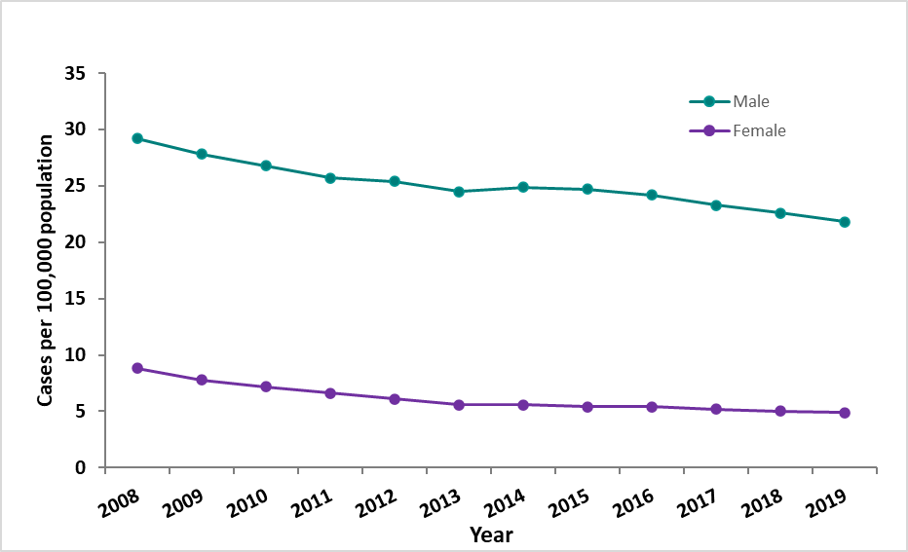
HIV in the United States
Rates of HIV, by Sex (Ages 13 and Older) United States, 2008–2019
Notes:
HIV incidence has declined in the United States approximately 8% from 2015 to 2019. In 2019, HIV infectious was 12.6 per 100,000. In 2019, the rate for males was 5 times the rate for females. MSM population are most affected by HIV in the US although decreasing over time. MSM accounted for 69% of new HIV diagnoses in the US. Other transmission categories have remained stable.

Slide 19
HIV in West Virginia
Rates of HIV, by Sex (Ages 13 and Older) West Virginia, 2008–2019
Notes:
Unfortunately, here in West Virginia we have seen our rates of HIV increase overtime. This is likely no surprise to many of you. The substance misuse epidemic that Appalachia is experiencing has significantly increased the transmission of infectious conditions like HIV through injection drug use. First seeing the emergence of HIV among persons who inject drugs at the beginning of 2017. Persons who inject drug are 22 times more likely to acquire HIV than among the general population. Despite the increased risk of HIV, they are among the least to access prevention, treatment, and healthcare.

Slide 20
Perinatal HIV
HIV can be passed from mother-to-child anytime during pregnancy, childbirth and breastfeeding
All pregnant women should be tested for HIV
Perinatal HIV transmission accounts for the majority of childhood HIV infections
Mothers with HIV that receive antiretrovirals (prenatal and natal) are less likely to pass HIV to their infants
After birth, all babies born to women with HIV should receive HIV medicines
Notes:
Perinatal, or mother-to-child HIV transmission happens when a pregnant person living with HIV passes HIV to their baby. It can happen during pregnancy, delivery, and through breastfeeding. Without treatment, 25 to 30% of babies born to a mother living with HIV will get HIV. However, if mothers are aware of their HIV infection and treated along with their infants, the chances of the infant getting HIV are less than 1%. According to CDC research, more women take the prenatal HIV test if the opt-out approach is used. Perinatal transmission of HIV accounts for the majority of childhood HIV infections and can almost always be prevented with proper medical care. All pregnant women should get tested for HIV and share the test results with their prenatal care provider. If a woman has not received prenatal care she should request a rapid HIV test at delivery. Providing the proper medication to pregnant people living with HIV and their newborn babies will cut the risk of transmitting HIV to the baby from 25% to 2% or less. After birth, all babies born to women with HIV should receive HIV medicines. This should be given as soon as possible after birth, preferably within 6 hours of delivery, to prevent perinatal transmission of HIV.

Slide 21
Diagnoses of Perinatally Acquired HIV, 2018
Notes:
In the United States and Puerto Rico, a total of 35 children born during 2018 had HIV infection attributed to perinatal transmission which is less than 1% Most perinatal HIV diagnoses were among black/African American children. Thirty-six areas, including WV, reported no perinatally acquired infections among infants born in 2018. HIV diagnoses among children have declined by 54% from 2014-2018, however given the increases of HIV diagnoses associated with persons who inject drugs it is important WV continues to screen pregnant women and promote opt out screening.
Note: Because of delays in the reporting of births and diagnoses of HIV infection attributed to perinatal exposure, the exclusion of data for the most recent 2 years allowed at least 24 months for data to be reported to CDC.

Slide 22
Novel Coronavirus 2019 (COVID-19)
Pregnant and recently pregnant women are at higher risk for severe disease from COVID-19
Pregnant women with COVID-19 are at higher risk for preterm birth and higher risk for other adverse pregnancy outcomes
COVID-19 vaccination is recommended for all people 12 and older, including people who are pregnant, breastfeeding, trying to get pregnant now, or might be pregnant in the future
Notes:
Pregnant and recently pregnant women are at a higher risk for severe illness from COVID-19 than nonpregnant women (hospitalization, ICU, ventilator). Additionally, pregnant women with COVID-19 are at a higher risk for preterm birth and might have a higher risk for other adverse pregnancy outcomes. Older age and having underlying medical conditions are associated with increased risk of moderate to severe or critical COVID-19 illness among pregnant women.
Having certain underlying medical conditions, and other factors, including age, can further increase a pregnant or recently pregnant (for at least 42 days following end of pregnancy) person’s risk for developing severe COVID-19 illness. Pregnant people with COVID-19 are also at increased risk for preterm birth (delivering the baby earlier than 37 weeks) and might be at increased risk for other poor pregnancy outcomes.
COVID-19 vaccination is recommended for all people 12 years and older, including people who are pregnant, breastfeeding, trying to get pregnant now, or might become pregnant in the future. If you have questions about getting vaccinated, talking with your healthcare professional might help, but is not required.

Slide 23
Severity of COVID-19 Among Pregnant Women

Slide 24
Pregnant Women at Risk Severe Illness
Presence of any health condition was associated with 39% increased risk
Two conditions was associated with 59% increased risk
Three or more conditions was associated with more than twice the risk of moderate to severe or critical illness compared to women without any reported conditions
Older age
Being a healthcare worker
Notes:
Association between older age (25 and older), healthcare occupation, any underlying medical condition, and increased risk of moderate-to-severe or critical COVID-19 illness are similar to those observed among nonpregnant adults
Includes underlying medical conditions (prepregnancy obesity, chronic lung disease, chronic hypertension, diabetes mellitus type 1 or 2, cardiovascular disease, and immunosuppression) and pregnancy-related conditions (gestational diabetes and gestational hypertension).
Data can help counsel pregnant women about their risk for moderate-to-severe or critical COVID-19 illness and guide their choice of prevention strategies, target public health messaging, and inform decisions around resource allocation. It is important that pregnant women are informed of their increased risk for severe COVID-19 illness, the signs of severe COVID-19 illness, and strategies for prevention, including vaccination
https://academic.oup.com/cid/article/73/Supplement_1/S17/6280195

Slide 25
Pregnant Women with COVID-19 in the United States
As of October 4, 2021, a 127,193-laboratory confirmed COVID-19 cases have been reported in pregnant people including 171 deaths
Highest number of deaths in a single month of the pandemic was reported in August 2021
97% of pregnant people hospitalized (either for illness or for labor and delivery) with COVID-19 were unvaccinated
Only 31% of pregnant people were fully vaccinated before or during their pregnancy
Notes:
In the US there has been a total of 127,193 laboratory confirmed cases of COVID-19 including 171 deaths. The highest number of deaths in a single month was reported this past August as many states were rocked by the fast-spreading delta variant. During the delta surge states saw severe outcomes from COVID-19 among unvaccinated pregnant women. 97% of pregnant women hospitalized for COVID-19 were unvaccinated. Although the proportion of fully vaccinated pregnant people has increased to 31.0% (as of September 18, 2021), the majority of pregnant people remain unprotected against COVID-19, and significant disparities exist in vaccination coverage by race and ethnicity.

Slide 26
Pregnant Women with COVID-19 in West Virginia
Notes:
Local health departments report individuals who have been diagnosed with COVID-19 (cases) to the state, including cases among pregnant women. As of October 11, 2021, 1,156 laboratory confirmed COVID-19 cases have been reported in pregnant people in WV including 3 deaths.
Office of Maternal Child and Family Health is participating in the surveillance of Emerging Threats to Mothers and Babies Network (SET-NET.) There are 4 datasets reported for Set-NET: Maternal form, pregnancy outcome and birth form, infant follow-up, and laboratory testing. Infant Follow-up is completed at 2 months and 6 months.
Data collected in this surveillance includes; timing of infection during pregnancy, severity of disease, outcome of pregnancy and whether the newborn was also diagnosed with COVID-19.

Slide 27
COVID-19 Vaccination Safe for Pregnant Women
August 1, 2021, CDC released new data on the safety of COVID-19 vaccines in pregnant women and recommend all people 12 years of age and older get vaccinated against COVID-19.
Data analysis from registry did not find an increased risk for miscarriage
Only 5.86% of pregnant women in West Virginia were fully vaccinated at the time of their infection.
Increased risk of severe illness and pregnancy complications related to COVID-19 among pregnant women make vaccination more urgent than ever.
Notes:
August 1, 2021, CDC released new data on the safety of COVID-19 vaccines in pregnant women and recommend all people 12 years of age and older get vaccinated against COVID-19. Data analysis from registry did not find an increased risk for miscarriage among nearly 2,500 pregnant women who received an mRNA COVID-19 vaccine before 20 weeks of pregnancy. Miscarriage typically occurs in about 11-16% of pregnancies, and this study found miscarriage rates after receiving a COVID-19 vaccine were around 13%, similar to the expected rate of miscarriage in the general population. Despite rise of pregnant women infected with COVID-19 in the past several weeks, only 5.86% of pregnant women in West Virginia were fully vaccinated at the time of their infection. Increased risk of severe illness and pregnancy complications related to COVID-19 among pregnant women make vaccination more urgent than ever.

Slide 28
Multisystem Inflammatory Syndrome in Children (MIS-C)
Condition where different body parts can become inflamed, including the heart, lungs, kidneys, brain, skin, eyes, or gastrointestinal organs.
Cause is unknown
Many children with MIS-C had COVID-19 or had been around someone with COVID-19.
Can be serious, even deadly, but most children who were diagnosed with this condition have gotten better with medical care.
As of October 1, 2021, a total of 5,217 cases have been reported nationwide and 46 deaths
WV has reported a total of 21 cases and 0 deaths
Notes:
Ongoing fever PLUS more than of the following:
Stomach pain
Bloodshot eyes
Diarrhea
Dizziness or lightheadedness (signs of low blood pressure)
Skin rash
Vomiting
Doctors may do certain tests to look for inflammation or other signs of disease. These tests might include:
Blood tests
Chest x-ray
Heart ultrasound (echocardiogram)
Abdominal ultrasound

Slide 29
MIS-C Cases and COVID-19 Cases
Notes:
The median age of patients with MIS-C was 9 years. Half of children with MIS-C were between the ages of 5 and 13 years.
61% of the reported patients with race/ethnicity information available occurred in children who are Hispanic/Latino (1,444 patients) or Black, Non-Hispanic (1,568 patients).
98% of patients had a positive test result for SARS CoV-2, the virus that causes COVID-19. The remaining 2% of patients had contact with someone with COVID-19.
60% of reported patients were male.
Cases of MIS-C follow surge in cases

Slide 30
Challenges in Prevention
Successful prevention of HIV, viral hepatitis, and STDs during pregnancy can be achieved
Several challenges exist:
Low implementation of screening recommendations
Low awareness of infection among pregnant women and their providers
Limited access to and availability of care and treatment
Notes:
Infectious diseases during pregnancy remain a public health concern and infectious diseases during pregnancy can complicate pregnancy, leading to serious consequences for a woman and her baby. We know that many people living with an infectious disease are not aware that they have one and timely screening is an important and necessary method for preventing poor outcomes . And in our state, the substance use epidemic compounds this problem as persons who inject drugs are at higher risk for acquiring bloodborne pathogens. Several challenges still exist including low implementation of screening recommendations and low awareness of status of their infection among pregnant women and their providers as well as limited access and availability of care and treatment.

Slide 31
References and Resources
Centers for Disease Control and Prevention. Monitoring selected national HIV prevention and care objectives by using HIV surveillance data—United States and 6 dependent areas, 2019. HIV Surveillance Supplemental Report 2021;26(No. 2). http://www.cdc.gov/hiv/library/reports/hiv-surveillance.html. Published May 2021. Accessed [10/6/2021].
Centers for Disease Control and Prevention. National Center for HIV, Viral Hepatitis, STD, and TB Prevention. Overview of HIV, Viral Hepatitis, STD, & TB During Pregnancy https://www.cdc.gov/nchhstp/pregnancy/overview.html. Accessed [10/1/2021]
Centers for Disease Control and Prevention. Viral Hepatitis Surveillance United States, 2019. https://www.cdc.gov/hepatitis/statistics/SurveillanceRpts.htm. Accessed [10/01/2021]
Schillie S, Wester C, Osborne M, Wesolowski L, Ryerson AB. CDC Recommendations for Hepatitis C Screening Among Adults — United States, 2020. MMWR Recomm Rep 2020;69(No. RR-2):1–17
https://www.cdc.gov/hiv/library/slideSets/index.html. Accessed [10/6/2021]
Provider Resources for STD Screening and Treatment https://www.cdc.gov/std/treatment-guidelines/provider-resources.htm
Risk Factors for Illness Severity Among Pregnant Women With Confirmed Severe Acute Respiratory Syndrome Coronavirus 2 Infection—Surveillance for Emerging Threats to Mothers and Babies Network, 22 State, Local, and Territorial Health Departments, 29 March 2020–5 March 2021. https://academic.oup.com/cid/article/73/Supplement_1/S17/6280195. Accessed [10/8/2021]
Notes:
The National STD Curriculum is a free educational website from the University of Washington STD Prevention Training Center. This project is funded by the Centers for Disease Control and Prevention (CDC).
This site addresses the epidemiology, pathogenesis, clinical manifestations, diagnosis, management, and prevention of STDs.
Free CME credit and CNE/CE contact hours are offered throughout this site. Pharmacology CE for advanced practice nurses is also available for many activities.

