Slide 1
Finding Opportunities for Contraceptive Counseling: Addressing Family Planning During Prolonged Inpatient Stays
Sarah Dotson, MD, MPH, FACOG
Assistant Professor of Obstetrics & Gynecology
Medical Director of Quality & Patient Safety
West Virginia University

Slide 2
Objectives
Review unintended pregnancy data for the US and WV as it relates to substance use and NAS
Discuss an interdisciplinary care model for patients experiencing medical complications of substance use
Developing a Quality Improvement Project
Summarize findings of resident QI project assessing contraceptive practices and needs among women admitted for IV antibiotic therapy at WVU

Slide 3
Pregnancy intentions
Reproductive age defined: 12- 51 years old
During those years
Average about 3 years total in peripartum stage ¹
i.e. either trying to conceive, pregnant, or postpartum
Rest of time spent preventing pregnancy
Unintended pregnancy
US rate is 45% (2.8 million; 1 in 20 women each year)¹
WV rate is 52%¹
Cost an estimated $145M in 2010¹
WV has the 6th highest teen pregnancy rate in US ²
Access to contraception is paramount
Guttmacher Institute. 2020. Unintended Pregnancy In The United States. [online] Available at: <https://www.guttmacher.org/fact-sheet/unintended-pregnancy-united-states> [Accessed 28 July 2020].
Power to Decide. (2020). West Virginia Data. Available at: https://powertodecide.org/ what-we-do/information/national-state-data/west-virginia. Accessed 10/6/21.
Notes:
Unintended includes mistimed and undesired. Declining since the 1980s among higher income women and increasing among lower income.
(1) Guttmacher Institute. 2020. Unintended Pregnancy In The United States. [online] Available at: <https://www.guttmacher.org/fact-sheet/unintended-pregnancy-united-states> [Accessed 28 July 2020].
22. Power to Decide. (2020). West Virginia Data. Available at: https://powertodecide.org/ what-we-do/information/national-state-data/west-virginia. Accessed 10/6/21.
23. Hamilton BE, Martin JA, Osterman MJK. Births: Provisional data for 2019. Vital Statistics Rapid Release; no 8. Hyattsville, MD: National Center for Health Statistics. May 2020. Available from: https://www.cdc.gov/nchs/data/ vsrr/vsrr-8-508.pdf.
24. Hamilton BE. State teen birth rates by race and Hispanic origin: United States, 2017-2018. National Vital Statistics Reports; vol 69, no.6. Hyattsville, MD: National Center for Health Statistics. July 2020.
25. America's Health Rankings analysis of CDC, Pregnancy Risk Assessment Monitoring System or state equivalent, United Health Foundation, AmericasHealthRankings.org. Available at: https://www.americashealthrankings.org/explore/health-of-women-and-children. Accessed 9/15/21.

Slide 4
Contraceptive CHOICE Project
Goal: Remove financial barriers to contraception
Methods:
9,256 women in St. Louis between the ages of 14-45
Counseling on all contraceptive options
FREE contraception of their choice
Results:
75% of women chose LARCs (IUD/implant)
86% continuation at 1 year vs 55% for other methods
Highest satisfaction rates
Lowest unintended pregnancy rates over 3 years (<1%)
(3) https://contraceptivechoice.wustl.edu/what-we-do/pathway-to-choice/. Accessed 10/6/21.
Notes:
2007-2011
Wanting contraception for at least 1 year.
3. https://contraceptivechoice.wustl.edu/what-we-do/pathway-to-choice/. Accessed 10/6/21.

Slide 5
Unintended Pregnancies and Substance Use
Unintended pregnancy rates among women with a current substance use disorder are much higher ~90% ⁴
Contributing factors include: ⁴⁻⁶
Lack of access to health care resources
Low socioeconomic status
Stigma
Fear of or experiencing forced treatment
Lack of knowledge regarding contraceptive choices
(4) Heil, S., Jones, H., Arria, A., Kaltenbach, K., Coyle, M., Fischer, G., Stine, S., Selby, P. and Martin, P., 2011. Unintended pregnancy in opioid-abusing women. Journal of Substance Abuse Treatment, 40(2), pp.199-202.
(5) Black, K. and Day, C., 2016. Improving Access to Long-Acting Contraceptive Methods and Reducing Unplanned Pregnancy among Women with Substance Use Disorders. Substance Abuse: Research and Treatment, 10s1, p.SART.S34555.
(6) Terplan, M., Hand, D., Hutchinson, M., Salisbury-Afshar, E. and Heil, S., 2015. Contraceptive use and method choice among women with opioid and other substance use disorders: A systematic review. Preventive Medicine, 80, pp.23-31.
Notes:
“What is the problem that we will be addressing”
Study performed in 2010- (2)
Guttmacher Institute, CDC

Slide 6
High-risk Pregnancies among Women with Substance Use
More likely to experience perinatal complications ⁷
Preterm birth, low birth weight, placental abruption, stillbirth
Neonatal Abstinence Syndrome
Known condition of neonates born to opioid-dependent mothers
Accounts for many postnatal hospitalizations and complications ⁸
Significant financial strain on the health care system
(7) Goler, N., Armstrong, M., Taillac, C. and Osejo, V., 2008. Substance abuse treatment linked with prenatal visits improves perinatal outcomes: a new standard. Journal of Perinatology, 28(9), pp.597-603.
(8) Patrick, S., Davis, M., Lehmann, C. and Cooper, W., 2015. Increasing incidence and geographic distribution of neonatal abstinence syndrome: United States 2009 to 2012. Journal of Perinatology, 35(8), pp.650-655.
Notes:
“Why do we care about said problem”
prematurity, low birth weight, placental abruption, and stillbirth.
Sequelae ranging from feeding difficulties to seizures
The cost of a hospital stay for a newborn with NAS was $9,500 in 2016, compared with $1,100 for other newborn hospital stays—a nearly 9-times increase in cost. This does not include increased cost associated with NICU stay.

Slide 7
West Virginia NAS Rate
WV has the highest rate of NAS in the nation
WV Rate of NAS in 2017 50.6 per 1,000 live births ⁹
Monongalia County 39.4 per 1,000 live births ¹⁰
National average 7 per 1,000 live births ¹¹
(9) “DHHR Releases Neonatal Abstinence Syndrome Data for 2017.” Department of Health and Human Resources. 15 July 2020. https://dhhr.wv.gov
(10) “West Virginia DHHR Releases NAS Birth Statistics by County.” West Virginia Press. 15 July 2020. https://wvpress.org
(11) “Interactive Maps Provide New Data on Neonatal Abstinence Syndrome Hospitalizations.” AHRQ News Now. http://www.ahrq.gov
Notes:
DHHR’s Bureau for Public Health, Office of Maternal Child and Family Health (OMFCH), with support from West Virginia University’s Department of Pediatrics Birth Score Office
Maternal opioid use disorder rates at delivery have more than quadrupled from 1999 to 2014.

Slide 8
(9) “Interactive Maps Provide New Data on Neonatal Abstinence Syndrome Hospitalizations.” AHRQ News Now. http://www.ahrq.gov
Notes:
2017 was peak, more recent data is slightly improved nationally and for WV

Slide 9
Quality Improvement
“Improve constantly and forever”
- Dr. W. Edwards Deming
ACGME requirement for residents
WVU OBGYN residents work in teams by class year
Notes:
Continual improvement

Slide 10
Coming up with a project
2018-2019
LARCs?
Postpartum IUD?
Focus on opioid use disorder?
Decrease NAS?
Dr. Loren Custer
Dr. Kirstie Cutlip
Dr. Kourtnie McQuillen

Slide 11
WVU Infusion Unit/Service
Postpartum overflow unit converted
Established 28 bed unit/Hospitalist service dedicated to the treatment of patients requiring long term antibiotic therapy with barriers to discharge
Infective endocarditis, osteomyelitis, etc
80% related to IVDU
Collaboration with Behavioral Medicine team
Initiate MAT therapy when desired
Provide counseling/support for recovery
Coordinate discharge planning – transfers to other facilities
Notes:
Cardiac Surgery, ID, Psych, PT/OT, OPAT, Care managers, nurses with specialty training/expertise in central lines and barriers to discharge

Slide 12
WVU Infusion Unit/Service
Captive audience for contraceptive counseling?
Notes:
Medical student interested in OBGYN and specifically contraception in SUD was doing a rotation on that unit and talked to patients about contraception, encouraged consults to GYN team to arrange LARC placement before discharge.

Slide 13
Establishing Contraception Plans in Women Receiving Long-Term IV Antibiotics
L. Custer, MD; K. Cutlip, MD; K. McQuillen, MD; M. Clemmer, PhD; S. Dotson, MD, MPH
Notes:
Project was approved by WVU IRB.

Slide 14
Defining the problem
Problem:
High rate of unintended pregnancies in women with SUD
SUD significantly increases morbidity/mortality associated with pregnancy and increases perinatal complications
Lack of outreach to this specific patient group
Global Project Aim:
Offer LARC contraception at the time of discharge from the new infusion unit
Smart Aim:
Increase the percentage of women age 15-45 using LARC contraception at the time of discharge from 6E by 25% by May 1, 2020.
Notes:
Sept 2019

Slide 15
Intervention #1 – Gyn Consults
Fall 2019: Met with multidisciplinary team on the infusion unit
Implementing a program for LARC placement
Medicine team to discuss with patients and consult Gynecology team if patient interested
Gynecology team completes consult and determines appropriateness
LARC placement occurs on day of discharge after completion of IV antibiotics
Winter 2019: Reconvened with with team to review and evaluate plan
No changes to plan/workflow
Spring 2020: Personally sought out consults
Gynecology team saw patients in appropriate age range
Notes:
In the initial phase, the Gynecology service did not receive a significant number of consults- we relied on primary managing team to initiate conversation rather than provide patients with educational materials and allow them to ask for consult if interested

Slide 16
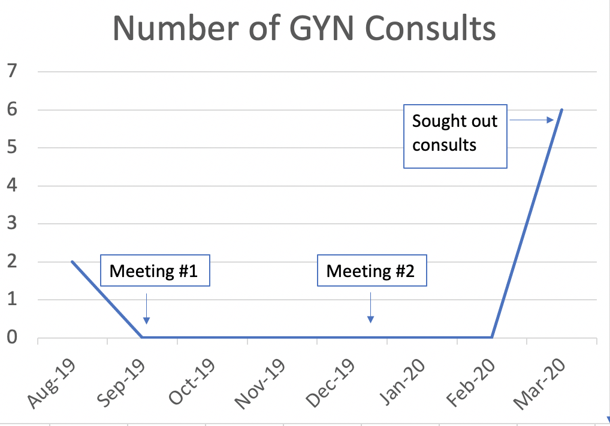
Intervention #1
Notes:
Meg Starcher initiated 2 consults to Gyn from the infusion unit while on a medicine rotation in Aug.

Slide 17
Intervention #1 - PDSA
Did not receive a significant number of consults
No plan in place for discussion with patients with weekly change in attending staff on 6E
Not feasible to see every patient for contraception counseling

Slide 18
Redirection of Project
New aim:
Increase the proportion of women ages 18- 45 discharged with contraceptive plan
Coordinate placement of LARCs or provide prescription birth control
Set up outpatient management/follow-up
Paps, STI testing, etc
Notes:
May 2020

Slide 19
Data Collection
Retrospective chart review of women discharged ages 18-45 from July 2019 through April 2020
New outcome measure: any contraception plan
Determine if contraception plan was in place at time of discharge and what type of contraception being used
History of surgical sterilization/hysterectomy
Contraception prescribed or noted in home meds
IUD or Nexplanon noted to be in place
138 charts reviewed (Jul ‘19 – May ‘20)
2-22 discharges/month
6 patients (>4%) deceased as of May 2020

Slide 20
Run Chart
Percentage with contraceptive plan in place by discharge month
Notes:
2-22 discharges per month

Slide 21
Birth Control Methods
Notes:
Among women with contraceptive plan in place – n=138
Nearly 50% of women on birth control in this population were using a form of permanent sterilization.

Slide 22
Intervention #2 – Join the team
Join the interdisciplinary team!
Implemented distribution of a “Contraception Packet”
Packet given to all women admitted to 6E for long-term IV antibiotics between the ages of 18 and 45
Contents included:
“Welcome letter”
Contraception guide including pictures and short description of options
Brief survey on pregnancy intentions and contraception

Slide 23
Intervention #2 – Join the team
Contraception packet integrated into distributed materials and reviewed at patient’s discretion
Primary team encouraged completion of survey and placed GYN consult if patient desired
Once GYN consult placed, our team would perform further contraception counseling, assessment of medical eligibility, and implementation of plan
Notes:
Primary team- 6E nurses, ID physician, therapist

Slide 24
Contraception Guide

Slide 28
Survey

Slide 29
Survey Results
92% did NOT currently wish to become pregnant (n=24)
54% were NOT currently using contraception (n=24)
83% of contraceptive users reports consistent use (n=12)
92% reported no barriers to obtaining contraception (n=24)
33% desired to talk more with Gynecology (n=24)
Notes:
Need to know the N for responding to each question. Especially for the last question – was it 33% of all respondents were interested in a Gyn consult, or does this include every survey respondent. Would be much more meaningful to exclude the patients who are already sterilized and show what % of those patients wanted to discuss contraceptive options.

Slide 30
Do you currently wish to become pregnant?
Notes:
What is the N for survey responses??

Slide 31
Are you currently using any type of birth control?

Slide 32
If you are currently using birth control, what kind?
Notes:
No one in this population was using Depo???
This might be better to lump LARCS together. It would then be nearly exactly 1/3 sterilized, 1/3 LARC and 1/3 condoms/pills.

Slide 33
If using birth control, how consistently do you use it?

Slide 34
Have you experienced and barriers to or difficulty obtaining contraception?
Notes:
Barriers: COVID limitations to Nexplanon placement

Slide 35
Are you interested in discussing birth control options with the Gynecology team?
Notes:
What is the N for the number of patients who answered this quesion?

Slide 36
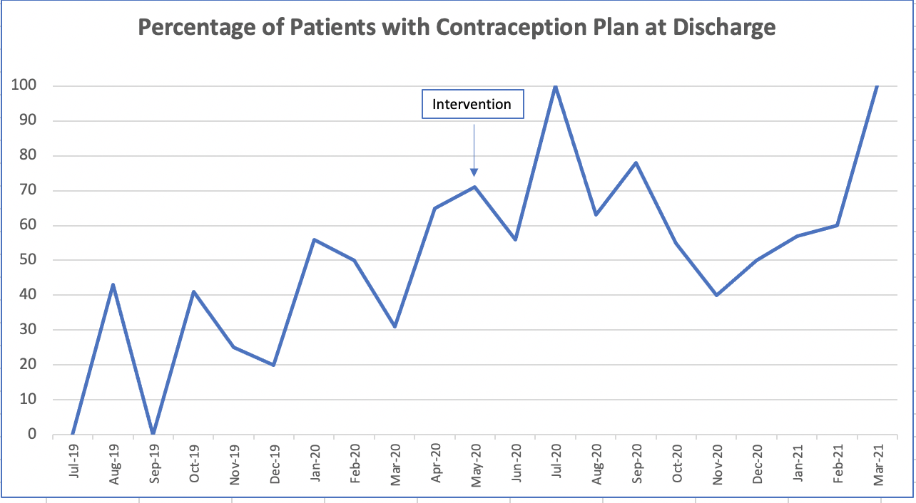
Results

Slide 37
Project successes
Overall increase in patients discharged with a contraceptive plan in place since starting this project
Moving towards decreasing unintended pregnancy rates
Improve the ease of LARC placement while inpatient
Able to integrate contraception planning into interdisciplinary care approach on this hospital unit

Slide 38
Limitations & Lessons Learned
Low patient turnover due to length of stay 2-6 weeks, limiting number of patients to be evaluated
LARCs only placed on day of discharge following resolution of bacteremia to decrease risk with foreign body implantation
Patients being discharged/transferred to complete antibiotic treatment at other facilities

Slide 39
Future Plans
Continue to distribute surveys and complete consultations over longer period of time
Teach non-coercive contraceptive counseling with members of multidisciplinary team – Love Your Birth Control!
Expand to other WVU facilities
Dual Diagnosis Unit has initiated a similar project incorporating STD and pap screening with contraception
Notes:
On admission to DDU (substance/mental health) – initiation of MAT therapy, stabilization of mental health and SUD– after initial stabilization, psych residents and counselors were trained to inquire about contraceptive use and interest. Psych residents that are comfortable will prescribe OCP or Depo Provera to patients. Those with additional questions or who are considering a LARC meet with a CNM for full contraceptive counseling. Also complete STD testing (if appropriate or desired) and paps. (3 abnormal paps, 2 trich, 2 chlamydia).

