Slide 1
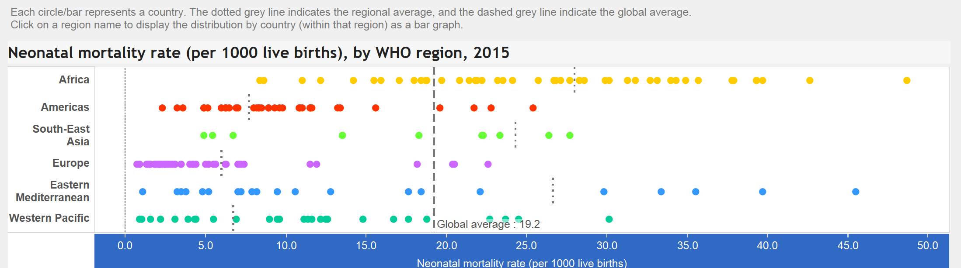
↑

Slide 2


Slide 3
Trends in Infant Mortality in the United States, 2005-2014. NCHS Data brief, No. 279, March 2017.

Slide 4
Trends in Infant Mortality in the United States, 2005-2014. NCHS Data brief, No. 279, March 2017.

Slide 5
Trends in Infant Mortality in the United States, 2005-2014. NCHS Data brief, No. 279, March 2017.

Slide 6
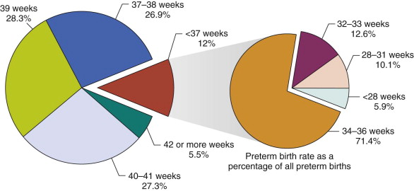
Ramachandrappa, Ashwin; Jain, Lucky. The Late Preterm Infant. Fanaroff and Martin's Neonatal-Perinatal Medicine. January 1, 2015. Pages 577-591.

Slide 7
Late Preterm Infants… not quite Term
Greg A. Barretto, Jr., MD, MS
Regional Medical Director, Newborn Medicine, Children’s Hospital of Pittsburgh
Medical Director, Neonatal Intensive Care Unit, Wheeling Hospital

Slide 8
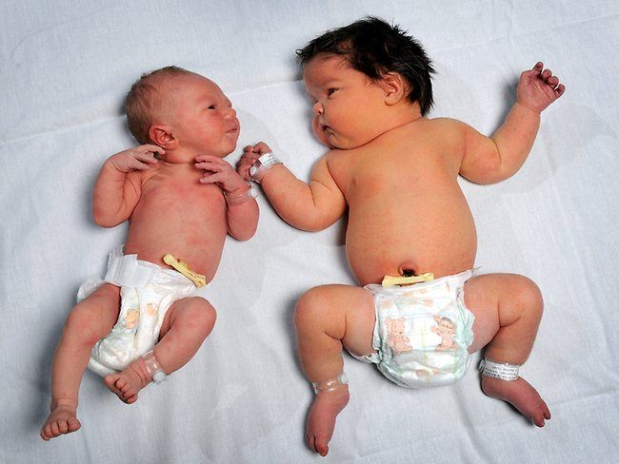

Slide 9


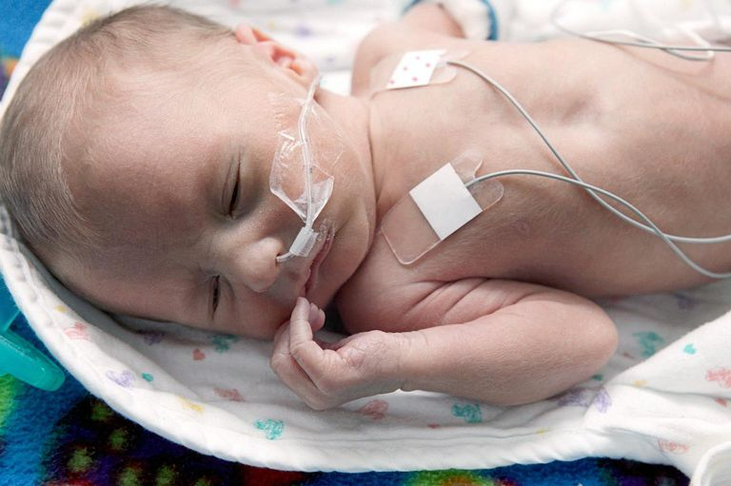
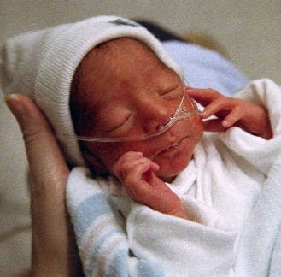
Term
Early Term
Late Preterm
“Moderate” Preterm
http://www.secretsofbabybehavior.com/2013/10/in-news-full-term-pregnancy-is-now.html
http://www.newkidscenter.com/Babies-Born-at-37-Weeks.html
https://www.verywell.com/health-concerns-of-the-late-preterm-infant-2748610
http://www.marketwire.com/library/MwGo/2014/11/5/11G025552/Images/2014_Premature_Baby_Photo_Copyright_March_of_Dimes-767396815372.JPG

Slide 10
Engle, W., Kominiarek, M. Late Preterm Infants, Early Term Infants, and Timing of Elective Deliveries. Clin Perinatol 35 (2008) 325-341.

Slide 11
Early Term… 37^{0/7} to 38^{6/7} weeks
may occur as a result of:
  spontaneous early term labor
  prelabor spontaneous rupture of chorioamniotic membranes
  maternal and fetal pathology necessitating an iatrogenic delivery
  delivery for nonindicated reasons
Ananth, C., et al. Epidemiology of Moderate Preterm, Late Preterm and Early Term Delivery. Clinics in Perinatology, 2013-12-01, Volume 40, Issue 4.

Slide 12
Early Term...
Delivery at 37 weeks compared to 39 weeks
3.1 fold ↑ in RDS
2.5 fold ↑ in Transient Tachypnea of the Newborn
1.7 fold ↑ in pneumonia
2.8 fold ↑ respiratory failure
4.8 fold ↑ in surfactant use
2.8 fold ↑ in ventilator use
48% vs 27% risk of morbidity at 38 weeks
17.8% vs 8% vs 4.6% NICU admission rates; 37 weeks, 38 weeks and 39 weeks respectively
Ananth, C., et al. Epidemiology of Moderate Preterm, Late Preterm and Early Term Delivery. Clinics in Perinatology, 2013-12-01, Volume 40, Issue 4.
Parikh, L., et al. Neonatal Outcomes in Early Term Births. Am J Obstet Gynecol 2014; 211:265.e1-11.

Slide 13
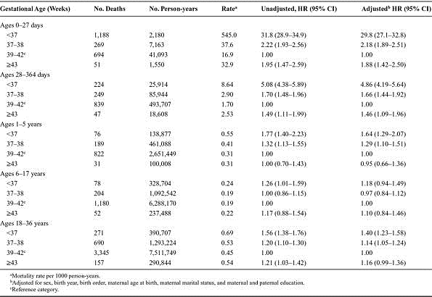


TABLE 3 . Association Between Gestational Age at Birth (1973-1979) and All-cause Mortality in Various Age Ranges (Through 2008)
Early-term Birth (37-38 Weeks) and Mortality in Young Adulthood.
Crump, Casey; Sundquist, Kristina; Winkleby, Marilyn; Sundquist, Jan
Epidemiology. 24(2):270-276, March 2013. DOI: 10.1097/EDE.0b013e318280da0f
2

Slide 14
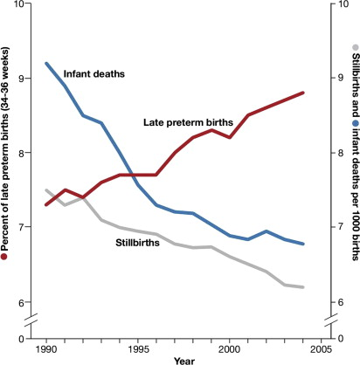
Stillbirth Reduction Efforts and Impact of Early Births… Clinics in Perinatology, 2013.
there is considerable downside to late preterm and early term deliveries
however, stillbirth rate has decreased in part because of improved management of conditions associated with increased risk for stillbirth
optimal gestational age for delivery in many of these conditions is uncertain
Jain, L. The Tug of War Between Stillbirths and Elective Early Births. Clinics in Perinatology, 2013-12-01, Volume 40, Issue 4.

Slide 15
ACOG… Recommendations for the Timing of Delivery
Committee Opinion, Number 560, April 2013 (Reaffirmed 2017)
Condition | General Timing | Suggested Specific Timing
Placental/uterine issues
Placenta previa | Late preterm/early term | 36 0/7 – 37 6/7 weeks gestation
Placenta previa with suspected accrete, increta, or percreta | Late preterm | 34 0/7 – 35 6/7 weeks gestation
Prior classical cesarean | Late preterm/early term | 36 0/7 – 37 6/7 weeks gestation
Prior myomectomy | Early term/term (individualize) | 37 0/7 – 38 6/7 weeks gestation

Slide 16
ACOG… Recommendations for the Timing of Delivery
Committee Opinion, Number 560, April 2013 (Reaffirmed 2017)
Condition | General Timing | Suggested Specific Timing
Fetal issues
Growth Restriction (single) Uncomplicated Concurrent conditions | Early term/term Late preterm/early term | 38 0/7 – 39 6/7 weeks gestation 34 0/7 – 37 6/7 weeks gestation
Growth Restriction (twins) Di-Di, uncomplicated Di-Di, concurrent conditions Mo-Di, uncomplicated | Late preterm/early term Late preterm Late preterm | 36 0/7 – 37 6/7 weeks gestation 32 0/7 – 34 6/7 weeks gestation 32 0/7 – 34 6/7 weeks gestation
Multiple Gestations Di-Di Mo-Di | Early term Late preterm/early term | 38 0/7 – 38 6/7 weeks gestation 34 0/7 – 37 6/7 weeks gestation
Oligohydramnios | Late preterm/early term | 36 0/7 – 37 6/7 weeks gestation

Slide 17
ACOG… Recommendations for the Timing of Delivery
Committee Opinion, Number 560, April 2013 (Reaffirmed 2017)
Condition | General Timing | Suggested Specific Timing
Maternal issues
Chronic Hypertension Controlled, no meds Controlled, meds Difficult to control Gestational HTN Preeclampsia, severe Preeclampsia, mild | Early term/term Early term/term Late preterm/early term Early term Late preterm Early term | 38 0/7 – 39 6/7 weeks gestation 37 0/7 – 39 6/7 weeks gestation 36 0/7 – 37 6/7 weeks gestation 37 0/7 – 38 6/7 weeks gestation after 34 0/7 weeks gestation after 37 0/7 weeks gestation
Diabetes Pregestational, CTRL Pregestational, vascular Pregestational, NO CTRL Gestational, CTRL Gestational, NO CTRL | Not indicated Early term/term Late preterm/early term Not indicated Late preterm/early term | 37 0/7 – 39 6/7 weeks gestation Individualized Individualized

Slide 18
ACOG… Recommendations for the Timing of Delivery
Committee Opinion, Number 560, April 2013 (Reaffirmed 2017)
Condition | General Timing | Suggested Specific Timing
Obstetric issues
PPROM | Late preterm | 34 0/7 weeks gestation

Slide 19
Cesarean Delivery by Gestational Age
National Vital Statistics Report. Births: Final Data for 2015, Volume 66, Number 1.

Slide 20
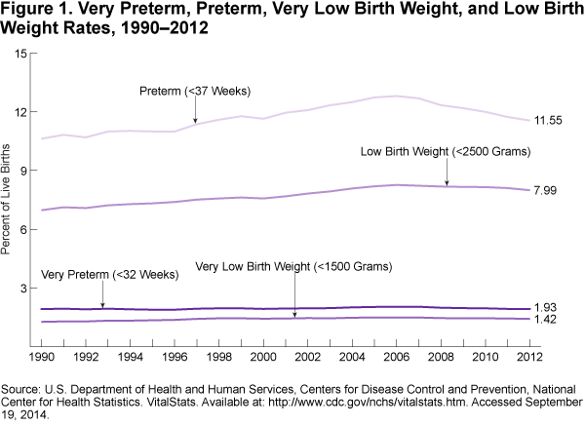

Slide 21
Archaic Terminology
Accubation… childbirth
Child Bed Fever… Infection (in the mother) following child birth
Confinement… period of labor and delivery of the infant
Corruption… Infection
Infant Child… stillborn or sudden infant death syndrome
Lying In… time of delivery of infant
Near Term Infants… unrecognized as premature
http://freepages.rootsweb.ancestry.com/~wakefield/definitions/defmedic.html

Slide 22
Late Preterm Infants…
NOW recognized as premature
underestimated for morbidity and mortality

Slide 23
Late Preterm Infants… Mortality
Gestational Age (weeks) | Early Neonatal Mortality Rate (1-7 days) |  | Infant Mortality Rate (1-365 days)
 | Mortality Rate | Risk Ratio | Mortality Rate | Risk Ratio
34 | 7.2 | 25.5 | 12.5 | 10.5
35 | 4.5 | 16.1 | 8.7 | 7.2
36 | 2.8 | 9.8 | 6.3 | 5.3
37 | 0.8 | 2.7 | 3.4 | 2.8
38 | 0.5 | 1.7 | 2.4 | 2.0
39 | 0.2 | 0.8 | 1.2 | 1.2
40 | 0.3 | Reference | 1.4 | Reference
Ramachandrappa, Ashwin; Jain, Lucky. The Late Preterm Infant. Fanaroff and Martin's Neonatal-Perinatal Medicine. January 1, 2015. Pages 577-591.
Adapted from Young PC, et al. Mortality of late-preterm (near-term) newborns in Utah. Pediatrics. 2007;119:e659.

Slide 24
Late Preterm…
Delivery at 34 0/7 weeks to 36 6/7 weeks compared to 39 weeks
7 fold ↑ in morbidity (22% vs 3%)
10- to 14-fold ↑ in morbidity with other known risk factors (i.e. maternal hypertension, diabetes, infections, maternal chronic disorders, antepartum hemorrhage)
Longer birth hospital stay (8.8 vs 2.2 days)
10 fold ↑ cost of care ($26,054 vs $2061)
Late Preterm Infants. UpToDate.

Slide 25
Late Preterm… complications
During birth hospitalization:
  Temperature Instability
  Respiratory Distress
  Apnea
  Sepsis
  Hypoglycemia
  Feeding Difficulties
  Hyperbilirubinemia
Late Preterm Infants. UpToDate.

Slide 26
Late Preterm… complications
Long-term morbidity:
  Neurodevelopmental outcome
  Failure to Thrive?
  Respiratory outcome?
Late Preterm Infants. UpToDate.

Slide 27
Late Preterm… Temperature instability
insufficient brown fat for nonshivering thermogenesis
large surface area compared with body mass
deficient subcutaneous fat and nonkeratinized thin skin
less ability to maintain flexion of extremities
underdeveloped response of the temperature sensors in the posterior hypothalamus… release thermogenic hormones (thyroxine and norepinephrine)
more frequent delivery-room interventions… impede strategies to prevent heat loss
Agren, J. The Thermal Environment of the Intensive Care Nursery. Fanaroff and Martin’s Neonatal-Perinatal Medicine.
Notes:
Hormones peak at term gestation

Slide 28
Late Preterm… Temperature instability
Delivery room temperature is ≥ 24 ºC
  infant should be wiped and placed on the mother’s chest
  covered with a cap and blanket
  uninterrupted conductive heat support through skin-to-skin care is required to maintain thermal balance
Agren, J. The Thermal Environment of the Intensive Care Nursery. Fanaroff and Martin’s Neonatal-Perinatal Medicine.

Slide 29
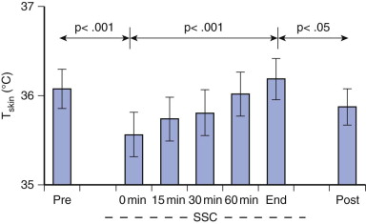
Extremely Preterm… Skin-to-Skin Care
Agren, J. The Thermal Environment of the Intensive Care Nursery. Fanaroff and Martin’s Neonatal-Perinatal Medicine.

Slide 30
Late Preterm… Respiratory Distress
Greater risk of respiratory failure:
  Respiratory Distress Syndrome (RDS)
  Transient Tachypnea of the Newborn (TTN)
  Hypoxic Respiratory Failure or Persistent Pulmonary Hypertension of the newborn (PPHN)
  Pneumonia
  Apnea of Prematurity
Sahni, R, et al. Physiologic Underpinnings for Clinical Problems in Moderately Preterm and Late Preterm Infants. Clinics in Perinatology, 2013-12-01, Volume 40, Issue 4.

Slide 31
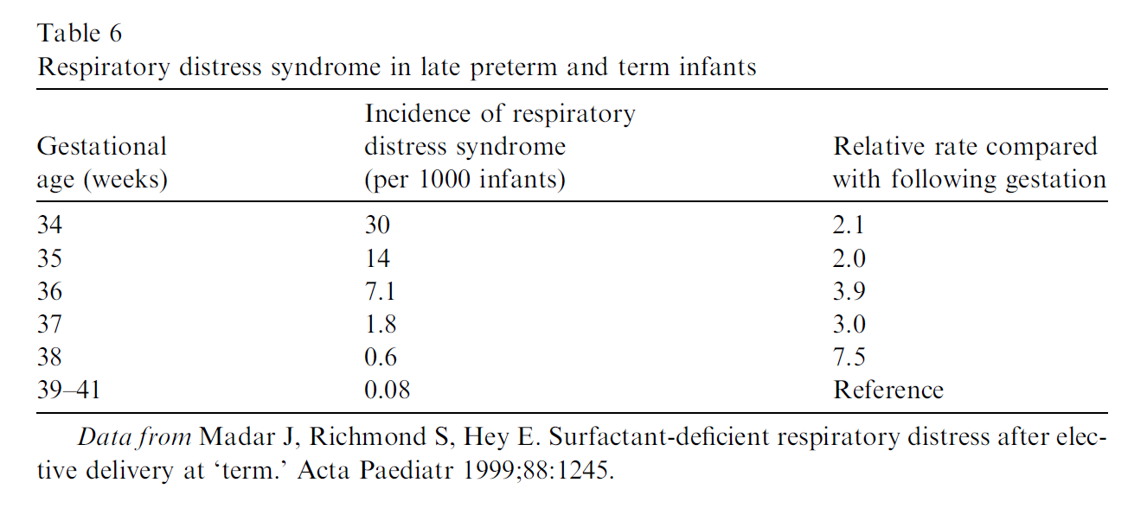
Late Preterm… Respiratory Distress
Engle WA, Kominiarek MA. Late Preterm Infants, Early Term Infants, and Timing of Elective Deliveries. Clin Perinatol 2008; 35; 325 – 341.

Slide 32
Late Preterm… Respiratory Distress
Respiratory Distress Syndrome (RDS)
  13-fold ↑ compared with infants born at 37 to 40 weeks gestation (5.2% vs 0.4%)
  most common cause of respiratory morbidity
  quantitative and/or qualitative deficiency of pulmonary surfactant superimposed on cardiorespiratory immaturity
    35 weeks gestation there is a significant surge in surfactant pool size
Sahni, R, et al. Physiologic Underpinnings for Clinical Problems in Moderately Preterm and Late Preterm Infants. Clinics in Perinatology, 2013-12-01, Volume 40, Issue 4.

Slide 33
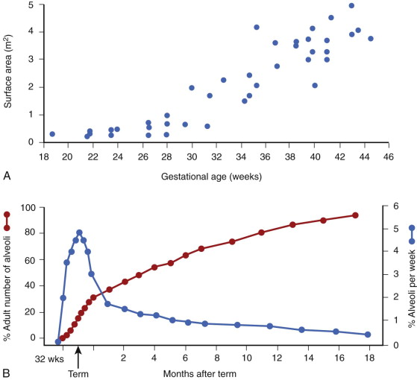
Lung Development and Maturation
Fanaroff and Martin's Neonatal-Perinatal Medicine.
Kallapur, Suhas G.; Jobe, Alan H.. Published January 1, 2015. Pages 1042-1059. © 2015

Slide 34
Late Preterm… Respiratory Distress
Transient Tachypnea of the Newborn (TTN)
  incidence of 4%
  second most common cause of respiratory morbidity
  lack of timely clearance of pulmonary fluid from alveolar airspaces
  increased risk in infants born without active labor or by elective cesarean section
    Starling forces
    Vaginal squeeze during delivery
    ENaCs (epithelial sodium channels)
Sahni, R, et al. Physiologic Underpinnings for Clinical Problems in Moderately Preterm and Late Preterm Infants. Clinics in Perinatology, 2013-12-01, Volume 40, Issue 4.

Slide 35
Late Preterm… Respiratory Distress
Hypoxic Respiratory Failure or Persistent Pulmonary Hypertension of the newborn (PPHN)
  more likely to occur in infants born at 34 to 37 weeks gestation who develop RDS compared with infants born at 32 weeks gestation
  may require therapies like high frequency ventilation, nitric oxide, and ECMO
Sahni, R, et al. Physiologic Underpinnings for Clinical Problems in Moderately Preterm and Late Preterm Infants. Clinics in Perinatology, 2013-12-01, Volume 40, Issue 4.
Notes:
Developmental increase in smooth muscle in the walls of the pulmonary blood vessels and the resultant increase in the pulmonary vascular resistance.

Slide 36
Late Preterm… Respiratory Distress
Pneumonia
  15-fold ↑ in infants born at 34 weeks gestation compared with infants born at 39 weeks gestation (1.5% vs 0.1%)
  fetal infection as an underlying cause of preterm delivery predisposes late preterm infants to sepsis and pulmonary infection
  mechanical ventilation can injure the immature lung further and increase the risk of pulmonary infections
Sahni, R, et al. Physiologic Underpinnings for Clinical Problems in Moderately Preterm and Late Preterm Infants. Clinics in Perinatology, 2013-12-01, Volume 40, Issue 4.

Slide 37
Late Preterm… Respiratory Distress
Apnea of Prematurity
  10% have significant apnea of prematurity with frequent delays in establishing coordination of feeding and breathing
  more susceptible to bradycardia due to a significantly less mature parasympathetic nervous system
Obstructive and Mixed Apnea
  highly compliant chest wall
  upper airways that tend to collapse when the diaphragm contracts
Sahni, R, et al. Physiologic Underpinnings for Clinical Problems in Moderately Preterm and Late Preterm Infants. Clinics in Perinatology, 2013-12-01, Volume 40, Issue 4.
Notes:
Higher incidence of SIDS in 33 to 36 weeks (1.37/1000 live births vs 0.69/1000 live births).

Slide 38
Late Preterm… Sepsis
Immunologic immaturity and Infections
  higher rate of early-onset sepsis and health care associated infections
  gestational age-related decreases in complement levels
  reduced levels of IgG
Sahni, R, et al. Physiologic Underpinnings for Clinical Problems in Moderately Preterm and Late Preterm Infants. Clinics in Perinatology, 2013-12-01, Volume 40, Issue 4.

Slide 39
Late Preterm… Hypoglycemia
Glucose Homeostasis
  10% to 15% experience an episode of hypoglycemia
  reduced glycogen stores and low activity of key gluconeogenic and glycolytic enzymes
  risk of hypoglycemia is increased when:
    there are increased energy demands (eg sepsis, hypoxia, and cold stress)
    enteral intake is inadequate (eg abnormal suck and swallow or feeding intolerance)
  compensatory mechanisms responsible for protecting the brain from hypoglycemic injury are not entirely in place until term (Garg & Devaskar, 2006)
Sahni, R, et al. Physiologic Underpinnings for Clinical Problems in Moderately Preterm and Late Preterm Infants. Clinics in Perinatology, 2013-12-01, Volume 40, Issue 4.

Slide 40
Late Preterm… Feeding difficulties
Gastrointestinal Immaturity and Feeding
  difficulty in coordinating suck and swallowing
    immature orobuccal coordination
    Immature deglutination mechanisms
  difficulty establishing and maintaining adequate breastfeeding
    mild oromotor hypotonia, rapid fatigue, cold stress and general lack of strength
  higher frequency of GE Reflux further reducing food intake
    immature peristaltic functions… 38 weeks when myenteric muscle contractions are present
    Immature sphincter controls in the esophagus, stomach and intestines
Sahni, R, et al. Physiologic Underpinnings for Clinical Problems in Moderately Preterm and Late Preterm Infants. Clinics in Perinatology, 2013-12-01, Volume 40, Issue 4.

Slide 41
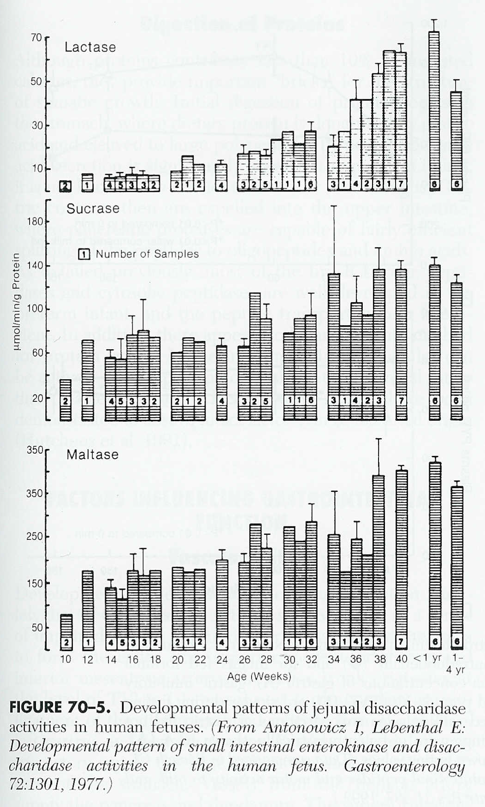

Slide 42
Late Preterm… Hyperbilirubinemia
Hepatic immaturity and Hyperbilirubinemia
  occurs more commonly in late preterm infants due to developmental immaturity of the liver and feeding difficulties
    higher rates of bilirubin production with shortened RBC life span
    decreased hepatic uptake and conjugation
    increased enterohepatic circulation
  ”overly represented” in hospital readmissions and the Kernicterus registry
Sahni, R, et al. Physiologic Underpinnings for Clinical Problems in Moderately Preterm and Late Preterm Infants. Clinics in Perinatology, 2013-12-01, Volume 40, Issue 4.

Slide 43
Late Preterm… Long-term outcomes
Increased risk of:
  neurologic impairments
  developmental disabilities
  school failure
  behavioral and psychiatric problems
  “from infancy to adulthood”
Sahni, R, et al. Physiologic Underpinnings for Clinical Problems in Moderately Preterm and Late Preterm Infants. Clinics in Perinatology, 2013-12-01, Volume 40, Issue 4.

Slide 44
MDI, Mental Developmental Index; PDI, Psychomotor Developmental Index; DAS, Differential Ability Scales
Vohr, B. Long-Term Outcomes of Moderately Preterm, Late Preterm, and Early Term Infants. Clinics in Perinatology, 2013-12-01, Volume 40, Issue 4.

Slide 45
Vohr, B. Long-Term Outcomes of Moderately Preterm, Late Preterm, and Early Term Infants. Clinics in Perinatology, 2013-12-01, Volume 40, Issue 4.

Slide 46
Vohr, B. Long-Term Outcomes of Moderately Preterm, Late Preterm, and Early Term Infants. Clinics in Perinatology, 2013-12-01, Volume 40, Issue 4.

Slide 47
Late Preterm… Neurodevelopment
significant proportion of brain growth, development and networking occurs during the last 6 weeks of gestation (Adams-Chapman, 2006)
MRI studies… approximately 50% of the increase in cortical volume occurs between 34 and 40 weeks gestation (Huppi et al., 1998)
  brain size at 34-35 weeks is ~60% of term (Ruju, T, 2006)
there is a period of accelerated cerebellar growth during late gestation, which slows down if interrupted by preterm birth (Limperopoulos et al., 2005)
Jorgensen AM. Late Preterm Infants: Clinical Complications and Risk: Part Two of a Two-Part Series. Nursing for Women’s Health August/September 2008; 12(4); 319 – 331.

Slide 48
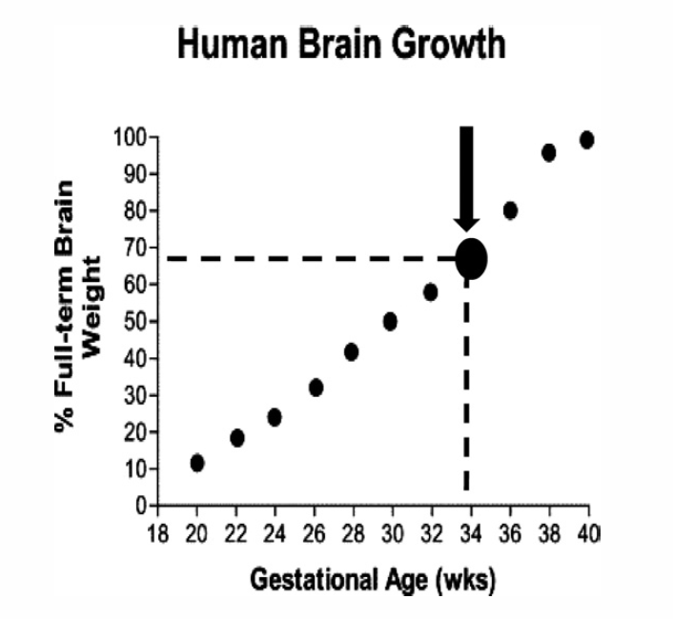
Late Preterm… Neurodevelopment
Kinney HC. The near-term (late preterm) human brain and risk for periventricular leukomalacia: a review. Semin Perinatol 2006; 30: 81 – 8.

Slide 49
Term
Early Term
Late Preterm
“Moderate” Preterm
http://www.secretsofbabybehavior.com/2013/10/in-news-full-term-pregnancy-is-now.html
http://www.newkidscenter.com/Babies-Born-at-37-Weeks.html
https://www.verywell.com/health-concerns-of-the-late-preterm-infant-2748610
http://www.marketwire.com/library/MwGo/2014/11/5/11G025552/Images/2014_Premature_Baby_Photo_Copyright_March_of_Dimes-767396815372.JPG

Slide 50
Multidisciplinary Guidelines for the Care of Late Preterm Infants
A Collaborative Project Facilitated by National Perinatal Association
http://nationalperinatal.org/Resources/LatePretermGuidelinesNPA.pdf

Slide 51

6
IN-HOSPITAL ASSESSMENT AND CARE
National Perinatal Association
In-Hospital Assessment and Care
Late preterm infants (LPIs), like all other newborns, should have a qualified healthcare provider assigned to their care during the immediate postpartum recovery period following birth.⁷ Late preterm infants may experience delayed or inadequate transition to the extra-uterine environment, so careful consideration of staffing ratios during transition (1–12 hours after birth) for this population of infants is necessary.⁸ Because of their increased vulnerabilities, LPIs require continued close monitoring throughout the first 24 hours after birth. Whenever possible, mother and infant should remain together, rooming in 24 hours a day. Frequent, prolonged, skin-to-skin contact should be encouraged to promote optimal physiological stability. All LPIs are at risk for morbidities severe enough to require transition to a higher level of care. If a LPI is transitioned to a higher level of care, special attention should be paid to preparing the mother for going home without her newborn, and she
should be monitored closely for signs of postpartum depression and post-traumatic stress disorder in the postpartum period.
*When communicating with families and providing education as listed in the Family Education column, concepts should be shared in a manner appropriate for the needs of the family including those whose first language is not English.
 | HEALTHCARE TEAM | FAMILY EDUCATION*
STABILITY
Initial Assessment References: 2, 7, 9, 10, 11, 12, 13, 14, 15 | Establish gestational age (GA) prior to delivery, if possible. Keep warm and dry, and stimulate per Neonatal Resuscitation Protocol (NRP) guidelines. Place stable infants skin to skin with mother as soon as possible after delivery and cover with a warm blanket. Do initial assessment and Apgar scores during infant’s skin-to-skin contact with mother if infant remains stable. After initial stabilization, assess newborn q 30 min until condition has been stable for 2 h, then q 4 h for first 24 h, then q shift until transition/discharge. » Assess respiratory rate (RR), type of respirations, and work of breathing. » Assess heart rate (HR) and rhythm, presence of murmur, distal pulses, and perfusion. » Assess axillary temperature. » Assess tone and activity. » Assess cord stump. Support uninterrupted skin-to-skin contact by delaying Vitamin K, eye care, and foot and hand prints until after the first breastfeeding or until 1–2 h after birth (Vitamin K and eye prophylaxis can be delayed up to maximum time allowed by hospital protocol if there are no specific risk factors.) Obtain weight, length, and head circumference after first breastfeeding unless needed to adjust care. » Plot measurements on appropriate preterm growth curve. » Determine if Small for Gestational Age (SGA), Appropriate for Gestational Age (AGA), or Large for Gestational Age (LGA). Assess with New Ballard Score within 12 h of birth to confirm GA. Identify maternal risk factors that can affect infant’s initial stability (e.g., diabetes, medications, or illicit drugs). | Communicate risks of late preterm birth (prior to delivery, if possible), explaining that immature organ systems and brain of LPI may lead to complications in the immediate postpartum period (and beyond) that will require close monitoring, including: » Respiratory distress » Hypothermia » Sepsis » Hypoglycemia » Feeding difficulties and dehydration » Hyperbilirubinemia » Developmental, learning, and behavioral challenges Stress importance of immediate postpartum skin-to-skin contact with mother to: » Stabilize infant and support optimal transition after birth » Promote physiological stability in HR, RR, oxygen saturation, temperature, and glucose levels » Facilitate infant’s first breastfeeding

Slide 52
National Perinatal Association
IN-HOSPITAL ASSESSMENT AND CARE
7
 | HEALTHCARE TEAM | FAMILY EDUCATION*
STABILITY (continued)
Reducing Risks of Respiratory Distress References: 2, 7, 13, 14 | Monitor infant’s RR and work of breathing closely by visual inspection during first hour after birth. Maintain skin-to-skin contact if stable to decrease infant stress, optimize respiration and oxygen saturations, and protect from hypothermia-induced apnea. If signs of respiratory distress are present and persist, evaluate with pulse oximeter, stabilize infant, and consult with next level perinatal care provider about transferring infant to higher level of care. | Explain LPI’s increased risk for respiratory distress and apnea, including: » Immature lung development » Decreased surfactant level » Immature control of breathing » Decreased airway muscle tone leading to decreased ability to protect airway Teach how to recognize signs of respiratory distress and apnea and when to alert healthcare provider for immediate evaluation of infant.
Reducing Risks of Hypothermia References: 2, 7, 9, 14, 16 | Maintain neutral thermal environment. » Dry infant gently after birth. » Continue skin-to-skin care with parent whenever possible. » Cover infant’s back with warmed blanket. » Keep hat on infant when not in skin-to-skin contact. » Use a pre-warmed blanket during weighing. » Keep infant’s bed away from air vents and drafts. Prevent heat loss when skin-to-skin care is not an option or is ineffective in maintaining infant’s temperature. » Swaddle with double wrap. » Increase ambient temperature. » Use radiant warmer or incubator. » Assess axillary temperature to ensure 97.7–99.5°F (36.5–37.5°C) q 30 min × 1 h, then q 4 h for first 24 h, then q shift until transition/discharge. Postpone bath until thermal, respiratory, and cardiovascular stability is well established (typically 2–12 h after birth). » Consider partial rather than whole-body bathing. » Dry infant immediately after bath and cover infant’s head with dry hat. » Place infant in skin-to-skin contact with mother, if possible, for optimal warming. If temperature instability occurs, take actions to stabilize. If instability persists, consult with next-level perinatal care provider about transferring infant to higher level of care. | Explain LPI’s increased risk for hypothermia: » Decreased brown fat (thermogenesis) and white fat (insulation) » Increased heat loss due to higher surface-area-to-mass ratio Teach importance of skin-to-skin contact in keeping infant warm. Stress importance of adequate clothing when not in skin-to-skin contact. Teach how to take infant’s temperature accurately.
Reducing Risks of Sepsis References: 17, 18, 19 | Identify maternal and neonatal risk factors: » Maternal Group B Strep (GBS)-positive or unknown status with inadequate antenatal antibiotic prophylaxis » Chorioamnionitis/maternal fever >100.4°F (38.0°C) » Maternal cold or flu-like symptoms » Prolonged (≥18 h) rupture of membranes » Fetal instability during labor or delivery (continued to next page) | Explain LPI’s increased risk for sepsis: » Immature immune system » Additional risk factors, if present Teach ways to reduce illness. » Wash hands, limit visitors, avoid crowds, protect against contact with sick people. » Breastfeed for as long as possible during the first year after birth or longer. (continued to next page)

Slide 53
8
IN-HOSPITAL ASSESSMENT AND CARE
National Perinatal Association
 | HEALTHCARE TEAM | FAMILY EDUCATION*
STABILITY (continued)
Reducing Risks of Sepsis (continued) References: 17, 18, 19 | Assess and monitor for signs of infection: » Respiratory distress, apnea » Temperature instability » Glucose instability, jitteriness » Pale, mottled, or cyanotic color » Lethargy » Feeding problems » Abdominal distension, vomiting If signs of sepsis occur, stabilize infant, initiate septic workup (CBC, blood culture), and start antibiotics. Consult with next level perinatal care provider about transferring infant to higher level of care. | Teach how to recognize early signs of infection. Inform when to alert healthcare provider for immediate evaluation of infant.
Reducing Risks of Hypoglycemia References: 7, 12, 20, 21 | Review the antepartum/intrapartum history (as described by the Association of Women’s Health, Obstetric, and Neonatal Nurses (AWHONN) Assessment and Care of the Late Preterm Infant Evidence-Based Clinical Practice Guidelines) for conditions that increase the risk of hypoglycemia. » Maternal conditions: Gestational or pre-existing diabetes mellitus Pregnancy-induced hypertension Maternal obesity Tocolytic use for preterm labor Late antepartum/intrapartum administration of IV glucose Difficult/prolonged delivery Nonreassuring fetal heart rate pattern » Neonatal conditions: Prematurity Intrauterine growth restriction Twin gestation 5-minute Apgar score <7 Hypothermia/temperature instability Sepsis Respiratory distress Polycythemia-hyperviscosity Follow American Academy of Pediatrics (AAP) 2011 guidelines for postnatal glucose homeostasis or established hospital protocol for glucose monitoring of at-risk infants (all LPIs); serum glucose nadir occurs 1–2 h after birth. Monitor infant for symptoms of hypoglycemia. Facilitate feeding at breast during first hour after birth if mother and infant are stable. Monitor to ensure frequent ongoing feedings on demand, at least 10–12 breastfeedings or 8–10 formula feedings per day. Provide intervention if required: » Offer feeding (at breast if breastfeeding). » Recheck glucose 1 h after feeding. » If glucose is still low or infant is unable to adequately feed, provide IV glucose and consult with next level perinatal care provider about transferring infant to higher level of care. | Explain LPI’s increased risk for hypoglycemia: » Low glycogen stores » Immature metabolic pathways to make glucose Explain any additional risk factors for hypoglycemia that may be present. Stress importance of feeding infant frequently, at least 10–12 breastfeedings or 8–10 formula feedings per day. Teach how to recognize symptoms of hypoglycemia and when to alert healthcare provider for immediate evaluation of infant.

Slide 54
National Perinatal Association
IN-HOSPITAL ASSESSMENT AND CARE
9
 | HEALTHCARE TEAM | FAMILY EDUCATION*
STABILITY (continued)
Reducing Risks of Feeding Difficulties References: 7, 12, 22, 23 | Identify maternal risk factors that may affect successful breastfeeding: » Multiple gestation » Diabetes » Pregnancy-induced hypertension » Chorioamnionitis » Cesarean delivery Provide assistance as needed to ensure adequate feeding frequency, at least 10–12 breastfeedings or 8–10 formula feedings per day. Maintain nursing staff lactation competencies consistent with scope of practice and responsibilities. Provide a dedicated lactation consultant, ideally an International Board Certified Lactation Consultant (IBCLC), whenever possible. Provide (or refer to) a feeding specialist (occupational or physical therapist or speech/language pathologist) to evaluate infants with persistent feeding difficulties. Adopt the Baby Friendly Hospital Initiative’s Ten Steps to Successful Breastfeeding whenever possible (www.babyfriendlyusa.org/eng/10steps.html). | Explain LPI’s increased risk for inadequate feeding: » Immature suck/swallow/breathe coordination » Inadequate breastmilk transfer due to low muscle tone, ineffective latch, and decreased stamina » Low milk supply due to inadequate breast emptying Stress the value to mother and baby of exclusive breastmilk feeding. » Explain the value of colostrum in providing immune protection and nutrition. » Reassure mothers that small amounts of colostrum are usually adequate in the first few days if baby is feeding frequently enough. Teach how to recognize early feeding cues: » Opening eyes » Moving head back and forth » Opening mouth, tongue thrusting, rooting, or sucking on hands/fingers » Crying (a late hunger cue often leading to difficulty with latch due to infant frustration) Explain the probable need to awaken infant for feeds due to LPI’s immature brain and increased sleepiness. » Infant will transition to full cue-based feeds when closer to term gestational age. Encourage mothers to ask for assistance as needed with breastfeeding or formula feeding.
First Breastfeeding References: 7, 12, 24 | Assess mother’s desire to breastfeed as well as her knowledge and level of experience. Facilitate immediate, uninterrupted, and extended skin-to-skin contact for stable infants until after the first breastfeeding (usually within first 1–2 h). | Remind mother that babies are born to breastfeed. » Review benefits of breastfeeding for baby: decreased risk of infection, diarrheal illness, Sudden Infant Death Syndrome (SIDS), and obesity. » Review benefits for mother: decreased risk of breast cancer, ovarian cancer, and osteoporosis. » Review risks of formula feeding, e.g., increased risk of infection due to increased gastric pH and change in gut flora, risk of cow protein allergy, increased risk of SIDS (www.health-e-learning.com/articles/JustOneBottle.pdf). Explain reasons for formula use if formula is medically indicated. Explain the importance of early and prolonged skin-to-skin contact: » Promote optimal physiological stability » Facilitate the first breastfeeding

Slide 55
10
IN-HOSPITAL ASSESSMENT AND CARE
National Perinatal Association
 | HEALTHCARE TEAM | FAMILY EDUCATION*
STABILITY (continued)
Continued Breastfeeding References: 25, 26 | Monitor and document breastfeeding frequency. A healthcare professional with appropriate education and experience in lactation support, such as a RN, midwife and/or certified lactation consultant, should assess breastfeeding at least twice per day by evaluating: » Coordination of suck, swallow, and breathing » Mother’s breastfeeding position and comfort » Baby’s latch and milk transfer » Mother’s questions regarding breastfeeding Consider use of ultrathin silicone nipple shield if infant has ineffective latch or milk transfer. » Use of shield requires close follow-up by knowledgeable healthcare professional. Assess mother’s level of fatigue and coping. Refer mother to a qualified lactation specialist if feeding difficulties persist. | Provide written and verbal information about breastfeeding and ensure mother’s understanding. Stress the importance of frequent breastfeedings, at least 10–12 times every 24 h, waking baby if necessary, and encourage recognition of and response to early feeding cues. Educate about the size of a newborn’s stomach and the adequacy of frequent, small-volume feedings of colostrum. » Use the phrase “when your milk supply increases” rather than “when your milk comes in” to avoid implying that no milk is present during the colostrum phase. Stress the value of exclusive breastfeeding. Encourage mother to ask for assistance if needed.
Monitoring Breastfeeding Success References: 25 | Monitor weight daily, ideally when the baby is unclothed (taking care to maintain a neutral thermal environment). » Weight loss of more than 3% per day or 7% by day 3 merits further evaluation and close monitoring. Document voiding and stool patterns. | Explain importance of tracking voids and stools to determine adequate feeding intake: » 3 voids and 3 stools by day 3 » 4 voids and 4 stools by day 4 » 6 voids and 4 stools by day 6 and thereafter
Supplementation References: 12, 25 | Supplement feeds only if medically indicated. Maternal antenatal IV fluids may lead to infant diuresis in the first 24 h, increasing infant’s urine output and apparent weight loss and should be taken into consideration when evaluating the need for supplementation. If indicated, supplement with (in order of preference) expressed breastmilk, donor human milk, hydrolyzed formula, or formula. Supplement using one of the following: » Feeding tube at breast » Cup feeding » Finger feeding » Bottle feeding Supplement no more than recommended volumes (if breastfeeding is inadequate): » 2–10 mL per feed (first 24 h) » 5–15 mL per feed (24–48 h) » 15–30 mL per feed (48–72 h) » 30–60 mL per feed (72–96 h) Evaluate continued need for supplementation with daily feeding plan. Evaluate mother’s understanding of feeding plan. | Explain reasons for supplementing breastfeeding if indicated. Explain options for providing supplementation, methods of delivery, and volumes to be given. Stress value of exclusive breastmilk feeding if possible and risks of introducing formula. Explain feeding plan. » Explain that supplementation may be needed until the baby appears to be growing adequately but will likely be discontinued when baby matures and adequate growth is ensured.

Slide 56
National Perinatal Association
IN-HOSPITAL ASSESSMENT AND CARE
11
 | HEALTHCARE TEAM | FAMILY EDUCATION*
STABILITY (continued)
Breast Pumping References: 27 | Provide hospital-grade electric breast pump if pumping is needed. Assist with milk expression as soon as possible (ideally no later than 6 h after birth) if mother and infant are separated. Evaluate milk transfer and help mother hand express or pump after each feeding if milk transfer during breastfeeding is inadequate. Refer mother to a qualified lactation specialist if she has difficulty expressing milk or using breast pump. | Explain the importance of early and frequent milk expression if one of the following is present: » Mother and infant are separated » Breastfeeding is inadequate due to infant’s prematurity or illness Address the importance of reassuring/informing the mother that despite having to initially use a breast pump, she can go on to successfully breastfeed. Teach techniques of milk expression: » Hand expression » Mechanical milk pump use » Hands-on pumping Explain the importance of complete breast emptying at least 10–12 times per day to: » Reduce Feedback Inhibitor of Lactation (FIL) » Ensure adequate milk supply Teach proper handling and storage of expressed milk.
Reducing Risks of Hyperbilirubinemia References: 2, 7, 20, 28, 29, 30, 31, 32, 33, 119, 120 | Identify known maternal/infant/family risk factors that add to increased risk of LPI. Assess adequacy of feeding (especially breastfeeding), voiding, and stooling. Evaluate for visible jaundice within first 24 h. » If present, obtain either transcutaneous (TcB) or serum (TSB) bilirubin level. Obtain TcB or TSB at 24 h after birth or at the time of metabolic screening for all infants regardless of presence or absence of visual jaundice (visual assessment alone is not reliable). Plot bilirubin levels on hour-specific Bhutani Nomogram to determine risk category and intervention threshold(s) for infants >35 weeks GA. For infants <35 weeks GA, consult next level perinatal care provider. Obtain repeat bilirubin level prior to transition/discharge to determine rate of rise. If rate of rise is >0.2 mg /dL/h, consider initiating phototherapy. If bilirubin levels checked prior to transition/discharge are higher than threshold for age in hours, initiate phototherapy. » Provide phototherapy in mother’s room, if possible. » Monitor repeat bilirubin levels per hospital protocol. » Transfer to higher level of care if infant does not respond to phototherapy in expected manner. Plan for repeat bilirubin testing within 24–48 h if indicated for infants transitioned/discharged prior to 72 h of age. Additional testing may be needed to coincide with peak bilirubin levels which may occur on days 5-7 in LPIs. | Explain LPI’s increased risk for hyperbilirubinemia: » Delay in bilirubin metabolism and excretion » Peak bilirubin levels at days 5–7 after birth » Twice as likely to have significantly high bilirubin levels and more susceptible to bilirubin toxicity Provide written and verbal information about jaundice, risks of kernicterus, and possible need for phototherapy to treat hyperbilirubinemia. Teach how to recognize signs and symptoms of hyperbilirubinemia and when to alert healthcare provider for immediate evaluation of infant. Stress importance of adequate feeding to minimize the risk of dehydration and hyperbilirubinemia. Stress importance of follow-up for all LPIs.

Slide 57
12
IN-HOSPITAL ASSESSMENT AND CARE
National Perinatal Association
 | HEALTHCARE TEAM | FAMILY EDUCATION*
STABILITY (continued)
Optimizing Neurologic Development References: 34 | Assess parents’ understanding of LPI brain immaturity and implications for apnea risks, feeding and sleeping behaviors, tone, and development. | Explain immaturity of LPI’s brain and central nervous system (CNS). » Fetal brain cortical volume increases by 50% between 34 and 40 weeks GA, with great increase in surface area. Review implications of immature brain for apnea risks, feeding and sleeping behaviors, tone, and development, including: » Apnea of prematurity and periodic breathing » Poor coordination of suck/swallow/breathe and need for pacing if bottle feeding » Increased sleep needs and need to wake for feeds » Decreased muscle tone and need for positioning support for airway and feeding/swallowing
SCREENING
Newborn Screening References: 55, 56, 73, 74, 75 | Ensure familiarity with requirements of individual state’s newborn screening mandates. (www2.aap.org/healthtopics/newbornscreening.cfm) Document date and time of state-required newborn screening. » Screening should be done 24 h after feeding is initiated. » Document plan to repeat test if screening performed earlier. » Document results, if available. Report abnormal results or plans for repeat testing to primary care provider. » Document that intended recipient received information sent. | Explain reasons for newborn screening. Stress importance of asking primary care provider about results of newborn screening. Stress importance of any follow-up that is indicated: » Date, time, and location of follow-up appointment
Hearing References: 2 | Perform hearing screen prior to transition/discharge. Document hearing screening date and results. Make referral to audiology service if indicated. | Explain reasons for hearing screening. Reinforce understanding of hearing screening procedure. Stress importance of any follow-up that is indicated: » Date, time, and location of follow-up appointment Explain that screening does not always diagnose a hearing deficit and that the need for follow-up does not always mean that the infant is impaired.
Anomalies References: 93 | Evaluate infant for congenital anomalies. Consider pulse oximetry screening for congenital heart defects per hospital protocol. | Explain any physical or internal anomalies found. Stress importance of any follow-up that is indicated. » Date, time, and location of follow-up appointment
Maternal Screening References: 36, 37, 38, 39, 40, 41, 42 | Review maternal blood type. Review prenatal lab results and risk factors. » Be aware of Center for Disease Control and Prevention (CDC) recommendations for HIV screening and treatment. Review ingestion of illicit and prescription drugs or other substances during pregnancy and refer mother to drug or alcohol rehabilitation program, if indicated. (continued to next page) | Provide referrals to smoking cessation, drug or alcohol treatment, psychiatric, or support services, if indicated. Explain risks of secondhand smoke exposure. » Stress importance of providing a smoke-free environment for all infants and children, especially those born prematurely. (continued to next page)

Slide 58
National Perinatal Association
IN-HOSPITAL ASSESSMENT AND CARE
13
 | HEALTHCARE TEAM | FAMILY EDUCATION*
SCREENING (continued)
Maternal Screening (continued) References: 36, 37, 38, 39, 40, 41, 42 | Review use of prescription or herbal medications or supplements of concern, if identified. Review smoking history (present or past use). » Refer family members who smoke to smoking cessation program. » Encourage mothers who quit smoking during or just prior to pregnancy to avoid relapse (high risk during the postpartum period). Screen for psychiatric illness or perinatal mood disorders (including postpartum depression and post-traumatic stress disorder). » Parents separated from the infant at birth (e.g., due to cesarean delivery or NICU admission) are at higher risk for perinatal mood disorders. » Mothers of infants born prematurely are at increased risk for mood disorders in the first 6 months postpartum (three times higher than mothers of term infants). » Make referrals for treatment if indicated. Evaluate mother’s understanding of any referrals made. | » Secondhand smoke exposure is associated with apnea, SIDS, behavior disorders, hyperactivity, oppositional defiant disorder, sleep abnormalities, and upper respiratory infections. Explain risks and benefits of prescription and herbal medications and supplements, if indicated. » Where medications are indicated, encourage use of medications compatible with breastfeeding, if possible. Reference LactMed at http://toxnet.nlm.nih.gov/cgi-bin/ sis/htmlgen?LACT. Provide information about the signs and symptoms of postpartum depression and post-traumatic stress disorder, and encourage parents to seek help if needed.
SAFETY
In-Hospital Safety References: 7 | Model proper hand hygiene when handling baby or feeding equipment. Model proper equipment, positioning, and monitoring of the newborn for bathing, diapering, and routine care. Model safe sleeping practices when placing baby in bed. | Teach importance of handwashing before handling baby or feeding equipment. Teach proper use of: » Bulb syringe to suction nares, if needed » Thermometer to take auxiliary temperature Teach about safe bathing procedures, bath temperature, and maintaining a neutral thermal environment during bathing and care. Stress importance of placing babies on their backs to sleep in hospital and at home.
SUPPORT
Staff Support | Assess adequacy of staff support for physicians, midwives, nurses, lactation and feeding specialists, social workers, occupational therapists, physical therapists, case managers, transition/discharge planners, and home health services, including: » Availability of staff to support level of services offered » Staffing ratios » Competencies and skills » Availability of referral services | Explain roles of multidisciplinary staff. Provide case manager evaluation to initiate transition/ discharge planning process.
Family Support | Assess adequacy of family support including: » Partner’s presence, involvement, and coping » Grandparents and/or friends Provide social worker evaluation of special needs as indicated. | Provide contact information for support resources as indicated. Reinforce potential challenges of caring for LPI at home and encourage use of any needed resources.

Slide 59

14
TRANSITION TO OUTPATIENT CARE
National Perinatal Association
Transition to Outpatient Care
Transition of care involves a set of actions designed to ensure continuity of care from inpatient to outpatient healthcare providers. Planning for transition of care should begin at the time of admission and requires a coordinated, multidisciplinary approach. The term “transition of care” is preferred to the term “discharge planning” in order to emphasize the active and dynamic nature of this process.
Optimal transition of care relies on accountable providers who ensure that accurate and complete information is successfully communicated and documented. The accountable sending provider sends the appropriate documents to the receiving provider in a timely manner, verifies the receipt of the information by the intended receiving provider, clarifies the receiving provider’s understanding of the information sent, documents the transaction, and resends
information if not received by the intended recipient. The accountable receiving provider acknowledges having received the documents and asks any questions for clarification of the information contained therein, uses the information, and takes actions as indicated, ensuring continuity of the plan of care or services.⁴³
*When communicating with families and providing education as listed in the Family Education column, concepts should be shared in a manner appropriate for the needs of the family including those whose first language is not English.
 | HEALTHCARE TEAM | FAMILY EDUCATION*
STABILITY
General References: 2, 44 | Delay transition/discharge until the late preterm infant (LPI) is at least 48 h of age. Document infant stability for at least 24 h: » Successful feeding for at least 24 h without excessive weight loss » Stable vital signs for at least 12 h either while in skin-to-skin care or in an open crib with appropriate clothing » No significant emesis » Adequate voiding » At least 1 stool/24 h » No signs of sepsis | Reinforce understanding of LPI’s increased risks compared with term infant: » Respiratory distress » Hypothermia » Sepsis » Hypoglycemia » Inadequate feeding and dehydration » Hyperbilirubinemia » Immature brain

Slide 60
National Perinatal Association
TRANSITION TO OUTPATIENT CARE
15
 | HEALTHCARE TEAM | FAMILY EDUCATION*
STABILITY (continued)
Feeding References: 2, 18, 23, 25, 50, 51, 52, 53, 54, 55, 56, 57, 58, 59, 60, 61, 62 | For breastfeeding infants: » Provide formal assessment by breastfeeding specialist at least twice before transition/discharge. » Provide prescription for breast pump if indicated. For formula feeding infants: » Provide formal assessment by feeding specialist if intake is inadequate or weight loss is abnormal. For all infants: » Document adequate infant feeding competency for at least 24 h. » Evaluate parents’ understanding of home feeding plan. | Provide written and verbal infant feeding information: » Recognizing early hunger cues » Breastfeeding frequency and technique » Supplemental feeding only if indicated (review indications, such as signs of dehydration) » Breast pumping, hand expression, and milk storage » Formula mixing if indicated » Assessing adequate intake » Knowing how many wet diapers and stools to expect (3 voids and 3 stools by day 3, 4 voids and 4 stools by day 4, 6 voids and 4 stools by day 6 and thereafter) » Understanding significance of decreased urine and stool output Teach how to give Vitamin D drops; explain that Vitamin D deficiency is widespread in pregnant and breastfeeding mothers, leading to increased risk of rickets in infants. Teach how to give supplemental iron; explain that lack of iron transfer from mother (normally occurs in the third trimester) leads to increased risk of infant anemia. Provide detailed home feeding plan. Provide contact information for community breastfeeding support.
Hyperbilirubinemia References: 31, 63, 64, 65, 66, 67, 68, 69 | Document maternal and infant risk factors. Document 24-h bilirubin level and repeat level prior to transition/discharge. Document follow-up plan for bilirubin check within 24–48 h of transition/discharge. Additional testing may be needed to coincide with peak bilirubin levels which may occur on days 5-7 in LPIs. | Teach how to recognize signs and symptoms of worsening hyperbilirubinemia: » Deepening yellow skin and eye color (visual assessment alone is not reliable) » Sleepiness and lethargy » Decreased feeding » Increased irritability and high-pitched cry Inform when to call primary care provider. Explain follow-up plan for bilirubin check when indicated.
Circumcision References: 70, 71, 72 | Monitor for at least 2 h after procedure to assess for bleeding. Document parents’ understanding of post-circumcision care. | Explain and demonstrate post-circumcision care. Explain and demonstrate care of intact penis if infant is not circumcised.

Slide 61
16
TRANSITION TO OUTPATIENT CARE
National Perinatal Association
 | HEALTHCARE TEAM | FAMILY EDUCATION*
STABILITY (continued)
Newborn Care | Assess parents’ understanding about general newborn care and issues specific to LPIs. | Provide written and verbal education about general newborn care and issues specific to LPIs: » Bathing and diaper changing » Cleaning and caring for umbilical cord » Value of skin-to-skin holding » Need for increased clothing to keep warm when not in skin-to-skin contact
Developmental Care References: 45, 46, 47, 48, 49 | Assess parents’ understanding about developmental care of preterm/LPI. Model recognition of and sensitivity to infant’s behavioral cues. | Explain the differences between corrected gestational age (GA) and chronological age. » Developmental milestone expectations are based on corrected GA rather than chronological age. Stress importance of close monitoring of corrected GA developmental milestones by primary care provider. Provide written and verbal education about developmental care of preterms (including LPI): » Need for protection from overstimulation » Need for positional support if low muscle tone » Normal sleep/wake cycles and need for extra sleep Teach signs (behavioral cues) of stress and overstimulation, including: » Limb extension, finger or toe splaying » Twitches or startles » Arching or limpness » Facial grimace or scowl » Abrupt color changes » Irregular breathing » Gaze aversion » Crying Teach signs of relaxation and readiness for engagement, including: » Limb flexion, relaxed fingers and toes » Smooth movements » Rounded, flexed trunk and back » Relaxed face and mouth » Normal color » Regular breathing » Eyes open and engaged » Quiet-alert state Stress the importance of skin-to-skin holding for optimal brain development.

Slide 62
National Perinatal Association
TRANSITION TO OUTPATIENT CARE
17
 | HEALTHCARE TEAM | FAMILY EDUCATION*
SCREENING
Newborn Screening References: 55, 56, 73, 74, 75 | Ensure familiarity with requirements of individual state’s newborn screening mandates. Document date and time of state-required newborn screening. » Ensure that screening is be done 24 h after feeding is initiated. » Document plan to repeat test if screening performed earlier. » Document results, if available. Report abnormal results or plans for repeat testing to primary care provider. » Document that intended recipient received information sent. | Reinforce reasons for newborn screening. Stress importance of asking primary care provider about results of newborn screening tests. Stress importance of any follow-up that is indicated: » Date, time, and location of follow-up appointment
Hearing References: 2 | Review hearing screen test date and results. Make referral to audiology service if indicated. | Reinforce understanding of hearing screening procedure. Stress importance of any follow-up that is indicated: » Date, time, and location of follow-up appointment Explain that screening does not always diagnose a hearing deficit and that the need for follow-up does not always mean that the infant is impaired.
Anomalies References: 93 | Document any congenital anomalies. Consider pulse oximetry screening for congenital heart defects per hospital protocol. If screen is done, document results. | Explain any physical or internal anomalies found. Stress importance of any follow-up that is indicated: » Date, time, and location of follow-up appointment
Maternal Screening References: 36, 37, 38, 39, 40, 41, 42 | Review maternal blood type, prenatal lab results, and risk factors. Review ingestion of illicit and prescription drugs or other substances during pregnancy and any referrals for drug or alcohol rehabilitation program. Review use of prescription or herbal medications or supplements of concern, if identified. Review smoking history (present or past use) » Refer family members who smoke to smoking cessation program. » Encourage mothers who quit smoking during or just prior to pregnancy to avoid relapse (high risk during the postpartum period). Screen for psychiatric illness or perinatal mood disorders (including postpartum depression and post-traumatic stress disorder). » Parents separated from the infant at birth (e.g., due to cesarean delivery or NICU admission) are at higher risk for perinatal mood disorders. » Mothers of infants born prematurely are at increased risk for mood disorders in the first 6 months postpartum (three times higher than mothers of term infants). » Make referrals for treatment if indicated. Evaluate mother’s understanding of any referrals made. | Provide referrals to smoking cessation, drug or alcohol treatment, psychiatric, or support services, if indicated. Explain risks of secondhand smoke exposure. » Stress importance of providing a smoke-free environment for all infants and children, especially those born prematurely. » Secondhand smoke exposure is associated with apnea, Sudden Infant Death Syndrome (SIDS), behavior disorders, hyperactivity, oppositional defiant disorder, sleep abnormalities, and upper respiratory infections. Explain risks and benefits of prescription and herbal medications and supplements, if indicated. » Where medications are indicated, encourage use of medications compatible with breastfeeding, if possible. Reference LactMed at http://toxnet.nlm.nih.gov/cgi-bin/ sis/htmlgen?LACT. Provide information about the signs and symptoms of postpartum depression and post-traumatic stress disorder and encourage parents to seek help if needed.

Slide 63
18
TRANSITION TO OUTPATIENT CARE
National Perinatal Association
 | HEALTHCARE TEAM | FAMILY EDUCATION*
SCREENING (continued)
Parent-Infant Bonding References: 77 | Assess family, home, and social risk factors that may affect bonding. Assess signs of attachment: » Infant’s ability to demonstrate cues » Parents’ ability to recognize and respond appropriately to infant’s cues | Reinforce parents’ understanding of infant cues. Encourage frequent and prolonged skin-to-skin contact with both parents.
SAFETY
Family Risk Factors References: 41, 57, 76, 77 | Document screening done and referrals made for the following: » Drug or alcohol use in home » Smokers in home » Domestic violence » Mental health issues » Social services involvement Evaluate parent’s understanding of any referrals made. | Provide written and verbal information about available support services, if indicated.
Home Environment | Assess parents’ knowledge of how to make the home environment safe for infants. See Tips and Tools, Safety for Your Child (www.healthychildren.org/English/tips-tools/Pages/default.aspx) Document screening and referrals made for the following: » Adequate housing/shelter » Utilities » Phone » Fire alarms » Transportation | Teach ways to make the home environment safe for infants. Stress importance of adequate shelter for infant. Provide written and verbal information about available support services, if indicated. Review family’s plan for communication with and transportation to primary care provider for infant follow-up visits.
Safe Sleep References: 24, 94, 95, 96, 97, 98, 99 | Document education about safe infant sleep practices provided. See Ages & Stages, A Parent’s Guide to Safe Sleep (www.healthychildren.org/English/ages-stages/baby/sleep/pages/ A-Parents-Guide-to-Safe-Sleep.aspx) | Reinforce the LPI’s increased risk for SIDS. Provide written and verbal information about placing infant on his/her back to sleep and on tummy to play. Explain unsafe sleeping practices. Recommend use of pacifier after first month after birth.
Infection & Immunizations References: 2, 18, 53, 54, 57, 78, 79, 80, 81, 82, 83 | Document education provided. Give hepatitis B vaccine prior to transition/discharge. » If parents defer until 2-month vaccine schedule or defer entirely, document the decision. Give respiratory syncytial virus (RSV) prophylaxis and recommendations for repeat dosing as indicated. See Talking with Parents about Vaccines for Infants (www.cdc.gov/vaccines/spec-grps/hcp/conv-materials.htm#talkpvi) | Review ways to reduce illness. » Wash hands, limit visitors, avoid crowds, protect against contact with sick people. » Breastfeed for as long as possible during the first year after birth or longer. Stress importance of infant immunizations. Stress importance of flu shots and pertussis boosters for family and care providers. Provide written and verbal information about RSV prophylaxis and prevention.

Slide 64
National Perinatal Association
TRANSITION TO OUTPATIENT CARE
19
 | HEALTHCARE TEAM | FAMILY EDUCATION*
SAFETY (continued)
Car Seat Safety References: 84 | Ensure parents have a car seat or assist them in procuring one. Ensure car seat testing is done in the same car seat infant will use after transition/discharge. » A trained professional should teach proper use of car seat. Arrange for a car bed if the infant fails the car seat test. | Instruct parents to bring their own car seat in for testing. Provide written and verbal instruction on proper use of car seat: » Correct way to secure car seat in car » Correct way to secure infant in car seat » Age of transition to front-facing car seat
Shaken Baby Prevention Education References: 117 | Provide shaken baby syndrome information and explanation using visual aids and document viewing prior to transition/discharge. | Provide written and verbal instruction about risks of shaking baby. Teach ways to calm infant. Teach ways to cope with crying infant.
When To Call 911 or Local Emergency Number | Assess parents’ understanding of when to call 911. | Teach how to recognize life-threatening events and when to call 911, including: » Apnea » Choking » Difficulty breathing » Cyanosis Teach CPR.
When To Call Primary Care Provider | Assess parents’ understanding of when to call primary care provider. | Teach how to recognize signs of illness and when to call primary care provider, including: » Lethargy » Fever, hypothermia » Poor skin color » Decreased urine output » Abdominal distension » Vomiting » Bloody stool » Inconsolable infant » Uncertainty about significance of infant’s symptoms

Slide 65
20
TRANSITION TO OUTPATIENT CARE
National Perinatal Association
 | HEALTHCARE TEAM | FAMILY EDUCATION*
SUPPORT
Staff Support | Assess adequacy of staff support for physicians, midwives, nurses, lactation and feeding specialists, social workers, occupational therapists, physical therapists, case managers, transition/discharge planners, and home health services » Availability of staff to support level of services offered » Staffing ratios » Competencies and skills » Availability of referral services | Explain roles of multidisciplinary staff.
Family and Social Support | Evaluate support needs and address barriers to care: » Family / Social support network » Community-based services (e.g., WIC, lactation support, social services) » Home health care referral » Ongoing infant care education Ask parents if they have any questions or concerns that have not already been addressed. Provide a call-back number for general questions that come up after when family is home. | Provide written and verbal information about available resources, if indicated. Reinforce potential challenges of caring for LPI at home and encourage use of needed resources.
TRANSFER OF CARE
Primary Care Provider References: 85, 86 | Identify community primary care provider and document name, address, phone, fax, and email address. Document plan for first follow-up appointment. | Review name, place, time, and purpose of first follow-up appointment. Stress importance of initial and subsequent follow-up appointments.
Discharge Summary & Checklist References: 43, 77 | Complete transition/discharge summary: » Maternal history, prenatal lab results, labor and delivery course » Birth events, Apgar scores, measurements » Hospital course, lab results, procedures, medications » Immunizations given » Feeding history and detailed feeding plan » Growth chart with birth and transition/discharge weights » Follow-up appointments planned Send copy of transition/discharge summary to community primary care provider » Document acknowledgment that the intended recipient received and understood the information sent. » Resend information if not received. Give copy of transition/discharge summary to parents (in person) and evaluate parents’ understanding of content. Evaluate and assist with transportation issue(s), as needed. | Explain content of transition/discharge summary. » Stress importance of bringing transition/discharge summary to all follow-up appointments. Explain infant’s growth curve, immunization record, list of medications, feeding plan, and follow-up. » Ensure parents understanding of information explained. » Ask parents if they have any questions or concerns that have not already been addressed. » Provide a call-back number for general questions that come up after the family is home.

Slide 66

National Perinatal Association
SHORT-TERM FOLLOW-UP CARE
21
Short-Term Follow-Up Care
Late preterm infants (LPIs) should be seen by their community primary care provider within 1–2 days after transition/ discharge from the hospital; the provider should assess the infant’s continued stability, review screening results, ensure ongoing safety, and evaluate the adequacy of support systems. LPIs can appear deceptively vigorous in the first day
or two after birth prior to transition/discharge. It is not unusual for morbidities common to LPIs to first appear a few days after transition/discharge. If not detected and managed early, these can quickly escalate and lead to re-hospitalization, increased family stress, and even permanent disability and death.²
It is especially important that breastfeeding LPIs be seen within a day after transition/discharge because of the feeding challenges so prevalent in this population. Immature feeding patterns, such as uncoordinated suck/swallow/breathe,
ineffective milk transfer, and increased sleepiness because of immature brain/central nervous system (CNS) development, may not be apparent until the mother’s milk supply increases on postpartum days 2–5. Feeding failure, in both breastfed and formula-fed newborns, can be caused by other morbidities more common in LPIs, such as respiratory distress, cold stress, sepsis, hyperbilirubinemia, low muscle tone, and decreased stamina. Congenital heart disease and patent ductus arteriosis, also more common in LPIs, should be considered for any infant with feeding failure.
The community follow-up care provider should have received a copy of the transition/discharge summary from the in- hospital care provider prior to the initial follow-up visit. To guide evaluation, the follow-up care provider should carefully review maternal and infant history, as well as the infant’s hospital course, on the first follow-up visit. Because LPIs have many needs and because it is critically important to assess carefully the issues of continued stability, screening, safety, and support, it may be necessary to schedule extra time for follow-up visits of LPIs. Short-term follow-up care should include weekly assessments until the infant reaches 40 weeks of corrected gestational age (GA) (the infant’s due date) or is clearly thriving.²⁵ More frequent visits may be necessary if weight or bilirubin checks are indicated.
*When communicating with families and providing education as listed in the Family Education column, concepts should be shared in a manner appropriate for the needs of the family including those whose first language is not English.
 | HEALTHCARE TEAM | FAMILY EDUCATION*
STABILITY
Respiratory Distress References: 87 | Assess infant for current signs of respiratory distress. Ask parents if infant has had any history of apnea, cyanosis, or respiratory distress. | Reinforce LPI’s increased risk for apnea and respiratory instability, especially when in car seat and upright devices.

Slide 67
22
SHORT-TERM FOLLOW-UP CARE
National Perinatal Association
 | HEALTHCARE TEAM | FAMILY EDUCATION*
STABILITY (continued)
Sepsis References: 88 | Assess infant for current signs of sepsis. Ask parents about any recent symptoms of sepsis. Ask parents if the infant’s care givers or any of the care givers’ family members have signs of illness. | Reinforce LPI’s increased risk for sepsis and re-hospitalization. Review ways to reduce illness: » Wash hands, limit visitors, avoid crowds, protect against contact with sick people » Breastfeed for as long as possible during the first year after birth or longer Review signs and symptoms of sepsis: » Difficulty breathing or feeding, increased or decreased temperature, decreased energy level Review how to take infant’s temperature. If temperature >100.4°F (38°C), take infant to primary care provider.
Weight Loss References: 2, 25, 89, 90 | Assess weight 1–2 days after hospital transition/discharge using appropriate preterm growth curves and compare with infant’s transition/discharge weight. In addition to weight loss, take into account the number of wet diapers and stools when evaluating adequacy of intake (3 voids and 3 stools by day 3, 4 voids and 4 stools by day 4, 6 voids and 4 stools by day 6 and thereafter) Evaluate feeding practices if weight loss greater than appropriate for age. » Ask mother about any pain with breastfeeding. » Do oral exam and check for abnormalities, such as ankyloglossia, cleft palate, or thrush. » Observe infant feeding (breast or bottle). » Modify feeding and supplementation appropriately. » If unable to observe infant feeding, immediately refer mother to lactation consultant or feeding specialist. » Make appointment for repeat infant weight check. | Reinforce LPI’s increased risk for excessive weight loss. Review normal weight-loss parameters: » No more than 3% per day or total of 10% loss » Regained by 14 days after birth Review and validate understanding of feeding plan. » Explain need for supplementation of breastmilk if infant has excessive weight loss. » Explain need to prevent infant dehydration by ensuring infant has adequate fluid intake. Stress importance of follow-up for weight check: » Date, time, and location of follow-up appointment
Feeding References: 23 | Determine family understanding of post-discharge feeding plan and assess adherence to plan (including iron and Vitamin D supplementation). Assess current feeding practices, including type of milk, length of time feeding, amount taken (if formula fed). Assess urine output, stool color, and frequency and symptoms of gastroesophageal reflux disease (GERD), colic, or oral aversion. Modify feeding and supplementation plan if indicated. » Encourage pumping and supplementing with expressed breastmilk if supplementation is needed for breastfed infants. » Provide prescription for breast pump, if indicated. » Supplement with formula only as last resort. Encourage and support breastfeeding. » Congratulate mother about choosing to breastfeed. » Ask about pain with breastfeeding or any other concerns. » Observe breastfeeding if concerns or pain are described by mother (evaluate for ankyloglossia). » Make immediate referral to lactation consultant if needed. | Reinforce LPI’s increased risk for failure to thrive and re-hospitalization: » Immature feeding skills » Ineffective sucking/swallowing » Uncoordinated suck/swallow/breathe; may not be noticed until after increase in breastmilk supply » Longer sleep cycles; may need to wake for feedings Review normal feeding frequencies: » 10–12 times/d for breastfeeding infants » 8–10 times/d for formula-fed infants Review normal urine output and stool frequency and color as indicators of adequate feeding intake (and lack of normal urine/stool as signs of dehydration): » At least 6 wet diapers/24 h by day 5 after birth » At least 1 yellow seedy stool daily by day 4 after birth Review benefits of breastfeeding/breastmilk for all infants and their mothers. Provide contact information for lactation specialist and community breastfeeding support.

Slide 68
National Perinatal Association
SHORT-TERM FOLLOW-UP CARE
23
 | HEALTHCARE TEAM | FAMILY EDUCATION*
STABILITY (continued)
Hyperbilirubinemia References: 28, 56, 64, 66, 91 | Assess infant for jaundice 1–2 d after transition/discharge. Assess for any feeding difficulties or dehydration, especially if infant is breastfeeding exclusively. Follow-up maternal and infant blood type and Direct Coombs tests if available. Review 24-hour bilirubin level and repeated evaluation done prior to transition/discharge. If concerned about elevated bilirubin, obtain Total Serum Bilirubin (TSB) or Transcutaneous Bilirubin (TcB) level (visual assessment is not reliable). Arrange for repeat bilirubin check, home phototherapy with follow-up, or hospital admission, as indicated. | Reinforce LPI’s increased risk for jaundice requiring hospitalization and/or phototherapy. » Stress increased risk for kernicterus Review delayed peak in bilirubin levels for LPIs (at days 5–7 after birth) and possible need for additional testing to coincide with this peak. Review signs and symptoms of worsening hyperbilirubinemia: » Deepening yellow skin and eye color (visual assessment alone is not reliable) » Sleepiness and lethargy » Decreased feeding » Increased irritability with high-pitched cry Stress critical importance of follow-up with primary care provider if infant has signs or symptoms of worsening jaundice. Explain that breastfed infants are at higher risk for jaundice and need close monitoring of feedings to reduce risk of hyperbilirubinemia. » Infant may need supplementation. » Expressed breastmilk is ideal first choice. » If mother’s own milk or donor human milk is not available, cow’s-milk-based formula may be used for supplementation.
Circumcision | Assess circumcision site for healing. | Review normal course of healing and care of circumcised penis. Review care of intact penis if infant is not circumcised.
Newborn Care References: 2, 7 | Evaluate appropriateness of infant’s clothing for warmth, general cleanliness. Evaluate evidence for proper care of umbilicus and diaper area. Assess parents’ knowledge and skill regarding routine newborn care. | Review parents’ understanding of all routine newborn care procedures, e.g., taking temperatures, appropriate clothing, bathing, and diapering.

Slide 69
24
SHORT-TERM FOLLOW-UP CARE
National Perinatal Association
 | HEALTHCARE TEAM | FAMILY EDUCATION*
STABILITY (continued)
Developmental Care References: 45, 46, 47, 48, 49 | Evaluate parents’ level of understanding about the special developmental care needs of the LPI. | Explain the differences between corrected gestational age (GA) and chronological age. » Developmental milestone expectations are based on corrected GA rather than chronological age. Stress importance of close monitoring of developmental milestones by primary care provider. Provide written and verbal education about developmental care of preterms (including LPI): » Need for protection from overstimulation » Need for positional support if low muscle tone » Normal sleep/wake cycles and need for extra sleep Teach signs (behavioral cues) of stress and overstimulation, including: » Limb extension, finger or toe splaying » Twitches or startles » Arching or limpness » Facial grimace or scowl » Abrupt color changes » Irregular breathing » Gaze aversion » Crying Teach signs of relaxation and readiness for engagement, including: » Limb flexion, relaxed fingers and toes » Smooth movements » Rounded, flexed trunk and back » Relaxed face and mouth » Normal color » Regular breathing » Eyes open and engaged » Quiet-alert state Stress the importance of skin-to-skin holding for optimal brain development.

Slide 70
National Perinatal Association
SHORT-TERM FOLLOW-UP CARE
25
 | HEALTHCARE TEAM | FAMILY EDUCATION*
SCREENING
Newborn Screening References: 55, 56, 73, 74, 75 | Ensure familiarity with requirements of individual state’s newborn screening mandates. Follow-up on state-specific newborn screening mandates as indicated. Make referral or follow-up plan, if indicated. | Respond to parents’ questions about newborn screening results. Explain any abnormalities found during newborn screening results. Stress importance of any follow-up that is indicated: » Date, time, location of follow-up appointment
Hearing References: 92 | Within the first 3 months after birth, order brainstem auditory evoked response (BAER) for any infant with Total Serum Bilirubin (TSB) ≥20 mg/dL. | Explain reason for BAER if ordered: » Vulnerability of hearing to high bilirubin levels » Importance of normal hearing for speech development Stress importance of following-up on any hearing screening ordered: » Date, time, and location of follow-up appointment
Anomalies References: 93 | Identify physical or internal anomalies requiring further assessment or follow-up care. Assess parents’ understanding of anomalies if present. Make follow-up plan for family. | Respond to any questions about infant’s anomalies. Stress importance of any follow-up that is indicated: » Date, time and location of follow-up appointment
Maternal Screening References: 36, 37, 38, 39, 40, 41, 42 | Review maternal prenatal lab results and risk factors. Review ingestion of illicit and prescription drugs or other substances during pregnancy and referrals to drug or alcohol rehabilitation program. Review use of prescription or herbal medications or supplements of concern, if identified. Review smoking history (present or past use). » Refer family members who smoke to smoking cessation program. » Encourage mothers who quit smoking during or just prior to pregnancy to avoid relapse (high risk during the postpartum period). Screen for psychiatric illness or perinatal mood disorders (including postpartum depression and post-traumatic stress disorder). » Parents separated from the infant at birth (e.g., due to cesarean delivery or NICU admission) are at higher risk for perinatal mood disorders. » Mothers of infants born prematurely are at increased risk for mood disorders in the first 6 months postpartum (three times higher than mothers of term infants). » Make referrals for treatment if indicated. Evaluate mother’s understanding of any referrals made. | Provide referrals to smoking cessation, drug or alcohol treatment, psychiatric, or support services, if indicated. Explain risks of secondhand smoke exposure. » Stress importance of providing a smoke-free environment for all infants and children, especially those born prematurely. » Secondhand smoke exposure is associated with apnea, Sudden Infant Death Syndrome (SIDS), behavior disorders, hyperactivity, oppositional defiant disorder, sleep abnormalities, upper respiratory infections. Explain risks and benefits of prescription and herbal medications and supplements, if indicated. » Where medications are indicated, encourage use of medications compatible with breastfeeding, if possible. Reference LactMed at http:// toxnet.nlm.nih.gov/cgi-bin/sis/htmlgen?LACT. Provide information about postpartum depression and post-traumatic stress disorder and encourage parents to seek help if needed. Review increased risk for postpartum mood disorders in mothers of infants born prematurely: » Nearly three times higher risk during first 6 months postpartum
Parent-Infant Bonding References: 77 | Assess family, home, and social risk factors that may affect bonding. Assess maternal health and parents’ ability to cope with challenges of newborn care and monitoring that can affect healthy bonding. Assess signs of bonding and attachment: » Infant’s ability to demonstrate cues » Parents’ ability to recognize and respond appropriately to infant’s cues | Review parents’ understanding of infant cues. Encourage skin-to-skin contact of LPI with both parents. Encourage parents to verbalize feelings about caring for their LPI and challenges they face that may affect healthy bonding and attachment.

Slide 71
26
SHORT-TERM FOLLOW-UP CARE
National Perinatal Association
 | HEALTHCARE TEAM | FAMILY EDUCATION*
SAFETY
Family Risk Factors References: 41, 57, 76, 77 | Assess and address family risk factors and make referrals if needed: » Drug or alcohol use in home » Smokers in home » Domestic violence » Mental health issues » Social services involvement » Provide additional education as needed. Evaluate parents’ understanding of any referrals made. | Provide verbal and written information about where to get professional and community support.
Home Environment | Assess and address parents’ knowledge of how to make the home environment safe for infants. » See Tips and Tools, Safety for Your Child (www.healthychildren.org/English/tips-tools/Pages/default.aspx) » Provide additional education as needed. Document screening and referrals made for the following: » Adequate housing/shelter » Utilities » Phone » Fire alarms » Transportation | Teach ways to make the home environment safe for infants. Stress importance of adequate shelter for infant. Provide written and verbal information about available support services, if indicated. Review family’s plan for communication with and transportation to primary care provider for infant follow-up visits.
Safe Sleep References: 24, 94, 95, 96, 97, 98, 99 | Assess and address parents’ understanding of safe sleep practices. » Provide additional education as needed. | Reinforce LPI’s increased risk for SIDS. Provide written and verbal information about placing infant on his/her back to sleep and on tummy to play. Explain unsafe sleeping practices. Recommend use of pacifier after first month after birth.
Immunizations References: 2, 18, 53, 54, 57, 78, 79, 80, 81, 82, 83 | Assess and address parents’ views and understanding about importance of immunizations for infant and family members. » Provide additional education as needed. | Reinforce importance of immunizations for infant: » Scheduled immunizations as recommended by American Academy of Pediatrics (AAP) » Flu shots during flu season » Respiratory syncytial virus (RSV) prophylaxis as indicated Stress importance of flu shots and pertussis boosters for family and care providers.
Car Seat Safety References: 84 | Determine whether parents have an appropriate car seat and refer for help as needed. » Refer for assistance in obtaining appropriate car seat as needed. Assess and address parents’ understanding of proper use of car seats. » Provide additional education/training in proper car seat use as needed. | Review proper use of car seats: » Correct way to secure car seat in car » Correct way to secure infant in car seat » Age of transition to front-facing car seat

Slide 72
National Perinatal Association
SHORT-TERM FOLLOW-UP CARE
27
 | HEALTHCARE TEAM | FAMILY EDUCATION*
SAFETY (continued)
Shaken Baby Prevention Education References: 117 | Assess and address parents’ understanding of risks of shaking baby. » Provide additional education as needed. Assess and address parents’ knowledge of ways to calm infants and cope with infant crying. » Provide additional education as needed. Assess and address parents’ coping and stress levels as risks for shaken baby syndrome. » Provide additional education as needed. | Review risks of shaking any baby. Review ways to calm crying infants. Review ways to cope with infant crying. Provide information about community or professional resources as needed for support.
When To Call 911 or Local Emergency Number | Assess and address parents’ understanding of when to call 911. » Provide additional education as needed. | Review how to recognize life-threatening events and when to call 911, including: » Apnea » Choking » Difficulty breathing » Cyanosis Review CPR.
When To Call Primary Care Provider | Assess and address parents’ understanding of when to call a primary care provider for urgent evaluation of infant. » Provide additional education as needed. | Teach how to recognize signs of illness and when to call primary care provider, including: » Lethargy » Fever, hypothermia » Poor skin color » Decreased urine output » Abdominal distension » Vomiting » Bloody stool » Inconsolable infant » Ucertainty about significance of infant’s symptoms
SUPPORT
Family and Social Support | Evaluate support needs and address barriers to care: » Family / Social support network » Community-based services (e.g., WIC, lactation support, social services) » Home health care referral » Ongoing infant care education Ask parents if they have any questions or concerns that have not already been addressed. Provide a call-back number for general questions that come up after when family is home. | Provide verbal and written information about where to find support if needed. Reinforce potential challenges of caring for LPI at home and encourage utilization of resources as needed.

Slide 73

28
LONG-TERM FOLLOW-UP CARE
National Perinatal Association
Long-Term Follow-Up Care
There is no recognized endpoint to long-term follow-up care of late preterm infants (LPIs). Because research has documented increased morbidities for LPIs during infancy, childhood, adolescence, and through adulthood, follow-up care must begin at birth and continue, with varying degrees of surveillance and reflecting individual needs, throughout the lifespan.
The importance of establishing a medical home for each LPI cannot be overemphasized. A medical home is necessary to ensure that appropriate screening and assessments are completed, referrals are made, continuity of care is coordinated and implemented by a multidisciplinary team, and duplication of services is avoided. At each follow-up visit the continued stability, screening, safety, and support of LPIs and their families should be assessed.
Ongoing follow-up care should continue to be culturally, developmentally, and age-appropriate, taking into account families’ preferences and ensuring that parents are active participants in making informed decisions about follow-up testing and therapeutic interventions. Communication should occur and education should be provided in ways that are appropriate for families with limited or no English proficiency or health literacy and in ways that are developmentally appropriate for the target audience (e.g., teen parents).
If a LPI was transitioned to a higher level of care during the initial or subsequent hospitalizations, or if the mother and infant were separated at birth,
both mother and father/partner should be monitored closely for signs of postpartum depression and post-traumatic stress disorder during the postpartum period and the first year of the infant’s life. Because optimal infant development is so influenced by the mental health of the infant’s primary caregivers, especially that of the mother, referrals should be made for professional help and community support whenever indicated.^{100, 101, 102, 103}
*When communicating with families and providing education as listed in the Family Education column, concepts should be shared in a manner appropriate for the needs of the family including those whose first language is not English.
 | HEALTHCARE TEAM | FAMILY EDUCATION*
STABILITY
Growth References: 52, 104 | Monitor growth parameters (weight, length, and head circumference) at each well-child visit. Consider need for fortification or supplementation of either breastmilk or formula if infant is failing to thrive per appropriate preterm growth curves. » Assess both volume of intake and also caloric density of feeds when planning fortification or supplementation. » Reassess at each visit to determine continued need for fortification or supplementation to maintain normal growth. » Encourage fortification/supplementation in ways that encourage suckling at the breast, if possible, such as higher calorie transitional formula given at separate feeds from breastfeeding. This is preferable to giving fortified expressed milk in a bottle at each feeding, which discourages feeding at the breast. Recommend introducing solid foods no earlier than 6 months corrected gestational age (GA) and when infant demonstrates developmental readiness. | Assess parents’ knowledge and reinforce importance of good nutrition. Reinforce the health benefits of exclusive breast feeding with appropriate fortification or supplementation if indicated until 6 months of age. » Decreased incidence of gastrointestinal illness » Possible delay in onset of eczema allergies » No decrease in growth Provide verbal and printed information about appropriate introduction of solid foods at 6 months of age. Assess parents’ ability to choose and obtain healthy baby food. Encourage continued breastfeeding until at least 1 year of age or longer in addition to solid food. Reinforce the importance of continuing to monitor growth.

Slide 74
National Perinatal Association
LONG-TERM FOLLOW-UP CARE
29
 | HEALTHCARE TEAM | FAMILY EDUCATION*
STABILITY (continued)
Respiratory Illness References: 105, 118 | Assess parents’ understanding of ways to reduce upper respiratory infections throughout the first few years after birth. Ask about signs or symptoms of asthma. | Reinforce increased LPI’s risk for asthma, respiratory infection and re-hospitalization during the first year after birth: » Respiratory syncytial virus (RSV) is the most common infectious etiology » High morbidity is similar to that of extremely preterm infants if admitted to the PICU Review ways to avoid respiratory illness: » Keep immunizations current » Avoid crowds and contact with sick people » Careful and consistent handwashing » Protect from secondhand smoke » Breastfeed for as long as possible during the first year after birth or longer » Maintain good nutrition on a long-term basis » RSV prophylaxis as indicated
SCREENING
Sensory Screening References: 105, 106, 107, 108 | Evaluate for sensory impairments, including hearing, sight, and sensory integration. Follow-up brainstem auditory evoked response (BAER) results if referral had been made. Monitor for syndrome of auditory neuropathy/auditory dyssynchrony (normal otoacoustic emission (OAE) with abnormal auditory brain response (ABR)). | Provide education about increased risk for sensory impairments: » Hearing impairment or deafness » Visual impairment or blindness » Disorders of sensory integration » Auditory and visual processing delay Stress importance of hearing or vision follow-up » Review date, time, and locations of follow-up appointments. Stress importance of alerting primary care provider of any concerns about hearing, vision, or speech.
Developmental Screening References: 2, 4, 10, 47, 75, 77, 85, 106, 109, 110, 111, 112, 113, 114, 115, 116 | Perform regular developmental screening using valid and reliable assessment tools, such as: » Modified Checklist for Autism in Toddlers (MCHAT) » American Academy of Pediatrics’ (AAP) Bright Futures, including Pediatric Symptom Checklist (ages 4 y and up) » Brief Infant Toddler Social Emotional Assessment (BITSEA), for age 12–36 months; parent can fill out in 7–10 min See the AAP’s websites for more tools (www.medicalhomeinfo.org) and (www.aap.org/sections/dbpeds) Make referrals as indicated. | Teach about LPI’s increased risk for developmental delays: » Psychomotor delay » Cerebral palsy » Cognitive delay » Delay in school readiness » Increased need for special educational services » Increased disability (74% of total disability associated with preterm birth) Stress importance of developmental follow-up. » Review date, time, and location of follow-up appointments.

Slide 75
30
LONG-TERM FOLLOW-UP CARE
National Perinatal Association
 | HEALTHCARE TEAM | FAMILY EDUCATION*
SCREENING (continued)
Behavioral | Ask parents about any signs of behavioral or emotional disturbances in toddler or child. | Educate about LPI’s increased risk for behavioral and emotional disturbances: » Attention disorders » Hyperactivity » Internalizing behaviors » Autism » Schizophrenia Stress importance of alerting primary care provider regarding abnormal behaviors.
Screening | Assess family’s support system and coping abilities.
 | Make referrals as indicated.
References:
77, 86, 106
Maternal Screening References: 36, 37, 38, 39, 40, 41, 42 | Review ingestion of illicit and prescription drugs or other substances during pregnancy and refer mother to drug or alcohol rehabilitation program, if indicated. Review use of prescription or herbal medications or supplements of concern, if identified. Review smoking history (present or past use). » Refer family members who smoke to smoking cessation program. » Encourage mothers who quit smoking during or just prior to pregnancy to avoid relapse (high risk during the postpartum period). Screen for psychiatric illness or perinatal mood disorders (including postpartum depression and post-traumatic stress disorder). » Parents separated from the infant at birth (e.g., due to cesarean delivery or NICU admission) are at higher risk for perinatal mood disorders. » Mothers of infants born prematurely are at increased risk for mood disorders in the first 6 months postpartum (three times higher than mothers of term infants). » Make referrals for treatment if indicated. Evaluate mother’s understanding of any referrals made. | Provide referrals to smoking cessation, drug or alcohol treatment, psychiatric, or support services, if indicated. Explain risks of secondhand smoke exposure. » Stress importance of providing a smoke-free environment for all infants and children, especially those born prematurely. » Secondhand smoke exposure is associated with apnea, Sudden Infant Death Syndrome (SIDS), behavior disorders, hyperactivity, oppositional defiant disorder, sleep abnormalities, and upper respiratory infections. Explain risks and benefits of prescription and herbal medications and supplements, if indicated. » Where medications are indicated, encourage use of medications compatible with breastfeeding, if possible. Reference LactMed at http://toxnet.nlm.nih.gov/cgi-bin/ sis/htmlgen?LACT. Provide information about postpartum depression and post-traumatic stress disorder and encourage parents to seek help if needed. Provide contact information for local professional and community resources as appropriate to provide assistance for parenting support, substance abuse, domestic violence, and mental health issues

Slide 76
National Perinatal Association
LONG-TERM FOLLOW-UP CARE
31
 | HEALTHCARE TEAM | FAMILY EDUCATION*
SAFETY
Family Risk Factors References: 41, 57, 76, 77 | Assess family risk factors and make referrals if needed: » Drug or alcohol use in home » Smokers in home » Domestic violence » Mental health issues » Social services involvement Evaluate parents’ understanding of any referrals made. | Provide verbal and written information about where to get professional and community support.
Developmental Risk Factors | Assess for fine and gross motor development and behaviors that may lead to potential safety risks. | Review LPI’s increased risk for fine and gross motor development and behaviors that may lead to potential safety risks: » Hyperactivity » Seizure disorder
SUPPORT
Infant Support | Assess and address specialized support needs and make referrals, if indicated: » Physical, occupational, or speech therapy » Subspecialty care » Early childhood intervention (0–3 y) » School disability programs (ages 3 y and up) Use resources such as Child Find (free screenings, available in all states) to identify children who may need early intervention services (www.childfindidea.org). Use resources such as the National Dissemination Center for Children with Disabilities (www.nichcy.org). | Reinforce LPI’s increased risk for need of specialized support and resources. Provide verbal and written information about how to find state and community resources.
Family Support | Assess adequacy of family’s support system. Identify family’s support needs: » Parent support groups for specific disabilities » State parent-to-parent groups or other parenting support groups » State parent training and information Ask parents if they have any questions or concerns that have not already been addressed. Provide a call-back number for general questions that come up when family is home. | Reinforce increased risk of need for specialized family support due to special needs of infants born prematurely. Provide verbal and written information about how to find state and community resources for families of infants born prematurely.

Slide 77
Thank you!

