Slide 1
Caring for Substance Exposed Infants
Perspectives of West Virginia Nurses

Slide 2
Objectives
Discuss findings of recent survey of WV Nurses regarding Substance Exposed Neonates.
Explore perceived needs of WV Perinatal Nurses with regard to Substance Exposed Neonates

Slide 3
Caring for drug exposed infants can be emotionally, physically, and mentally demanding upon the nurse. Education may provide an understanding of the consequences of substance abuse on the newly born
(Raeside, 2003).
Notes:
Literature regarding the impact of substance use in pregnancy upon the nurses caring for the mother and infant is limited.

Slide 4
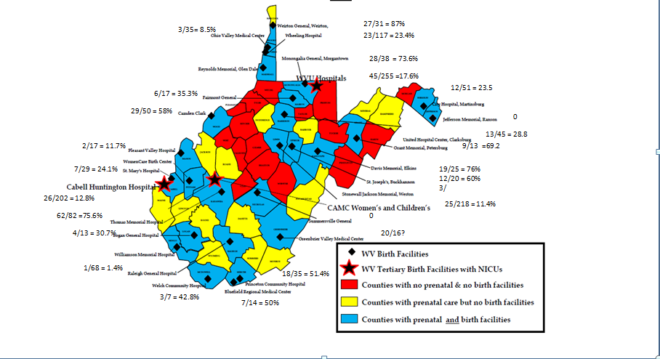
Participants
411/1413 = 29%
Notes:
56.7% of those completing the survey had been a nurse for 10 years or greater

Slide 5
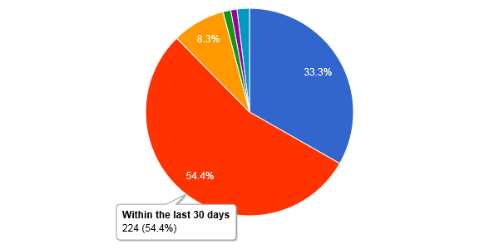
Most recent experience with a substance exposed infant
Today
137 (33.3)
361 of 412 or 87.7% of respondents reported their most recent experience within the last 30 days
Notes:
Compared to 44% in 2009
Majority of participants reported working in an Obstetrics or Mother baby unit.
Most reported that the patient to nurse ratio for substance exposed babies was 3:1

Slide 6
Relationship with the Infant
I find it a challenge to care for substance exposed neonates
Taking care of infants who are born sick or dependent as the result of their mother’s drug abuse places an unfair burden on society
My attitude toward substance exposure impacts the care I provide to the infant
Substance exposed infants are more demanding than other infants
Notes:
67% say they find it a challenge to care for substance exposed neonates

Slide 7
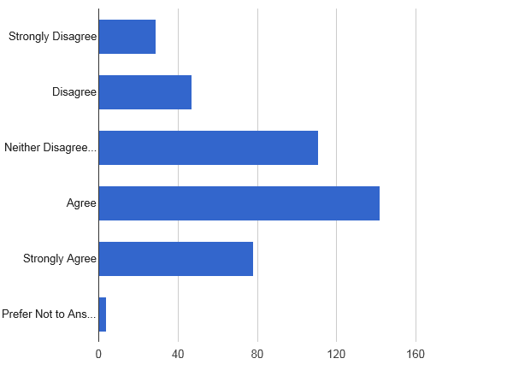
Taking care of infants who are born sick or dependent as the result of their mother's drug abuse places an unfair burden on society
29, 7.1%
47, 11.4%
111, 27.0%
142, 34.5%
78, 19.0%
4, 1%
Notes:
53.5 % feel that this places an unfair burden on society

Slide 8
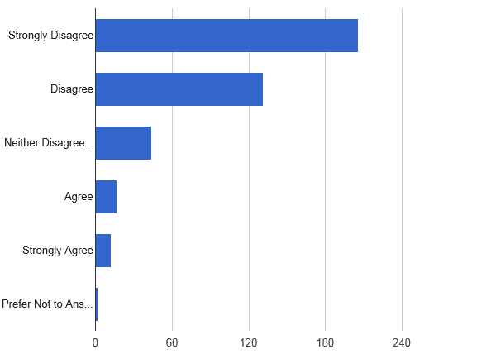
My attitude toward substance exposure impacts the care I provide to the infant
206, 50.0%
131, 31.8%
44, 10.7%
17, 4.1%
12, 2.9%
2, 0.5%
Notes:
Nearly 82% disagree that their attitude toward substance exposure impacts the care provided to the infant

Slide 9
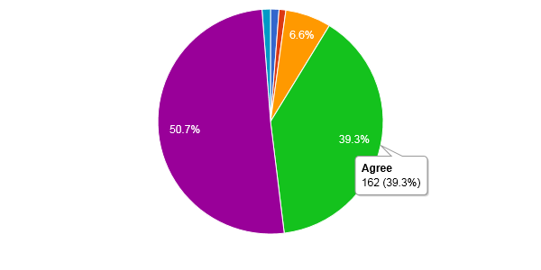
Substance exposed infants are more demanding than other infants
Strongly Disagree
Disagree
Neither Agree or Disagree
Agree
Strongly Agree
Prefer Not to Answer
Counts/frequency: Strongly Disagree (5, 1.2%), Disagree (4, 1.0%), Neither Disagree or Agree (27, 6.6%), Agree (162, 39.3%), Strongly Agree (209, 50.7%), Prefer Not to Answer (5, 1.2%)
Notes:
90% agree or strongly agree that substance exposed infants are more demanding than other infants.

Slide 10
Response to the Family
I find it a challenge to deal with the substance using mother/parent of a neonate
Women who abuse substance during pregnancy are more concerned with themselves than with their babies
Prenatal drug use should be considered a form of child abuse
I feel angry with the mother when I hear about the effect of drug abuse on infants
I find it difficult to maintain feelings of empathy, concern or helpfulness for mothers who are substance abusers
I typically feel angry in reaction to a woman who uses drugs during pregnancy
I feel it is important to foster mother/infant attachment during the infant’s stay in the hospital
Women who abuse substances while pregnant should be referred to a treatment program
Substance using parents are more demanding than other parents

Slide 11
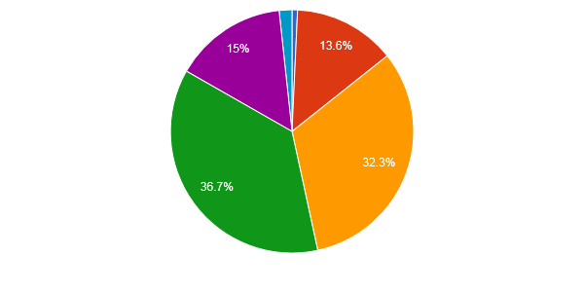
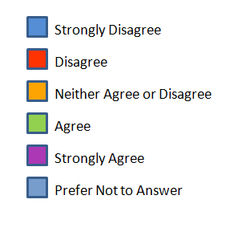
Women who abuse substances during pregnancy are more concerned with themselves than with their babies
Counts/frequency: Strongly Disagree (3, 0.7%), Disagree (56, 13.6%), Neither Disagree or Agree (133, 32.3%), Agree (151, 36.7%), Strongly Agree (62, 15%), Prefer Not to Answer (7, 1.7%)
Notes:
51.7 % felt that the substance using mother was more concerned with themselves than their babies

Slide 12
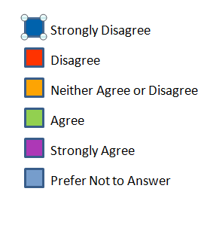
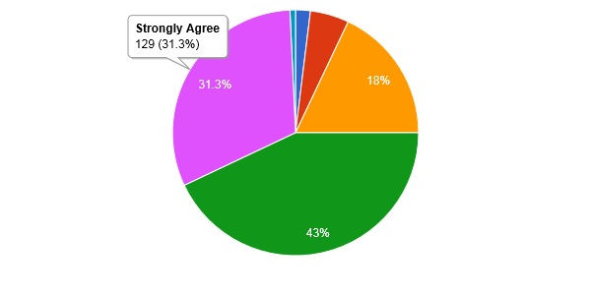
Prenatal drug use should be considered a form of child abuse
Counts/frequency: Strongly Disagree (8, 1.9%), Disagree (21, 5.1%), Neither Disagree or Agree (74, 18.0%), Agree (177, 42.8%), Strongly Agree (129, 31.3%), Prefer Not to Answer (3, 0.7%)
Notes:
74.3 % felt prenatal drug use should be considered child abuse

Slide 13
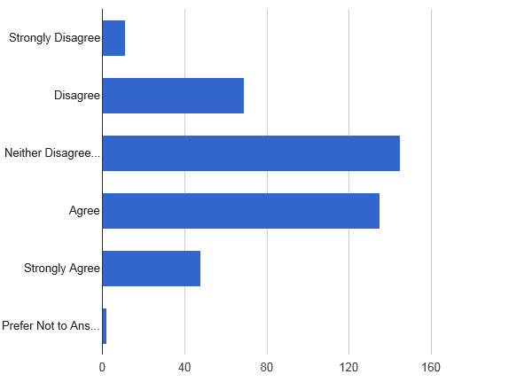
I feel angry with the mother when I hear about the effects of drug abuse on infants
Counts/frequency: Strongly Disagree (11, 2.7%), Disagree (69, 16.8%), Neither Disagree or Agree (145, 35.4%), Agree (135, 32.9%), Strongly Agree (48, 11.7%), Prefer Not to Answer (2, 0.5%)
Notes:
44.6 % admit that they experience feelings of anger toward the mother when they hear

Slide 14
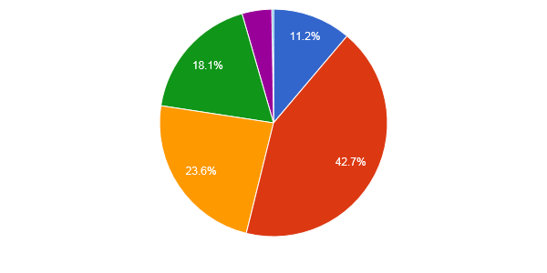
I find it difficult to maintain feelings of empathy, concern or helpfulness for mothers who are substance abusers
Counts/frequency: Strongly Disagree (45, 11.2%), Disagree (172, 42.7%), Neither Disagree or Agree (95, 23.6%), Agree (73, 18.1%), Strongly Agree (17, 4.2%), Prefer Not to Answer (1, 0.2%)
Notes:
53.9% feel they are able to maintain feelings of empathy, concern and helpfulness for the substance using mothers.

Slide 15
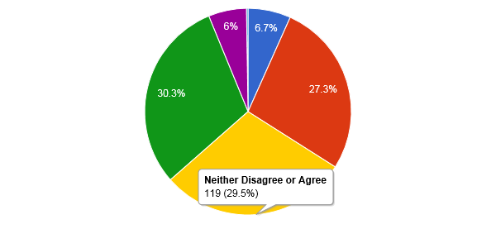
I typically feel angry in reaction to a woman who uses drugs during pregnancy
Counts/frequency: Strongly Disagree (27, 6.7%), Disagree (110, 27.3%), Neither Disagree or Agree (119, 29.5%), Agree (122, 30.3%), Strongly Agree (24, 6.0%), Prefer Not to Answer (1, 0.2%)
Notes:
Nearly equally divided when it comes to feelings of anger toward the substance using pregnant woman.

Slide 16
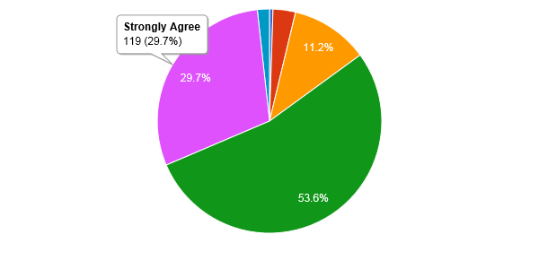
I feel it is important to foster mother/infant attachment during the infant’s stay in the hospital
Counts/frequency: Strongly Disagree (2, 0.5%), Disagree (13, 3.2%), Neither Disagree or Agree (45, 11.2%), Agree (215, 53.6%), Strongly Agree (119, 29.7%), Prefer Not to Answer (7, 1.7%)
Notes:
83.3 % feel it is important to foster attachment between mother/infant

Slide 17
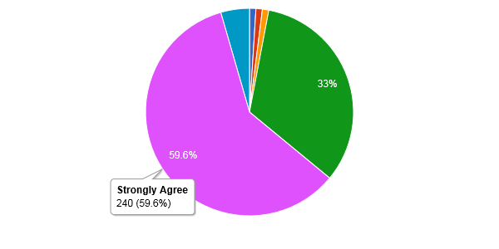
Women who abuse substances while pregnant should be referred to a treatment program
Counts/frequency: Strongly Disagree (4, 1.0%), Disagree (4, 1.0%), Neither Disagree or Agree (4, 1.0%), Agree (133, 33.0%), Strongly Agree (240, 59.6%), Prefer Not to Answer (18, 4.5%)
Notes:
92.6% would like to see the mothers referred to a treatment program.

Slide 18
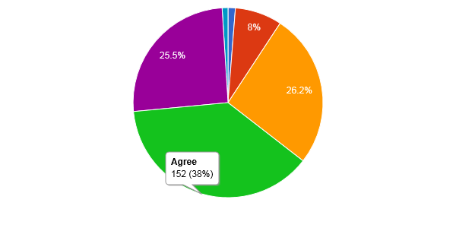
Substance using parents are more demanding than other parents
Counts/frequency: Strongly Disagree (5, 1.3%), Disagree (32, 8.0%), Neither Disagree or Agree (105, 26.3%), Agree (152, 38.0%), Strongly Agree (102, 25.5%), Prefer Not to Answer (4, 1.0%)
Notes:
63.5 % find substance using parents more demanding.

Slide 19
Tensions within the Work Environment
I refuse to be the primary nurse for the substance exposed infant
I become judgmental or punitive to the substance using mother
I feel frustrated when parents of substance exposed newborns don’t visit
Notes:
97 % report that they do not refuse to be the primary nurse for the substance exposed infant.

Slide 20
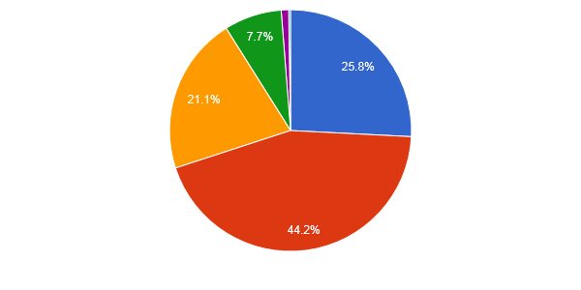
I become judgmental or punitive to the substance using mother
Counts/frequency: Strongly Disagree (104, 25.8%), Disagree (178, 44.2%), Neither Disagree or Agree (85, 21.1%), Agree (31, 7.7%), Strongly Agree (4, 1.0%), Prefer Not to Answer (1, 0.2%)
Notes:
The majority 70% do not feel that they become judgmental or punitive to the substance using mother.
97.2% say they will be the primary nurse for the infant.

Slide 21
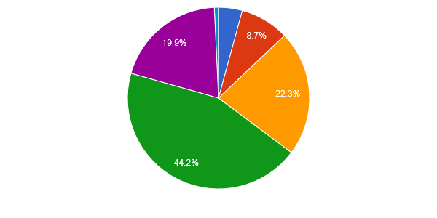
I feel frustrated when parents of substance exposed newborns don't visit
Counts/frequency: Strongly Disagree (17, 4.2%), Disagree (35, 8.7%), Neither Disagree or Agree (90, 22.3%), Agree (178, 44.2%), Strongly Agree (80, 19.9%), Prefer Not to Answer (3, 0.7%)
Notes:
64.1 % voiced frustration with the lack of visitation by the parents of the substance exposed newborn.

Slide 22
Nurses’ Needs
There is good communication between our staff and the child protective services personnel regarding the plan for substance exposed infants
I feel there are enough trained staff to care for substance exposed newborns when the need arises
I feel it would be of benefit for the substance exposed neonate to have consistent caregivers
I feel that I have not had sufficient information/training to care competently for substance-exposed infants

Slide 23
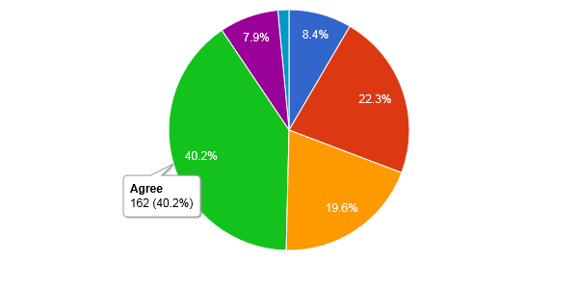
There is a good communication between our staff and the child protective services personnel regarding the plan for substance exposed infants
Counts/frequency: Strongly Disagree (36, 8.8%), Disagree (93, 22.6%), Neither Disagree or Agree (81, 19.7%), Agree (163, 39.7%), Strongly Agree (32, 7.8%), Prefer Not to Answer (6, 1.5%)
Notes:
Only 47.5 % of nurses believe there is good communication between the staff and Child protective Services. Looks like an opportunity for improvement

Slide 24
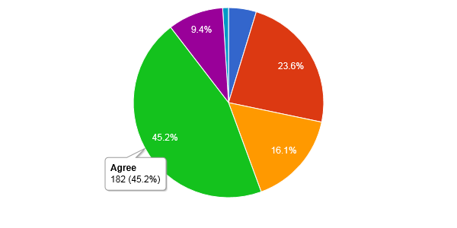
I feel there are enough trained staff to care for substance exposed newborns when the need arises
Counts/frequency: Strongly Disagree (19, 4.7%), Disagree (95, 23.6%), Neither Disagree or Agree (65, 16.1%), Agree (182, 45.2%), Strongly Agree (38, 9.4%), Prefer Not to Answer (4, 1.0%)

Slide 25
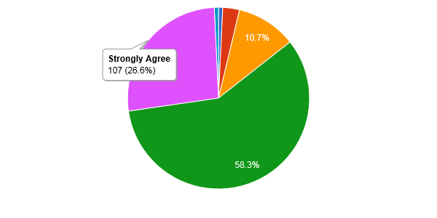
I feel it would be of benefit for the substance exposed neonate to have consistent caregivers
Counts/frequency: Strongly Disagree (3, 0.7%), Disagree (12, 3.0%), Neither Disagree or Agree (43, 10.7%), Agree (235, 58.3%), Strongly Agree (107, 26.6%), Prefer Not to Answer (3, 0.7%)
Notes:
85.1% consistent caregivers.

Slide 26
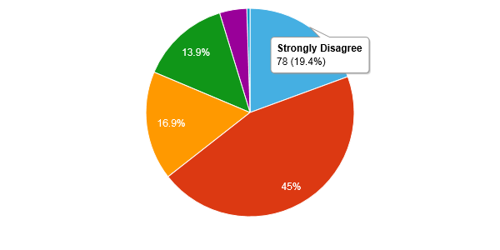
I feel that I have not had sufficient information/training to care competently for substance-exposed infants
Counts/frequency: Strongly Disagree (78, 19.4%), Disagree (181, 45.0%), Neither Disagree or Agree (68, 16.9%), Agree (56, 13.9%), Strongly Agree (17, 4.2%), Prefer Not to Answer (2, 0.5%)
Notes:
64.4% feel they have received enough information/training to care for substance exposed infants

Slide 27
Making a Difference
A multi-disciplinary team coordinates the plan of care for substance exposed newborns in my facility
Allowing mothers and babies to “room in” would encourage/promote the mother’s participation in the baby’s care
I feel it is my responsibility as a nurse to serve as an advocate for substance exposed infants and their families
I think it is worthwhile to spend my time and energy caring for substance exposed infants
I feel I am supportive of mothers who are honest regarding their substance use during pregnancy
The environment where we care for substance exposed neonates I optimum for babies and their families and promotes bonding

Slide 28
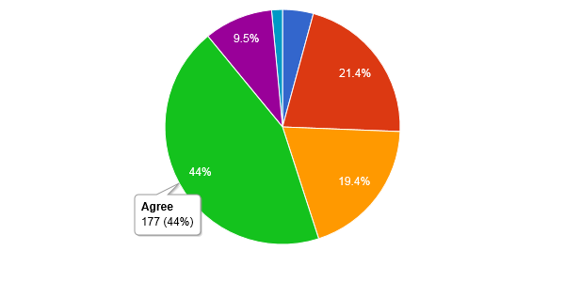
A multi-disciplinary team coordinates the plan of care for substance exposed newborns in my facility
Counts/frequency: Strongly Disagree (17, 4.2%), Disagree (86, 21.4%), Neither Disagree or Agree (78, 19.4%), Agree (177, 44.0%), Strongly Agree (38, 9.5%), Prefer Not to Answer (6, 1.5%)

Slide 29
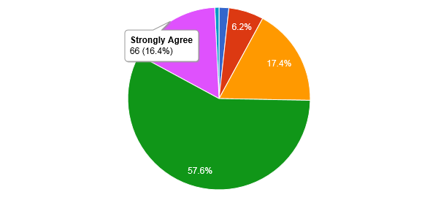
Allowing mothers and babies to “room in” would encourage/promote the mother’s participation in the baby’s care
Counts/frequency: Strongly Disagree (7, 1.7%), Disagree (25, 6.2%), Neither Disagree or Agree (70, 17.4%), Agree (232, 57.6%), Strongly Agree (66, 16.4%), Prefer Not to Answer (3, 0.7%)

Slide 30
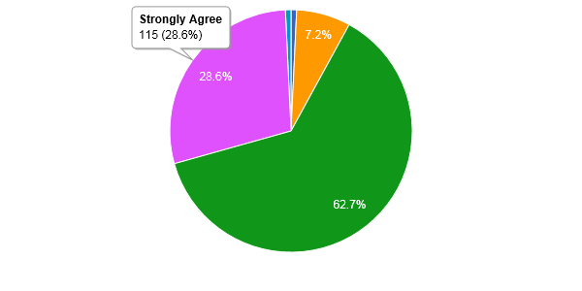
I feel it is my responsibility as a nurse to serve as an advocate for substance exposed infants and their families
Counts/frequency: Strongly Disagree (3, 0.7%), Disagree (0, 0.0%), Neither Disagree or Agree (29, 7.2%), Agree (252, 62.7%), Strongly Agree (115, 28.6%), Prefer Not to Answer (3, 0.7%)

Slide 31
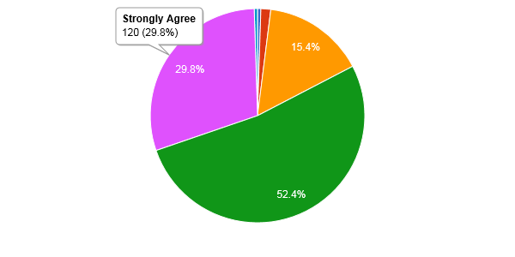
I think it is worthwhile to spend my time and energy caring for substance exposed infants
Counts/frequency: Strongly Disagree (2, 0.5%), Disagree (6, 1.5%), Neither Disagree or Agree (62, 15.4%), Agree (211, 52.4%), Strongly Agree (120, 29.8%), Prefer Not to Answer (2, 0.5%)

Slide 32
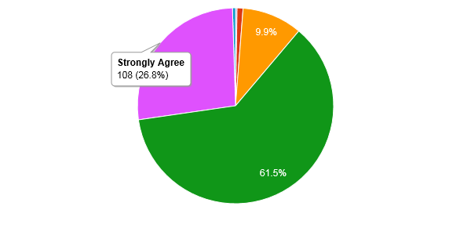
I feel I am supportive of mothers who are honest regarding their substance use during pregnancy
Counts/frequency: Strongly Disagree (1, 0.2%), Disagree (4, 1.0%), Neither Disagree or Agree (40, 9.9%), Agree (248, 61.5%), Strongly Agree (108, 26.8%), Prefer Not to Answer (2, 0.5%)

Slide 33
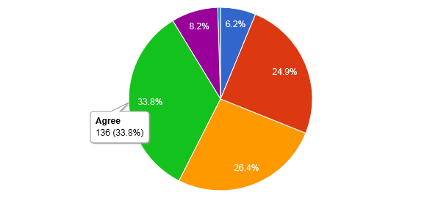
The environment where we care for substance exposed neonates is optimum for babies and their families and promotes bonding
Counts/frequency: Strongly Disagree (26, 6.3%), Disagree (104, 25.4%), Neither Disagree or Agree (107, 26.1%), Agree (137, 33.4%), Strongly Agree (34, 8.3%), Prefer Not to Answer (2, 0.5%)

Slide 34
Summary
Caring for Substance exposed infants and their families is stressful
Staff expressed feelings of frustration and anger
There is always room for improvement in communication among the care team and CPS
We want them to be honest about substance use
We want the moms to get treatment

Slide 35
Sandra Young, DNP, RN-BC Special Projects Consultant, WVPP
Clinical Resources Director
Thomas Health/Thomas Memorial Hospital
4605 MacCorkle Ave SW
South Charleston, WV 25309
(304) 766-3983 sandy.young@thomashealth.org
www.wvperinatal.org
Coordinated by the West Virginia Higher Education Policy Commission, Division of Health Sciences

