Slide 1
Immediate Postpartum Long Acting Reversible Contraception Implementation in West Virginia
Ally Roy, MD
Instructor
Marshall University School of Medicine
Department of Obstetrics and Gynecology

Slide 2
Learning objectives
Review safety, efficacy, cost effectiveness, and satisfaction rates of long acting reversible contraception (LARC) methods
Discuss importance and impact of immediate postpartum (IPP) LARC on unintended pregnancy reduction
Review risks and clinical barriers to IPP LARC
Discuss billing procedures for IPP LARC
Discuss institutional implementation of IPP LARC

Slide 3
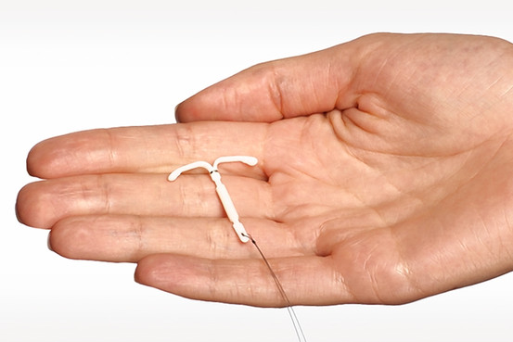
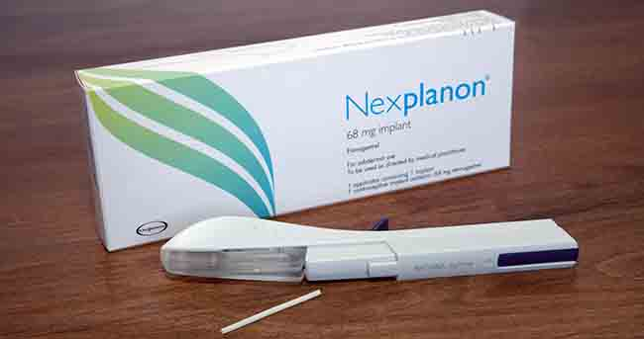
What are LARC methods?
Most effective form of reversible contraception
>99% effective contraception
Highest continuation rates among reversible methods

Slide 4
What are LARC methods?
Intrauterine devices (IUDs)
10 year copper IUD
Paraguard
5 year progestin IUDs
Mirena, Kyleena
3 year progestin IUDs
Skyla, Lilletta
Subdermal implant
Nexplanon (3 years)

Slide 5
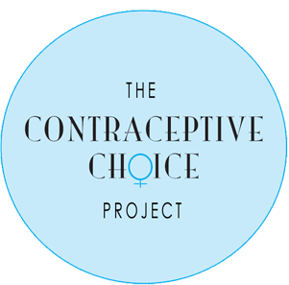
Prospective cohort study of >9000 women ages 14-45
Women counseled on all contraceptive methods
Provided contraceptives free of charge
75% chose LARC methods
LARC users had highest continuation rates, highest satisfaction rates, and lowest rates of unintended pregnancy

Slide 6
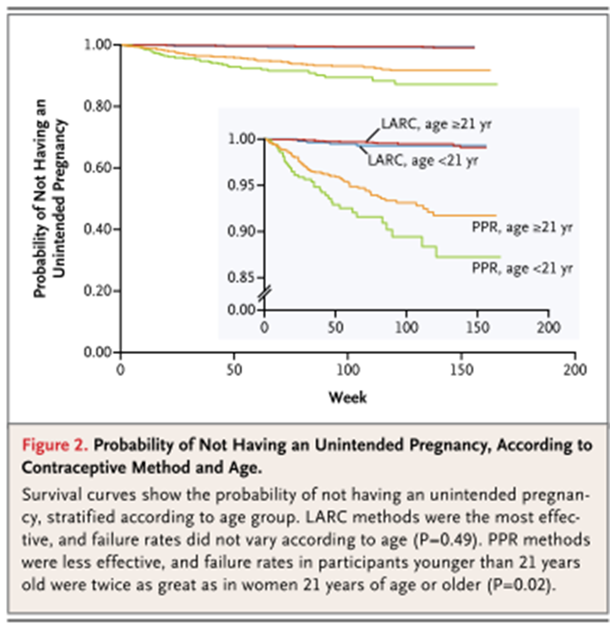
Winner, B., et al., Effectiveness of long-acting reversible contraception. N Engl J Med, 2012. 366(21): p. 1998-2007.

Slide 7
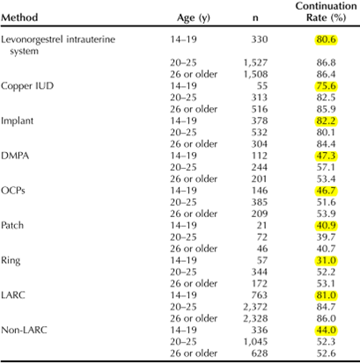
LARCs had 81% continuation rate at 1 year compared to 44% of non-LARC users
Winner, B., et al., Effectiveness of long-acting reversible contraception. N Engl J Med, 2012. 366(21): p. 1998-2007.

Slide 8
Patient satisfaction
Women using LARC methods had highest satisfaction at 1 year follow up
Method | % Satisfied at 1 year
Levonorgestrel IUD | 86%
Copper IUD | 80%
Subdermal Implant | 78%
Injection | 54%
Pills | 54%
Ring | 52%
Patch | 42%
Winner, B., et al., Effectiveness of long-acting reversible contraception. N Engl J Med, 2012. 366(21): p. 1998-2007.

Slide 9
What is IPP LARC?
Initiation in the immediate postpartum period before hospital discharge
Subdermal Implant: in the delivery room or postpartum unit prior to discharge
IUD: in the delivery room within 10 minutes of placental delivery
C-section or Vaginal deliveries
“Post-placental” IUD insertion

Slide 10
Why IPP LARC?
Decreasing the risk of unintended pregnancy
40-57% of women have unprotected intercourse before 6 week visit
In the first year postpartum 70% of pregnancies are unintended
Decrease risk of short-interval pregnancy
Pregnancy within a year of delivery
12-49% of postpartum adolescents experience short interval pregnancy
Can be a risk factor for preterm delivery and adverse neonatal outcomes

Slide 11
Why IPP LARC in WV?
Chart review of 207 patients from CHH in 2014
(61 MARC/ 146 Resident clinic)
Similar age and demographics
44 (21.3%) received lower efficacy method than what they desired during prenatal care
(Example: wanted IUD, received Depo-provera post partum)
50 patients desired postpartum tubal
Only 33 (66%) actually got their tubal
12 (24%) received nothing and 3 (6%) got IUDs
30 patients desired an IUD
Only 11 (36.7%) received them at their postpartum visit
Of the 207 patients, 61 (29.5%) did not show for their post partum visit

Slide 12
Benefits of IPP LARC
The patient is not pregnant
The patient is motivated to prevent pregnancy
The physician and patient are in the same place at the same time
Eliminates potential access barriers
10-40% of women do not attend their postpartum visit
40-75% of women who plan to use an IUD postpartum do not obtain it
At postpartum visit may have other barriers including device availability, clinician availability, or need for repeat visit for placement
Notes:
Eliminates potential access barriers such as transportation

Slide 13
Breastfeeding
Immediate IUD & implants are Category 2 among women breastfeeding
Advantages generally outweigh any theoretical or proven risks
Observational studies of progestin-only contraceptives suggest no effect on successful initiation and continuation of breastfeeding
Notes:
Theoretical concerns about exogenesis progestins and the effect on lactogenesis. Because progesterone withdrawl after delivery of the placenta is thought to trigger the onset of lactogenesis.

Slide 14
IUD expulsion and continuation
Expulsion rates for IPP IUD insertions are higher than for interval or postabortion insertions
Vary by study but may be 10-27%
Women should be counseled about risk of expulsion, signs & symptoms, and need to contact provider
Replacement IUD is covered by insurer

Slide 15
IUD expulsion and continuation
Randomized controlled trial of 112 women to IUD at cesarean delivery vs interval placement
At 6 months:
Significantly higher continuation in IPP placement group compared to interval group (83% vs 64%)
In the interval group:
39% did not obtain the IUD
25% did not return for the postpartum visit
Levi, E.E., et al., Intrauterine Device Placement During Cesarean Delivery and Continued Use 6 Months Postpartum: A Randomized Controlled Trial. Obstet Gynecol, 2015. 126(1): p. 5-11.

Slide 16
IUD expulsion and continuation
ACOG: “Despite the higher expulsion rate, evidence from clinical trials and from cost-benefit analyses strongly suggest the superiority of immediate placement in reduction of unintended pregnancy, especially for those at greatest risk of not having postpartum follow-up.”

Slide 17
Patient Counseling
Optimally women should be counseled prenatally about the option of IPP LARC
Counseling should include:
Convenience
Effectiveness
Benefits
Risks

Slide 18
IPP LARC Placement Procedure
Subdermal implant
Same technique
IUD
Within 10 minutes of delivery of the placenta
After vaginal delivery:
Cut strings to 10cm (*or can trimmed at follow up)
IUD grasped gently with ring forcep (not clamped), or manually
Placed gently at the fundus
Ultrasound guidance can be used
At the time of c-section
After initiating closure of the hysterotomy incision
IUD placed at fundus with inserter, ring forcep, or manually
Strings placed through cervix
Hysterotomy closure completed

Slide 19
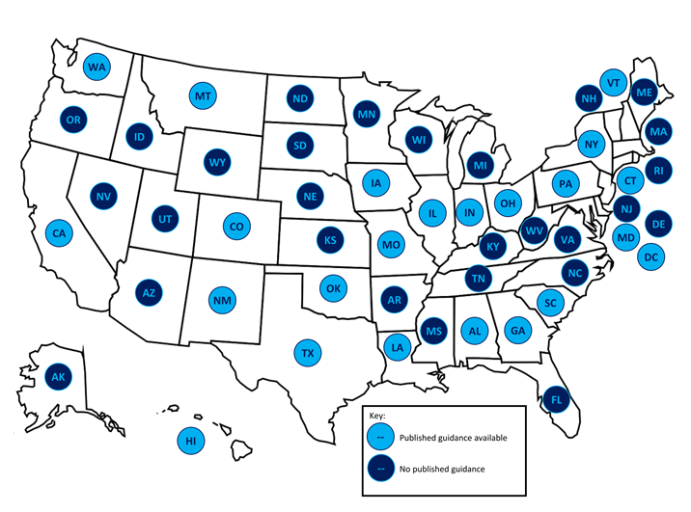
Progress
Beginning in 2012 some state Medicaid programs began to reimburse for immediate postpartum LARCs
Medicaid now reimburses for IPP LARCs separate from the global fee for delivery
WV obtained Medicaid coverage as of August 2016

Slide 20
Billing & Reimbursement
As of January 1, 2017 IPP LARC is reimbursed separately from the global obstetric fee
Reimbursement is for the LARC device and the insertion fee
Claims submitted for inpatient LARCs must include the exact billing codes specified in the WV Medicaid or managed care organization (MCO) policy.

Slide 21
Immediate postpartum LARC implementation
Build administrative support and infrastructure
Clinical leaders
Billing
Pharmacy
Discuss how hospitals will be reimbursed for the devices in addition to global labor and delivery charges and how physicians will receive reimbursement for the insertion procedures
Establish billing procedures
Signed affidavits from WV Medicaid and PEIA guaranteeing reimbursement
Develop pharmacy procedures
Create order sets

Slide 22
Immediate postpartum LARC implementation
Physician and nursing support and education
Build clinical support for postpartum LARCs
Physician champions and nursing leaders should identify and resolve any concerns
Convene clinical staff to develop the counseling, consent, and insertion procedures
Identify patients desiring immediate postpartum LARC insertion
Prenatal care counseling procedures and documentation should be reviewed to make sure that women’s preferences are documented and transferred to the hospital
Develop a process that is integrated into the usual operations of the labor and delivery or postpartum floor
IUDs easily accessible in medication area on labor and delivery
Postpartum Nexplanon supply box
Notes:
Considerations include timing and location for counseling/consent and the procedure, roles and responsibilities for nursing regarding supplies, and documentation processes.
Hospital clinicians should be able to identify women who plan to receive a LARC method in the hospital and those who may need additional counseling immediately postpartum.
Once the billing and pharmacy infrastructure is developed, the insertion procedure is treated as any other hospital process.

Slide 23
Immediate postpartum LARC implementation
Prenatal care providers
Need to be aware of postpartum LARC procedures at delivering hospital
Physicians, including residents
Must be trained prior to performing insertions
Nurses
Need to be prepared to support patient education and assist during the procedures
Lactation consultants
Need to be able to provide support to a woman’s decision-making regarding postpartum LARCs

Slide 24
Immediate postpartum LARC implementation
Meet regularly to discuss any problems, barriers, or concerns
Billing staff should review the payments received against claims submission data to identify any issues with denials
Monitoring the proportion of women choosing a postpartum LARC can provide evidence of the policy’s impact on LARC access and be used in quality improvement efforts

Slide 25
Questions?

Slide 26
References
Committee Opinion No. 670: Immediate Postpartum Long-Acting Reversible Contraception. Obstet Gynecol, 2016. 128(2): p. e32-7.
Committee on Health Care for Underserved, W., Committee opinion no. 615: Access to contraception. Obstet Gynecol, 2015. 125(1): p. 250-5.
Committee on Gynecologic Practice Long-Acting Reversible Contraception Working, G., Committee Opinion No. 642: Increasing Access to Contraceptive Implants and Intrauterine Devices to Reduce Unintended Pregnancy. Obstet Gynecol, 2015. 126(4): p. e44-8.
American College of Obstetricians and Gynecologists, ACOG Practice Bulletin No. 121: Long-acting reversible contraception: Implants and intrauterine devices. Obstet Gynecol, 2011. 118(1): p. 184-96.
Levi, E.E., et al., Intrauterine Device Placement During Cesarean Delivery and Continued Use 6 Months Postpartum: A Randomized Controlled Trial. Obstet Gynecol, 2015. 126(1): p. 5-11.
Centers for Disease, C. and Prevention, U S. Medical Eligibility Criteria for Contraceptive Use, 2010. MMWR Recomm Rep, 2010. 59(RR-4): p. 1-86.
Winner, B., et al., Effectiveness of long-acting reversible contraception. N Engl J Med, 2012. 366(21): p. 1998-2007.
Emily Heberlein, Deborah L Billings, Amy Mattison-Faye and Melanie Giese. 2015. The South Carolina Postpartum LARC Toolkit. Choose Well Initiative and the South Carolina Birth Outcomes Initiative.

