Slide 1
Wrap-up of Obstetrical Harm Prevention Project
Anne Banfield, MD, FACOG

Slide 2
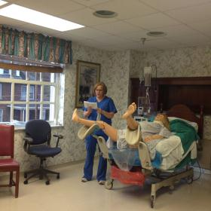
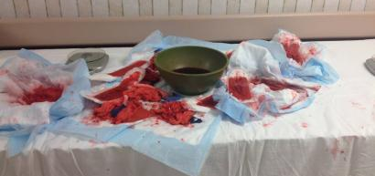
The Roadshow

Slide 3
Obstetric Hemorrhage Readiness
What we can do…….
Prevent and practice
Quantify blood loss (for all births?)
Be alert to vital sign triggers
Actively manage the 3rd stage of labor
“Move along” with uterotonic medications
Intrauterine balloon/B-lynch sutures
New approach to blood products
PRACTICE WITH YOUR PROTOCOL

Slide 4
Obstetric Hemorrhage Readiness
Questions to consider
Do we have a hemorrhage policy and are the components in place?
Are we prepared for a placenta acreta? Do we have an evaluation and referral plan?
Are we screening all admissions?
Are the offices up to speed?
Is the obstetric unit staff up to date?

Slide 5
Hypertensive disorders of pregnancy
Don’t forget the new definition:
AND
Blood pressure: systolic > 140 mmHg or diastoic > 90 mmgHg
After 20 wks gestation
Proteinuria (urinary excretion 0.3g or higher in 24 hrs)
OR
New onset any of the following
Thromocytopenia (<100,000/mL)
Renal insufficiency (Cr >1.1mg/dL or doubling)
Impaired liver function (twice normal concentraction
Pulmonary edema
Cerebral or visual symptoms

Slide 6
Hypertensive disoders of pregnancy
Considerations
Don’t forget
Use Protein to Creatinine ratio
Don’t wait 4 hours in Hypertensive Emergency
Consider each case before using Magnesium
Not everyone will present with “classic” symptoms
Patient’s risk factors
Not everything is Preeclampsia
Preeclamptics don’t manage fluid like other pregnant patients
Obstetrics is a team sport!

Slide 7
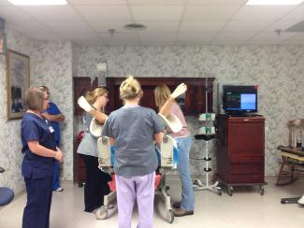
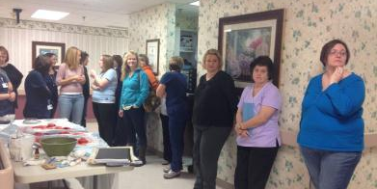
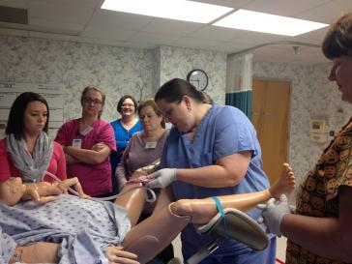
Davis Medical Center
PP Hemorrhage & Preeclampsia policy in place
Reminder cards each room
Preeclampsia & PP Hemorrhage order set awaiting approval

Slide 8
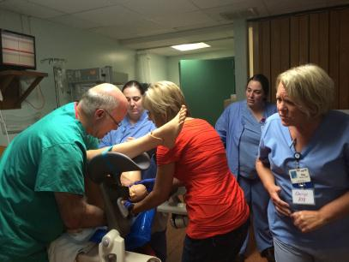
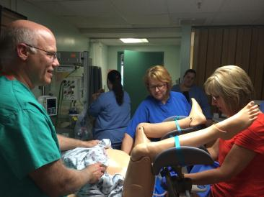
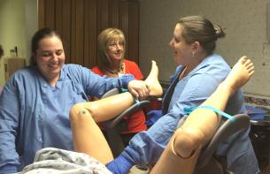
Fairmont General Hospital
Ob hemorrhage management policy in place

Slide 9
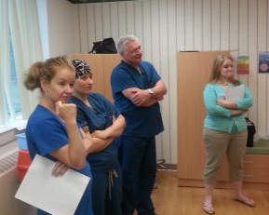
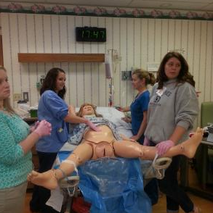
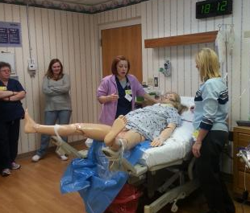
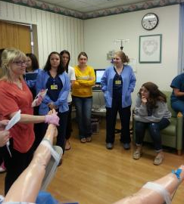
Grant Memorial Hospital
Postpartum hemorrhage policy in place
Reminder cards in use

Slide 10
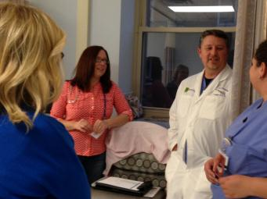
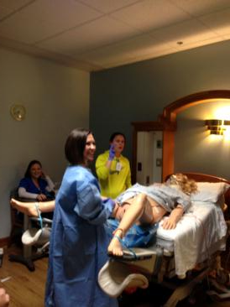
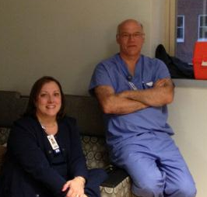
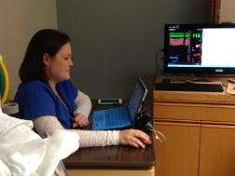
Greenbrier Valley Medical Center
Obstetrical Hemorrhage policy in place
Check-list for in-room use in place

Slide 11
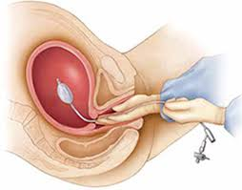
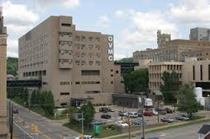
Ohio Valley Medical Center
Postpartum hemorrhage & Balloon catheter order sets in process
Postpartum hemorrhage protocol in process
Hemorrhage risk factor evaluation in place

Slide 12
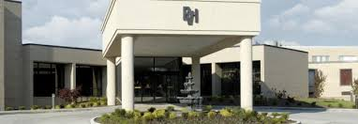
Pleasant Valley Hospital
Postpartum hemorrhage policy in place

Slide 13
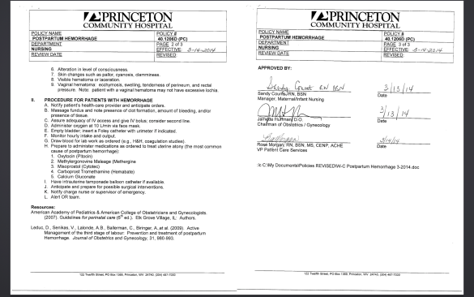
Princeton Community Hospital
Postpartum Hemorrhage Policy in place

Slide 14
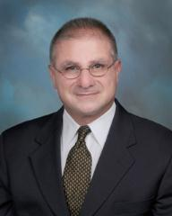
Stonewall Jackson Memorial Hospital
Blood loss competency in place
Creating drills to maintain skills
Postpartum Hemorrhage policy and procedure in process
Delivery tackle box & OB cluster cart in each room on admission, postpartum hemorrhage kit added at time of delivery

Slide 15
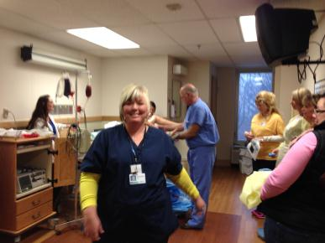
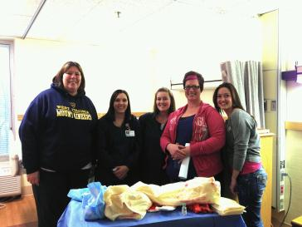
Summersville Regional Medical Center
Postpartum hemorrhage policy in draft

Slide 16
Welch Community Hospital
Williamson Memorial Hospital

Slide 17
Policy, Procedure & Order set review
Perinatal Partnership Outreach Education Committee will provide review services for any hospital interested in outside evaluation and feedback on policies, procedures or order sets.

Slide 18
Resources
https://www.cmqcc.org
http://www.acog.org/-/media/Patient-Safety-Checklists/psc010.pdf?dmc=1&ts=20141105T1045341036
http://www.acog.org/About-ACOG/ACOG-Districts/District-II/SMI-Other-Resources-and-Posters
Plan to arrange for shared file where policies, procedures and order sets can be used by all member hospitals to further development in their facilities

